Slide 1
Military and Family Life Counseling Program
Notes:
Talking Points
Welcome and thank you for being here. Today’s presentation is about one of the key resources available to military families who may need a little extra support: The Military and Family Life Counseling program.

Slide 2
What is the Military and Family Life Counseling Program?
Provides free, confidential non-medical counseling for service members, their families and survivors – personal records are not kept
Provides psycho-educational briefings and presentations
Augments existing military support services
Provides services on or off of military installations
Notes:
Talking Points
The Military and Family Life Counseling Program aims to help service members, their families and survivors be stronger than stress with the availability of free, short-term non-medical counseling. A hallmark of the program is that personal records are not kept. However, the advantages don’t stop there. Military and family life counselors are also available to provide presentations and briefings at unit events, youth camps and targeted locations, both on and off the installation.

Slide 3
Who are military and family life counselors and what do they do?
Master’s or doctorate-level licensed counselors
Work with families, individuals, couples and children
Work with existing military and family support programs to augment other services provided
Notes:
Talking Points
When you make an appointment with a military and family life counselor, you can rest assured that you’ll be speaking with someone who is not only qualified, but will also understand what you’re going through. All counselors through the Military and Family Life Counseling Program have a master’s or doctorate degree and maintain up-to-date licensing. They’re available for non-medical counseling sessions with you one-on-one, with your spouse, with your entire family or with your child.

Slide 4
Who is eligible for Military and Family Life Counseling services?
Active duty service members
National Guard members
Reserve members (regardless of activation status)
Department of Defense civilian expeditionary workforce members
Immediate family members or surviving family members of any of the above groups.
Not sure? Contact Military OneSource at 800-342-9647 or visit your installation’s Military and Family Support Center for more information.
Notes:
Talking Points
The stresses of military life can affect all members of the military community. Non-medical counseling through the Military and Family Life Counseling Program is available at no cost for:
Active duty service members
National Guard members
Reserve members (regardless of activation status)
Department of Defense civilian expeditionary workforce members
Immediate family members or surviving family members of any of the above groups.
If you are unsure about your own eligibility for non-medical counseling through the Military and Family Life Counseling Program, call Military OneSource at 800-342-9647 or visit the Military and Family Support Center on the installation closest to you.

Slide 5
Adult military and family life counselors
Life skills
Anger management
Communication
Relationship issues
Conflict resolution
Parenting
Decision-making skills
Military life
Deployment stress
Coping skills
Homesickness
Relocation adjustment
Reintegration
Separation
Building resiliency
Sadness, grief and loss
Notes:
Talking Points
Military and family life counselors, for adults, are available to discuss a wide range of challenges and concerns. In addition to topics specific to members of the military community – like deployments and relocations – counselors can also help with basic life skills, like communication and relationship issues. These sessions can be conducted one-on-one, with a couple or even with a group.
And don’t worry: seeking counseling won’t affect you or your spouse’s military career. With the exception of domestic violence, abuse, or duty-to-warn situations, all sessions are confidential, won’t be reported to command and do not affect your security clearance.

Slide 6
Child and youth behavioral military and family life counselors
Counselors are available to meet with military children and their families to discuss:
Self-esteem issues
Communication and relationships at home and school
Life skills, such as problem solving and adjustment
Behavioral issues, including bullying and anger management
Changes at home, such as deployment, reunion, divorce and grief
Notes:
Talking Points
But non-medical counseling isn’t just for adults. Child and youth behavioral military and family life counselors are also available to help service members and their families cope with the unique challenges and stressors faced by military children and teens. If your child is going through a difficult time – for instance, the deployment of a parent or a new PCS – speaking with a military and family life counselor can help them discover the tools they need to cope. Child and youth behavioral counselors must have parental consent before counseling a child and, during the appointment, a counselor will remain within the sight line of a parent or staff member at all times.
Of course, just like adult counselors, child and youth behavioral counselors are also available to help your child with topics that may not have anything to do with the military at all – such as self-esteem or bullying. You can reassure your child that everything talked about in their non-medical counseling sessions will stay completely confidential, with the exception of domestic violence, abuse, or duty-to-warn situations.

Slide 7
Child and youth behavioral military and family life counselors
Need to get in touch?
Ask about child and youth behavioral counselors at the following locations:
Child development centers
Installation-based youth and teen centers
On and off installation public schools
Department of Defense Education Activity schools
Operation Purple camps
Notes:
Talking Points
There are several options for finding a child and youth behavioral counselor for your child. In addition to checking with your local child development center or installation-based youth and teen center, you can also speak with someone at your child’s school.
Counselors may also be available at Operation Purple camps. Visit militaryfamily.org to learn more about Operation Purple camps near you.

Slide 8
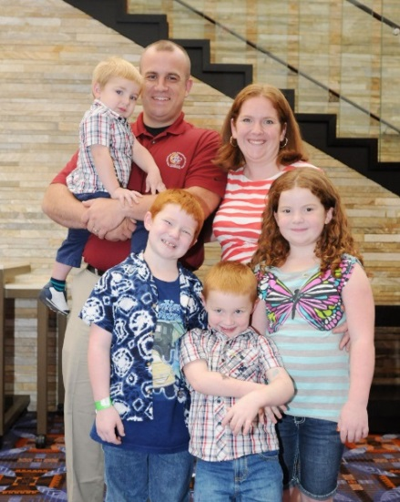
On-demand support
A flexible service option providing support for one to three days at events like:
Yellow Ribbon Reintegration Programs
Drill weekends
Family events
Annual training
Marriage retreats
Youth camps
Service providers can use the Resource Request System to request on-demand support for their next event: https://supportrequest.militaryonesource.mil/.
Visit https://www.militaryonesource.mil/confidential-help/mflc to plan topics for your next on-demand event.
Notes:
Talking Points
Don’t live near an installation? Don’t worry. Military and family life counselors and child and youth behavioral military and family life counselors also provide on-demand support for events lasting up to three days. Events like Yellow Ribbon Reintegration Programs, drill weekends, youth camps and family events can be more effective and impactful with military and family life counselors in attendance to provide briefings and presentations on some of life’s biggest challenges.
Service providers or military leaders can meet the needs of service members and their families by submitting a request for on-demand support through https://supportrequest.militaryonesource.mil/. However, do note that the request must be submitted at least 15 business days before the event is scheduled to occur. You can visit https://www.militaryonesource.mil/confidential-help/mflc to plan topics for your next on-demand event.

Slide 9
Surge support
When deployment challenges, natural disasters or crises strike ...
Up to 20 military and family life counselors or child and youth behavioral counselors
Available for 30-90 days
Face-to-face confidential non-medical counseling
In-person briefings
In-person presentations
Notes:
Talking Points
Another service delivery option for the Military and Family Life Counseling Program is surge support, which is tailored to provide support during a natural disaster or crisis. Up to 20 military and family life counselors are available to travel to targeted locations for 30 to 90 days to provide face-to-face, confidential non-medical counseling, in-person briefings and presentations.
Service providers, you can contact your military service headquarters to request local surge support.

Slide 10
How to access support
Don’t wait for a crisis to arise – get the support you need today. Contact your installation’s Military and Family Support Center to discuss support options near you.
Or, if you’re a service provider, request non-medical counseling services for unit events and youth camps at https://supportrequest.militaryonesource.mil.
Discover what the Military and Family Life Counseling Program has to offer at:
http://www.militaryonesource.mil/confidential-help/mflc.
Notes:
Talking Points
Don’t wait to ask for the help you need. Military and family life counseling services are available at installation Military and Family Support Centers. If an installation is not nearby, military service providers can request non-medical counseling services for unit events at https://supportrequest.militaryonesource.mil/.

Slide 11
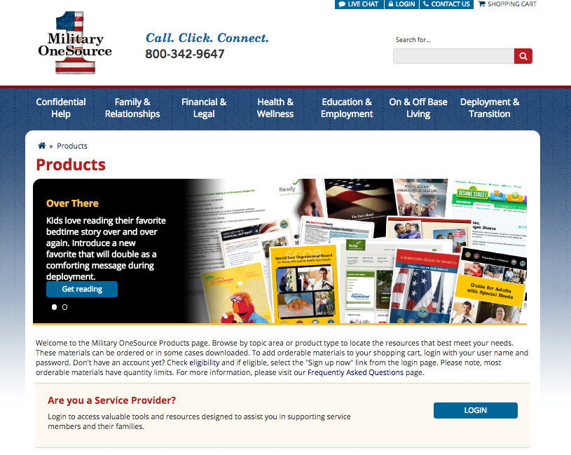
Help promote Military and Family Life Counseling services
The Military and Family Life Counseling Program Starter Kit includes:
100 brochures providing an overview of available services
50 trifolds containing lists of available presentations
10 service-specific posters for distributing throughout installation community areas
Visit militaryonesource.mil to order.
Notes:
Talking Points
Service providers and commanders can help get the word out about the many valuable services available through the program with the Military and Family Life Counseling Program Starter Kit. The program brochures, trifolds and posters can be distributed both on and off the installation and are easily replenished if you run out. Just visit militaryonesource.mil, click on the shopping cart in the upper right-hand corner, and select Continue Shopping to view a list of products by topic. The products for the starter kit will be listed under Non-medical Counseling.

