Slide 1

Military OneSource
Non-medical Counseling Services
Notes:
Military OneSource logo. Call. 800-342-9647, Click. www.militaryonesource.mil, Connect. 24/7
Military OneSource is a Department of Defense-funded program providing comprehensive information on every aspect of military life at no cost to active duty, National Guard and Reserve Component service members, and their families. Information includes but is not limited to deployment, reunion and reintegration, relationship, grief, spouse employment and education, parenting and child care, and much more.
Military OneSource has policy and programmatic information, helpful resources, products, articles and tips on numerous topics related to military life. Services are available 24 hours a day by telephone and online. In addition to the website support, Military OneSource offers call center and online support for consultations on a number of issues such as spouse education and career opportunities, issues specific to families with a member with special needs, health coaching, financial support and resources.

Slide 2
General Eligibility
Active duty, National Guard and Reserve Component service members
Immediate family members
Coast Guard when activated with the Navy
Civilian Expeditionary Workforce
Notes:
Talking points
All active duty, National Guard and Reserve Component service members and their immediate family members, including spouses, children or anyone legally responsible for a service member’s children during a time of separation or deployment are eligible, regardless of activation.
Members of the Coast Guard are eligible when activated and deployed with the Navy.
Civilian Expeditionary Workforce members and their families are eligible while deployed and 90 days prior and 180 days post deployment.
Briefer notes
Individual Ready Reserve personnel are eligible.
Eligibility begins on the initial entrance date (that is, official entrance date into the military or date of delayed enlistment).
A person transitioning out of the military by way of honorable discharge or retirement is eligible up to 180 days.
In general, extended family is not eligible.
Ineligible Coast Guard members don’t qualify because they are under the Department of Homeland Security, not DoD.
Extended program eligibility reaches anyone who is Defense Enrollment Eligibility Reporting System – more commonly known as DEERS – eligible, including survivors (non-remarried spouses and children) of active duty, National Guard and Reserve Component service members regardless of activation status and lifetime eligibility through the Wounded Warrior Resources.

Slide 3
Private and Confidential
Privacy is protected
Your personal information will not be
  Provided to the military or chain of command
  Shared with family or friends
  Released to other agencies
Privacy Exceptions
Duty to warn
Suspected family maltreatment (domestic violence, child or elder abuse or neglect)
Harm to self or others
Illegal activity
Notes:
Talking points
Contacts with Military OneSource, whether by telephone, online or face-to-face non-medical counseling, are private.
Military OneSource ensures that personal information is secure and each user is treated confidentially and with respect, regardless of rank.
Neither service members nor their commanders are advised when a family member seeks Military OneSource non-medical counseling.
Privacy exceptions include suspected family maltreatment (for example, domestic violence, child or elder abuse or neglect), threats to harm self or others and illegal activities. In these cases, Military OneSource consultants have a duty to report to the appropriate military and civilian authorities. Face-to-face counselors are an extension of Military OneSource, so these reporting requirements apply to them as well.
Briefer notes
Substance or alcohol abuse is disclosed only when:
The service member self-reports drug abuse violating DoD regulations
The family member reports alcohol abuse related to domestic violence perpetrated by the service member or abuse or neglect of a child or special needs family member
Illegal activity has occurred (anything that breaks local, state or federal law will be reported under duty to warn, including illegal drug use, operating a vehicle under the influence, underage drinking, etc.)
Air Force personnel are read the following additional statement regarding the Personnel Reliability Program self-reporting requirement: “As a Personnel Reliability Program certified or administrative qualified member, you are responsible to self-notify your Certifying Official of any behavior or circumstances that may or could reduce effectiveness or capability in your job performance, safety or personal reliability. This includes your physical and mental wellness, dependability, or financial or legal concerns. You are also required to self-notify prior to any health care evaluation or treatment, whether military or private that you are a Personnel Reliability Program individual. Failure to make notification may cast doubt on your reliability and violates DoD and United States Air Force policy in DoD Regulation 5210.42.”

Slide 4

Range of Support
Community Resources & Referrals
Financial
Deployment
Health Coaching
Life Transitions
Relationships
Moving
Children & Youth
Libraries
Special Needs
Career & Education
Confidential Non-medical Counseling
Notes:
Talking points
Military OneSource offers support on a wide variety of topics. Many are interconnected, depending on the situation. For example, a family may call about relocation issues. Discussion of those issues may lead to assistance with new jobs, education counseling if the spouse is in the middle of school, etc.
Briefer notes
Presenter can share relevant examples about the many uses of Military OneSource.

Slide 5





Military OneSource:
Something for Everyone
Did you know Military OneSource has…
  Smart shopping tips (audio clips)
  Planning for your golden years (video)
  Connecting with your child (booklet)
  Dealing with your stress (downloadable)
  Disaster preparation (webinar)
Notes:
Talking points
Military OneSource has resources for everyone, no matter how long they have been affiliated with the military, and the resources are not just related to military life, but life in general.
Some of the resources that people tend not to know about are:
ePublications
Pet sitting information
Healthy meal planning tips
Links to outside agencies that provide emergency services
Locators to find schools and other resources
Explore Military OneSource to find out what else we have available.

Slide 6


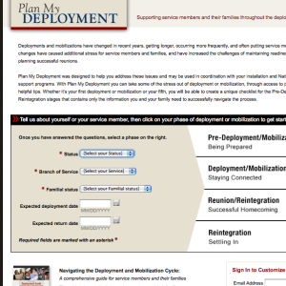
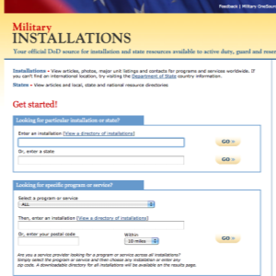
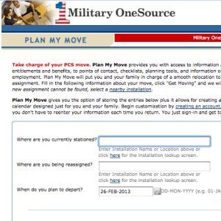

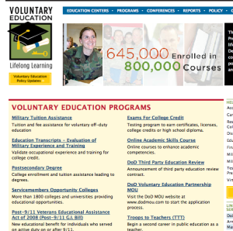
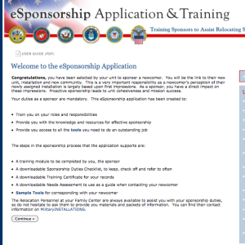
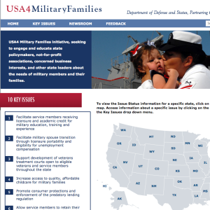
Our Websites
Notes:
Talking points
At the bottom of any Military OneSource page you will find links to Our Websites. These websites will further assist service members and family members with several things, including deployment, moving, locating installation services and much more!
Our websites include:
MilitaryINSTALLATIONS - MilitaryINSTALLATIONS allows you to search for programs and services on your installation.
Military Youth on the Move - This website is divided into kid, pre-teen, teenager and parent sections. You’ll find age appropriate information for your child to ease common struggles, including healthy living, safety, moving and new schools, money, and making new friends.
Military Spouse Employment Partnership Jobs Portal - The MSEP job portal is a job search engine specifically for military spouses. By entering the city, state and country of residence, spouses can browse through available jobs in the area. An advanced search allows spouses to search for a specific line of work.
Plan My Deployment - This tool helps service members and families understand what to expect and when throughout the deployment cycle. Entering the service member’s status, service branch, familial status, and expected deployment and return dates results in a personalized plan to help service members and families prepare for deployment.
Plan My Move - Similar to the personalized plans of Plan My Deployment, Plan My Move helps military service members and families create a timeline for a smooth move. Plug in your current duty station, new duty station and your departure date for your personalized timeline.
eSponsorship Training - If you have been assigned sponsorship of a newcomer, use your Common Access Card – known as the CAC – to access the eSponsorship application and training. You can also use this resource to communicate electronically and manage the sponsorship online.
MySECO - The MySECO website ensures spouses have 24/7 access to online education and career information, resources, tools and assessments. Using the tools and assessments, spouses can begin to explore their interests, skills, passions and personality type to determine the best fit for education and career choices and start to build a portable and meaningful career path.
USA4 Military Families - This website supports military families by explaining key issues that directly impact military service members and families. See the latest news or explore the key issues.
Voluntary Education - The Voluntary Education Portal offers guidance for anyone in the DoD community continuing their education. Information can be found about tuition assistance, the Post 9/11 G.I. Bill, Troops to Teachers, the Online Academic Skills Course, exams for college credit and much more.

Slide 7
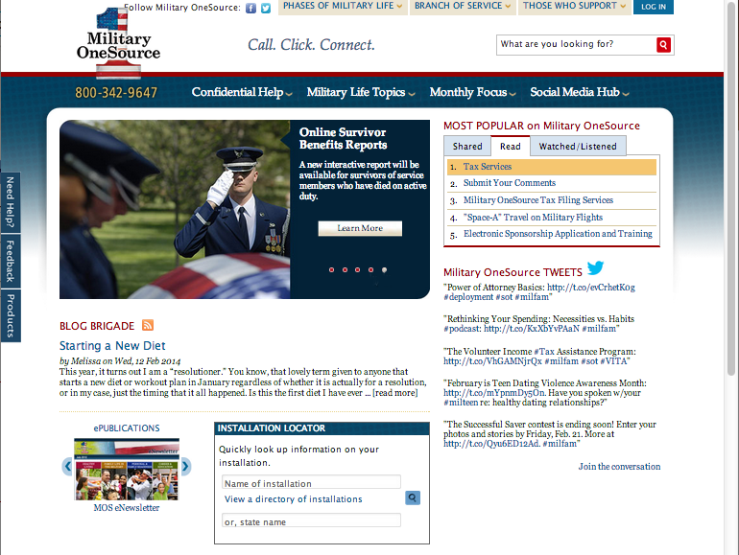
Military OneSource Homepage
Notes:
Talking points
There are two points of entry to the Military OneSource website the public and employee assistance program side. The public side offers a number of articles on military life topics and much more for service member, families, service providers, and leaders and requires no log in. If you are an eligible service or family member and would like to have access to confidential non-medical counseling, products and specialty consultations, select the log- in button at the top of this page. Note, that once you log into the employee assistance program side, you have left the public side of Military OneSource website.
The homepage offers quick access to:
Links to program pages
The most popular site content
An installation directory to help you find the resources closest to you
All of the available counseling options
Under the Military Life Topics tab, you will find links to each program page. Clicking on any link will take you to that program’s homepage where you will find a wealth of articles, resources and external links.
If you’re interested in the latest hot topics, browse the MOST POPULAR on Military OneSource menu in the top right-hand corner of the homepage. When something peaks your interest, simply click the link to read, watch or hear more.
The Installation Locator box in the middle of the page is your quick reference to all things about your current or soon-to-be installation. Simply fill in your installation’s name, state name or select your installation from the directory. This feature will also provide information on local support providers, like the Red Cross and Joint Force headquarters.
Hovering over the Confidential Help tab will immediately reveal contact phone numbers for instant contact or options for face-to-face, telephonic and online confidential non-medical counseling as well as confidential specialty consultation options (for example, adoption, health and wellness coaching, special needs and wounded warrior) and other services.

Slide 8
Military OneSource Homepage
Notes:
Talking points
Left menu:
The Need Help? tab takes users to options for confidential non-medical counseling services.
The Feedback tab navigates to a contact form for comments and suggestions, technical support or website accessibility.
The Products tab takes users to a menu of available products arranged by topic or product type, including audio and video tips, booklets, CDs and DVDs, resource guides and toolkits.
Top menu:
Hover over the Phases of Military Life tab to find helpful information no matter your current phase of military life, including new to the military, single life, career, Guard and reserve, deployment, family life, military leadership and retiring.
Click your branch of service under the Branch of Service tab for information specific to the Army, Marine Corps, Navy or Air Force.
The Those who Support tab leads to information specifically for community partners, leaders or command, and service providers.
The Log In tab takes users to a page that requires a username and password. While much of the information on Military OneSource is public, certain services, including confidential non-medical counseling, products and confidential specialty consultations are available only to eligible individuals through a secure log in.
Briefer notes
Note that the links for the ePublication Archives and MilitaryINSTALLATIONS, along with many more links, can be found at the bottom of the page.

Slide 9
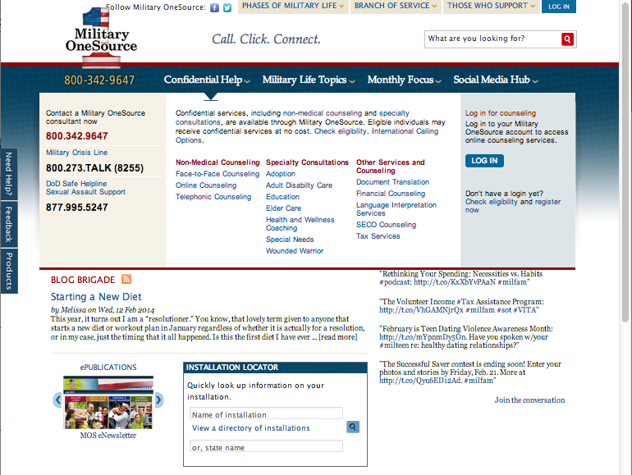
Confidential Help
Notes:
Talking points
Service members and family members can find confidential non-medical counseling information through the toll-free number, 800-342-9647 or through the links on any Military OneSource page by:
Hovering over the Confidential Help tab in the menu at the top of any page to see phone numbers for immediate support and the available counseling options offered through Military OneSource and a description of each, confidential non-medical counseling and specialty consultations as well as other services and counseling options.
Clicking the Military Life Topics tab in the menu at the top of any page to reveal a list of program pages. Selecting the non-medical counseling link will navigate to the program page for more information about Military OneSource confidential non-medical counseling options.
Clicking the Need Help? button in the left-hand margin of any Military OneSource page to be immediately taken to a simplified Counseling Services page.
Military OneSource confidential non-medical counseling:
Provides up to 12 confidential non-medical counseling sessions, per person, per issue at no cost. Note: financial counseling is unlimited.
Provides confidential short-term counseling to eligible individuals with such issues as: relocation, separation, reintegration, relationship issues, parenting skills, communication, anger management, grief, stress, deployment, life skills, coping skills, interpersonal skills and academic or occupational problems.
Is available via three different methods for convenience and generational preferences: face-to-face, telephonic and online. The Military OneSource consultant will assess your situation and help determine the most beneficial method. In most cases, referrals are made within 72 hours.
Does not provide or determine medical diagnosis. It is not a part of TRICARE, nor does it substitute for authorizations required for reimbursement under TRICARE.
Is not intended to be a part of a patient’s Medical Treatment Facility discharge plan or treatment of suicidal or homicidal thoughts, or Family Advocacy Program cases. It is not intended to address sexual assault, abuse, mental health conditions requiring in-patient hospitalizations and other behavioral concerns.
Military OneSource confidential specialty consultations:
Are available online or over the phone with specialists in various fields, including adoption, health and wellness coaching, special needs and wounded warrior.
Can be scheduled by calling Military OneSource at 800-342-9647 and asking for an appointment in one of the specialized areas.
Other Military OneSource services and counseling include:
Document translation
Financial counseling with certified financial planners
SECO counseling to help military spouses with career exploration, education, training and licensure, employment readiness, and career connections
Tax services
Briefer notes
Children are eligible for Military OneSource confidential non-medical face-to-face or telephonic counseling if:
A parent attends (for example, family counseling) with a child younger than 13
A parent brings a child between 13 and 18 to the individual counseling session
The child is 18 years or older

Slide 10

Non-medical Counseling is…
Short-term
Available for up to 12 sessions per issue
Appropriate for
  Relationship issues
  Stress management
  Decision making
  Communication
  Parenting skills
Notes:
Talking points
Military OneSource confidential non-medical counseling is designed to provide short term, goal-oriented counseling for issues that can effectively be addressed within 12 sessions, such as communication issues, adjustment to situational stressors, stress management, decision making, grief, blended-family issues and parenting-skills issues.
It is available for up to 12 sessions per issue, per eligible family member. Which means that someone could receive 12 sessions for one issue, perhaps something like adjusting to a deployment alone, and then, once those sessions are completed, 12 more sessions for couples-communication issues that may be experienced when the service member returns from deployment.
The information you provide to counselors is kept confidential, with the exception of the duty to warn issues, including harm to yourself or others, abuse and neglect ,or present or future illegal activity. As with any of the Military OneSource services, a family member may seek non-medical counseling without the knowledge or consent of the service member. If you have questions regarding your individual situation, a Military OneSource consultant can talk with you regarding confidentiality in more detail.

Slide 11
Non-medical Counseling is not…
A long-term counseling option
Part of a medical treatment facility discharge plan, or part of TRICARE
Available for those already under care
For individuals facing any of the following major issues:
    Post-traumatic Stress Disorder
    Psychological or fitness-for-duty evaluations
    Addictions
    Mental diagnoses requiring medication
    Determining a medical diagnosis
    Crisis situations
Notes:
Talking points
Non-medical counseling is not designed for issues requiring long-term support, including diagnosed addictions (for example, drugs, alcohol or other addictions), diagnosed mental health conditions that require medical treatment (for example, Post-traumatic Stress Disorder, depression, bipolar disorder, etc.), and other behavioral trauma related diagnoses.
It is also not designed to address long-term issues such as child abuse or neglect, domestic violence, suicidal ideation and mental health issues. For example, if a service member states that he or she has had suicidal thoughts, but adds that they would never do that to themselves or their family, then non-medical counseling would not be an option, due to suicidal ideation. In these situations, long-term care is more appropriate, and those individuals are referred to a military treatment facility or TRICARE for services and—if appropriate—community resources with their personal insurance. In some cases, the caller may be referred to a community social services program (for example, a National Guard member without insurance might be referred to a local state-run counseling program).
Military OneSource does not provide or determine any medical diagnosis, nor will we provide psychological or fitness-for-duty evaluations.
Non-medical counseling is not appropriate as part of a patient’s military treatment facility discharge plan, nor is it available for anyone who is already under the care of another counseling provider. For example, a service member who is seeking couples counseling but has a spouse who is being treated for bi-polar disorder would be ineligible. The service member could be seen individually, but we are unable to provide counseling support for the spouse because they have a medical diagnosis and are already working with another provider.
Briefer notes
Below are other examples of inappropriate issues that can be used if necessary:
An affiliate provider calls in that the service member abuses alcohol, but the affiliate provider is providing couple’s counseling and the service member is getting help elsewhere for substance abuse. In this case the service member would need to be moved out of non-medical counseling due to the substance abuse and concurrent service through another mental health professional.
A service member wants individual counseling but their primary care provider prescribed Zoloft for depression and nervousness. Since the caller is being treated for depression, he or she is not appropriate for non-medical counseling.
A service member was hospitalized for panic attacks, denies risk to continue with the non-medical counseling provider. Due to mental health hospitalization, this service member is not appropriate for non-medical counseling.
A service member was diagnosed with PTSD, but states that it is under control. He is requesting couple’s counseling. Due to the diagnosis of PTSD, the caller is not eligible for non-medical counseling.

Slide 12

Face-to-Face
With a counselor in your local community
Individuals, couples and families
Available for CONUS locations only
Notes:
Talking points
This confidential non-medical counseling option allows you to meet face-to-face with a professional counselor in your community. It begins with a call to Military OneSource where the consultant will complete a brief assessment to ensure that the issue is indeed appropriate for non-medical counseling support. Once it is deemed appropriate, the consultant will provide a referral to a counselor that best matches the needs of the caller. This referral is only good for 30 days, so the caller is encouraged to make contact fairly quickly. If the sessions are not initiated within 30 days, the person will need to make another phone call to a Military OneSource consultant and begin the process again.
The thorough assessment with the Military OneSource consultant lasts between 20 and 45 minutes and is considered one of the 12 sessions. The information from this session is then forwarded to the face-to-face counselor for their use.
A Military OneSource consultant will generally follow up after the referral to the counselor to check to see if appointments have been made and to confirm satisfaction with the counselor. If for some reason the participant-counselor relationship is not a good fit, we will make every attempt to find another counselor.
Face-to-face non-medical counseling is available to those in the continental U.S., Alaska, Hawaii, Puerto Rico and the Virgin Islands. However, it is best to keep in mind that due to locality issues, face-to-face non-medical counseling may not be available in certain areas, particularly those that are more remote. In this case, there is an option to travel to the nearest affiliate provider, or if applicable, to seek online or telephonic non-medical counseling.
Briefer notes
In some cases where we do not have a local affiliate provider available, the Military OneSource consultant can request a temporary provider, however this is not a guarantee and can take a few weeks to process.
Affiliate provider network criteria:
Master’s degree or higher
Five years post-master’s clinical experience
Minimum of three years employee assistance program experience

Slide 13

Telephonic
For individual adult sessions only
For those located CONUS and OCONUS
Available 8 a.m. – 8 p.m. EST
Notes:
Talking points
Telephonic confidential non-medical counseling has been added to increase access to support and to provide an option for those who are unable to attend in-person counseling sessions due to their overseas location or other circumstances.
Telephonic non-medical counseling sessions are conducted with a Military OneSource counselor and, like the face-to-face option, begin with a brief assessment.
Because this method of counseling is provided over the phone, it is not appropriate for complex issues, situations that require a group setting (for example, couples and family counseling) or for children under the age of 18.
Following the initial screening, the first telephonic session will be scheduled and the counselor will call the participant for a 45 minute session. Subsequent sessions will then be scheduled.

Slide 14

Online
Conducted in a secure, real-time chat format
For individual adults sessions only
Scheduled and not on-demand
Available 8 a.m. – 8 p.m. EST
Notes:
Talking points
Online confidential non-medical counseling is great for those who prefer communicating online versus face-to-face or telephonically. This option uses an instant-messaging format with the counselor and participant communicating online in real-time.
Sessions can begin once the online non-medical counseling request form is completed and – like the other non-medical counseling options – is assessed for appropriateness. The first session is then scheduled, as is each subsequent session, as they are not available on demand.
Online sessions are available to those located anywhere; however they can be impacted by technical issues, like connectivity or low bandwidth.
Because the counseling is conducted on a computer, it is inappropriate for children under 18 or couples or family counseling, including marriage counseling.

Slide 15
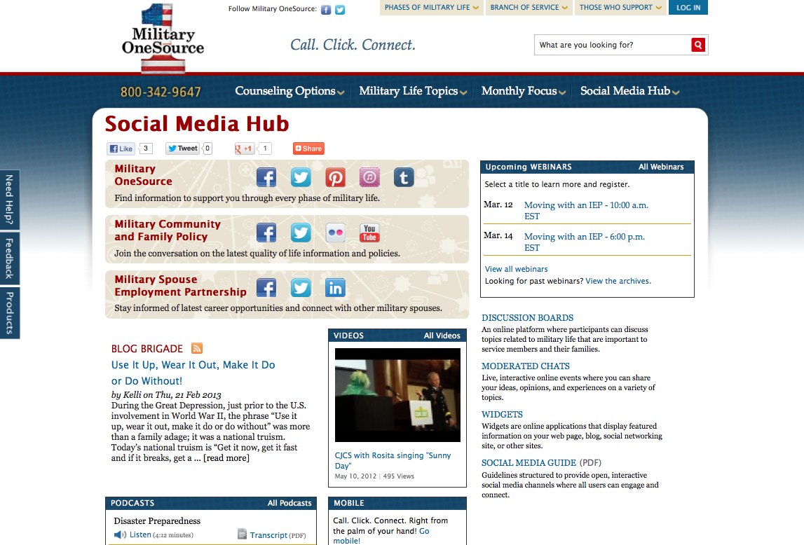
Social Media Hub
Notes:
Talking points
Access to Military OneSource social media outlets is conveniently located on the homepage.
View the Twitter feed on the right-hand side of the page.
Follow the link to the Military OneSource Facebook page.
The latest Blog Brigade entry can be found just below the image box, in the middle of the page.
More complete access to social media can be found by hovering over the Social Media Hub tab at the top of the homepage. Here you’ll find links to:
Social media hub
Blog Brigade
Discussion boards
Podcasts
Webinars
Widgets
Videos
Briefer notes
Explain some of the social media offerings and remind audience of upcoming webinars.

Slide 16
Spouse Education and
Career Opportunities Program
Military Spouse Career Center at Military OneSource
Spouse Education and Career Opportunities comprehensive counseling service available to ALL military spouses.
Career exploration and discovery
Education, training and state licensing/credentialing requirements
Employment readiness
Career connections
https://www.militaryonesource.mil/ and https://myseco.militaryonesource.mil
My Career Advancement Accounts Scholarship Program
Financial assistance for spouses of Service members in pay-grades of E1-E5, O1-O2 and W1-W2
Up to $4,000 for education/training and license/credential in a portable career
Financial assistance provided to more than 43,000 spouses in fiscal year 2012
https://aiportal.acc.af.mil/mycaa/
Military Spouse Employment Partnership
Web-enabled employment and career partnership connect military spouses with vetted Fortune 500 PLUS employers – 231 corporate partners
Partners’ Statements of Support to increase employment, provide career promotion opportunities and ensure pay equity for military spouses
Spouse Ambassador Network
https://msepjobs.militaryonesource.mil/

Slide 17
Access
You can expect:
24/7/365 worldwide access
Master’s-level consultants to answer your questions
Objective, experienced and caring people
Up-to-date and useful information
No cost
A commitment to quality
Toll-Free telephone
800-342-9647
MilitaryOneSource.mil
m.MilitaryOneSource.mil
Email your questions
to a consultant
Interaction with trained
outreach professionals
Notes:
Talking points
Military OneSource is available 24/7/365, in other words, when you need us, we are there.
You can call our toll-free number to talk to a trained master’s-level consultant who can offer confidential support and up-to-date practical solutions or appropriate referrals.
Or, access our website and browse through everything the site has to offer, including webinars, newsletters and all of the other support discussed during this presentation.
Even on the go, Military OneSource is at your fingertips. The mobile site allows you to reach all of the resources of the traditional Military OneSource website no matter where you are.
Access to some information and services, including confidential non-medical counseling, requires you to log-in. To do so, you will need to create your own user name and password.
You also have the option to email a consultant your question. The consultant will research your request and get back to you. If your request is urgent or time sensitive, you will want to call the toll-free number to speak with a live consultant.
All Military OneSource services and materials are available at no cost to service members and their families.
Additionally, Military OneSource is constantly looking for ways to improve the service, and values all feedback. We conduct surveys asking for information on your experience. The 12-question survey will periodically appear on the website, or you can access it direct via the Contact Us link.
For a situation where the service did not meet the expectation, there is a customer recovery process in place. Each complaint is documented and taken very seriously. All departments are notified to ensure proper training and actions are taken to immediately respond to the breakdown. Rest assured that Military OneSource truly cares for, and is committed to service members and families and strives for 100 percent customer satisfaction.

Slide 18
Questions?
Notes:
Talking points
Does anyone have any questions?
Let them know how long you will be around after the presentation and where they can find you if they think of a question they would like to ask later on.
Direct additional questions to the Military OneSource call center at 800-342-9647.

Slide 19

Call. Click. Connect.
800-342-9647 MilitaryOneSource.mil
Notes:
Briefer notes
Point out the contact phone number and website to audience members and remind them to direct additional questions and concerns to a Military OneSource consultant through the call center.

