Slide 1

Family Advocacy Program
Problematic Sexual Behavior in Children and Youth

Slide 2

Today’s Purpose
Introduce problematic sexual behaviors in children and youth and explain how the Family Advocacy Program now works to address these behaviors by supporting children who exhibit or are impacted by
PSB-CY and their families.
What is PSB-CY?
Why is PSB-CY a focus?
How do we address PSB-CY?
What is FAP’s role in addressing PSB-CY?
Introduce problematic sexual behaviors in children and youth and explain how the Family Advocacy Program now works to address these behaviors by supporting children who exhibit or are impacted by
PSB-CY and their families.
What is PSB-CY?
Why is PSB-CY a focus?
How do we address PSB-CY?
What is FAP’s role in addressing PSB-CY?
Note: Prevention, outreach and response will at all times reflect and accommodate a variety of cultural norms, ethnicities, religions, socioeconomic statuses and disabilities.
Note: Prevention, outreach and response will at all times reflect and accommodate a variety of cultural norms, ethnicities, religions, socioeconomic statuses and disabilities.

Slide 3

What Is PSB-CY? (1 of 3)
Behaviors initiated by children and youth under age 18 that involve sexual body parts (genitals, anus, buttocks or breasts) that are not typical sexual behaviors and are developmentally inappropriate, or potentially harmful to the individual(s) initiating the behaviors, the individual(s) impacted by the behaviors or others.
Behaviors initiated by children and youth under age 18 that involve sexual body parts (genitals, anus, buttocks or breasts) that are not typical sexual behaviors and are developmentally inappropriate, or potentially harmful to the individual(s) initiating the behaviors, the individual(s) impacted by the behaviors or others.

Slide 4

What is PSB-CY? (2 of 3)
Children and youth with PSB-CY exhibit a variety of behaviors influenced by personal demographics, familial factors, trauma history and mental health status.
Leading experts in the field who evaluate, treat and provide practice guidelines for PSB-CY strongly recommend that adults remember that children exhibiting or engaging in PSB-CY are children. Applying labels to these children such as “sex offender” can be stigmatizing and may even lead to recidivism.

Slide 5
What Is PSB-CY? (3 of 3)
Continuum of Sexual Behavior in Children
Normative (Common)
Sexual behaviors are considered developmentally normative when they occur infrequently and are easily distractible (i.e., the child is responsive to redirection).
Cautionary (Less Common)
Cautionary behaviors are identified as those that are disruptive to others and only moderately responsive to distraction and redirection.
Problematic (Uncommon)
Problematic behaviors are frequently disruptive to others and persist even after distraction and redirection. Children exhibiting these behaviors may cause harm to themselves or others and persist after explicit redirection. Redirection may be met with anger from the child.
Normative (Common)
Sexual behaviors are considered developmentally normative when they occur infrequently and are easily distractible (i.e., the child is responsive to redirection).
Cautionary (Less Common)
Cautionary behaviors are identified as those that are disruptive to others and only moderately responsive to distraction and redirection.
Problematic (Uncommon)
Problematic behaviors are frequently disruptive to others and persist even after distraction and redirection. Children exhibiting these behaviors may cause harm to themselves or others and persist after explicit redirection. Redirection may be met with anger from the child.

Slide 6
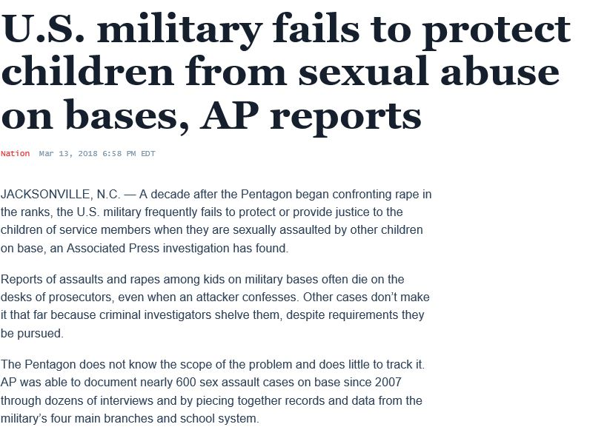
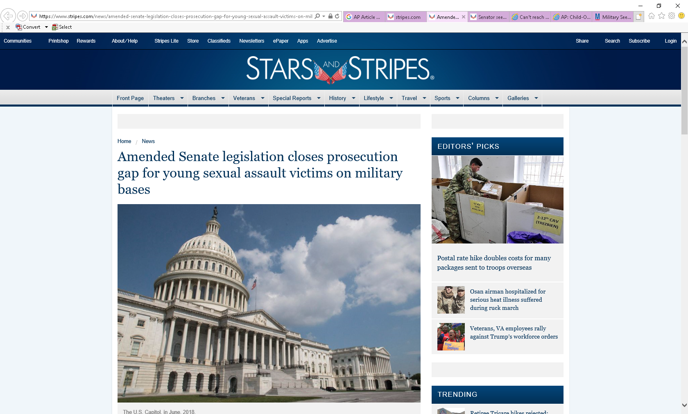
Why Is PSB-CY a Focus?
The Defense Department expanded the scope
of FAP to address the issue of problematic sexual behavior in children and youth occurring on military installations.
Throughout 2018, a team of experts developed policy and procedures to guide a coordinated community response for PSB-CY.
This coordinated community response system for PSB-CY:
  Supports youth and families impacted by PSB-CY
  Addresses the safety needs of any youth involved
  Limits the ongoing risks to family and community members

Slide 7
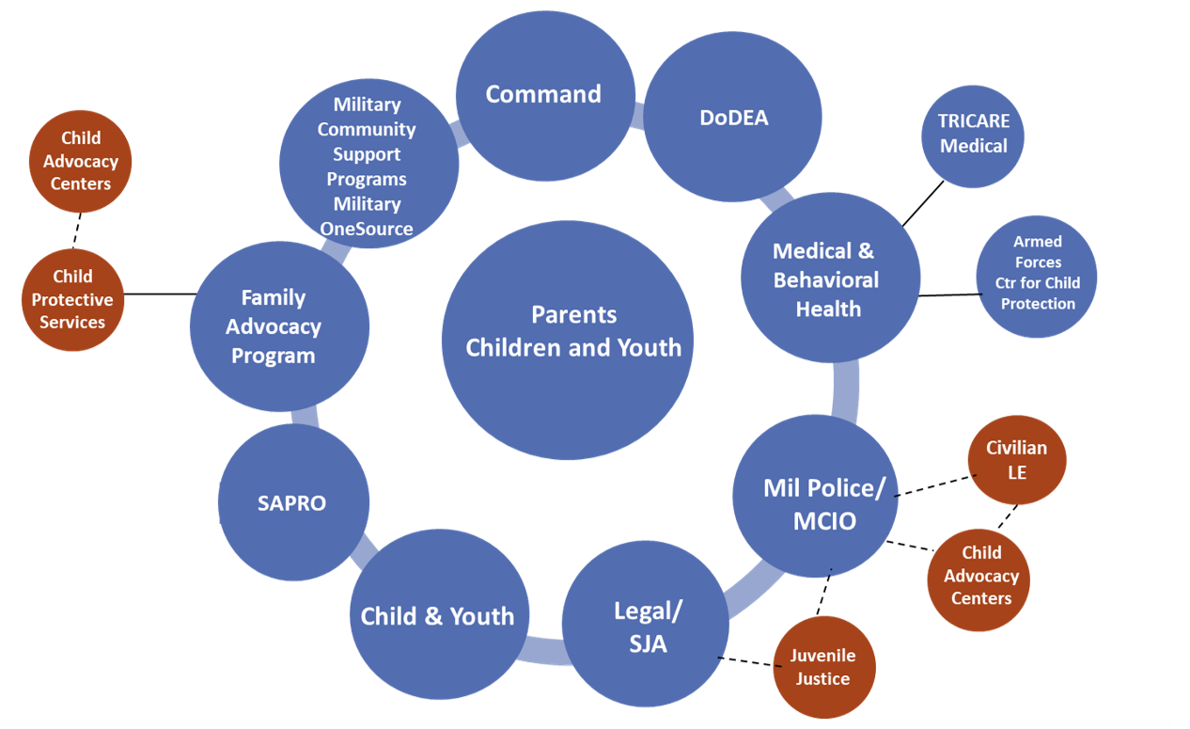
How Do We Address PSB-CY? (1 of 6)
The coordinated community response for PSB-CY:
The coordinated community response for PSB-CY:

Slide 8

How Do We Address PSB-CY? (2 of 6)
Family Advocacy Program’s role:
Support for all children and families involved in PSB-CY, including:
Coordinated response and
intervention plan
Safety planning
Child-focused support for parents
Evidence-guided clinical assessment, service planning and treatment when services are available on an installation,
or a warm handoff to appropriate
civilian providers
Case management
Support for all children and families involved in PSB-CY, including:
Coordinated response and
intervention plan
Safety planning
Child-focused support for parents
Evidence-guided clinical assessment, service planning and treatment when services are available on an installation,
or a warm handoff to appropriate
civilian providers
Case management

Slide 9
How Do We Address PSB-CY? (3 of 6)
Family Advocacy Program functions:
Convenes the multidisciplinary team
Ensures required notifications are made after activation of the MDT,* such as:
  Civilian law enforcement
  Child Protective Services
  Others, as required
Collects data
Delivers evidence-based clinical treatment when services are available on an installation, or conducts a warm handoff to appropriate civilian providers
*Additional information on the MDT, and FAP’s role and functions, can be found in Appendix B.

Slide 10
How Do We Address PSB-CY? (4 of 6)
The military community is focused on promoting the wellness, safety and healing of all children. Remember: Children exhibiting or engaging in PSB-CY are children.
The military community is focused on promoting the wellness, safety and healing of all children. Remember: Children exhibiting or engaging in PSB-CY are children.
OSD FAP has consulted with leading experts to recommend the following shift in how we talk about these concerning behaviors. →
OSD FAP has consulted with leading experts to recommend the following shift in how we talk about these concerning behaviors. →
Say this: | Not this:
Child with concerning sexual behavior | Offender
Child with PSB-CY | Perpetrator
Child exhibiting PSB-CY
Child engaging in PSB-CY
Impacted child | Victim
Child impacted by PSB-CY

Slide 11

How Do We Address PSB-CY? (5 of 6)
The military community is committed to supporting families in understanding child sexual behavior and keeping children safe. Trained FAP clinicians are standing by to help families learn:
The military community is committed to supporting families in understanding child sexual behavior and keeping children safe. Trained FAP clinicians are standing by to help families learn:
What sexual behavior is developmentally healthy and age appropriate
How to identify concerning sexual behavior exhibited by children or youth
What sexual behavior is developmentally healthy and age appropriate
How to identify concerning sexual behavior exhibited by children or youth

Slide 12
How Do We Address PSB-CY? (6 of 6)
Trained FAP clinicians are standing by to help families learn:
When to ask for help from FAP if they see concerning behaviors that need assessing
What their options are. These include:
  Calling their installation’s FAP office if they are concerned about the well-being of a child
  Contacting Military OneSource at 800-342-9647
  Referring a teen to youth-focused relationship and dating help at the 24/7 chat service Love is Respect. Text “love is” to 22522.

Slide 13

Does This Change FAP’s Focus?
No. FAP remains committed to its mission to prevent and respond to child abuse and neglect, and domestic abuse affecting service members and their families.
PSB-CY is an expansion of — rather than a change in — FAP’s scope in supporting the safety and resiliency of military families.
Note that the response system for
PSB-CY is different from how FAP responds to child abuse and neglect and domestic abuse.
No. FAP remains committed to its mission to prevent and respond to child abuse and neglect, and domestic abuse affecting service members and their families.
PSB-CY is an expansion of — rather than a change in — FAP’s scope in supporting the safety and resiliency of military families.
Note that the response system for
PSB-CY is different from how FAP responds to child abuse and neglect and domestic abuse.

Slide 14
What Is FAP’s Role In PSB-CY?
Legislative Authority (1 of 2)
Public Law 115-232 (National Defense Authorization Act for fiscal year 2019), Section 1089, requires that:
There shall be a consistent, standardized response to PSB-CY across the department.
“Any report or other allegation of PSB-CY on a military installation that is received by the installation commander, a law enforcement organization, a FAP, a Child Development Center, MTF or department school shall be reviewed by the Family Advocacy Program on the installation.”
The Family Advocacy Program shall conduct multifaceted MDT reviews and recommend treatment, counseling or other appropriate interventions for children, youth and families.

Slide 15
What Is FAP’s role in PSB-CY?
Legislative Authority (2 of 2)
Public Law 115-232 (NDAA for FY19), Section 1089, requires that:
Reviews of PSB-CY cases be conducted in a manner that protects the sensitive nature of the incident concerned, and with full involvement of appropriate authorities and entities, including parents or guardians
Family Advocacy Program personnel have appropriate training and experience working with juveniles
In addition, the law requires that the following information be collected on reported incidents of PSB-CY:
Description of the allegation
Whether a review was completed
Whether the incident was investigated by law enforcement
Whether action was taken in the incident

Slide 16

Resources
The following resources are appropriate for use by service members, families, service providers and leaders:
OneOp Series on PSB-CY
National Children’s Alliance Child Advocacy Center Locator for Military Families
National Children’s Alliance Learning Center on PSB-CY
National Center on the Sexual Behavior of Youth resources
American Academy of Pediatrics Guide on Promoting Healthy Sexual Development and Sexuality
The National Child Traumatic Stress Network
  Sexual Development and Behavior in Children
  Understanding and Coping with Sexual Behavior Problems in Children
The following resources are appropriate for use by service members, families, service providers and leaders:
OneOp Series on PSB-CY
National Children’s Alliance Child Advocacy Center Locator for Military Families
National Children’s Alliance Learning Center on PSB-CY
National Center on the Sexual Behavior of Youth resources
American Academy of Pediatrics Guide on Promoting Healthy Sexual Development and Sexuality
The National Child Traumatic Stress Network
  Sexual Development and Behavior in Children
  Understanding and Coping with Sexual Behavior Problems in Children

Slide 17
Appendix A – Multidisciplinary Team (1 of 2)
Core members: | Members included as needed:
Family Advocacy Program* *chair | Child-focused advocate for parents
Child and Youth Services (when they are the referral source or when the child/youth attends a child or youth program) | Civilian agencies with which there is an MOU (examples include Child Protective Services, Child Advocacy Center)
Department of Defense Education Activity (when they are the referral source or when the child/youth attends a DoDEA school or activity) | Staff judge advocate
Military Criminal Investigative Organization | Installation leadership
 | PAO/crisis communicator
 | Medical provider
Military Family Life Counselor*
*under discretion of assigned agency
Military Family Life Counselor*
*under discretion of assigned agency

Slide 18
Appendix A – Multidisciplinary Team
(2 of 2)
FAP responsibilities as chair of the MDT include:
Activating the MDT (if not regularly scheduled)
Using the MDT for decision points from referral through case closure
Communicating continuously and effectively with the MDT members
Ensuring FAP clinicians conduct or make available trauma-focused assessments for both the exhibiting and impacted child(ren)
Providing families with support options, including evidence-based
practice interventions
Considering relevant risk/protective factors for both the exhibiting and
impacted child(ren)
Considering developmental and cultural factors relevant to parent engagement and treatment options
Training the MDT on an annual basis

Slide 19
Appendix B – Roles in Addressing PSB-CY
(1 of 4)
Department of Defense Education Activity, Child Development Programs and Military Family Life Counselors
DoDEA and CDP: Respond to incidents of PSB-CY occurring in their settings Report via Serious Incident Reporting or other internal system of reporting Report non-normative behaviors to FAP Report to law enforcement or MCIO, if appropriate Engage parents Participate in the MDT Provide support to parents and children involved in PSB-CY in the DoDEA/CDP setting Document in DoDEA/CDP records Participate in safety and supervision planning for children impacted by and exhibiting PSB-CY Military family life counselors: Support DoDEA or Child and Youth Services staff Engage and support parents Participate in DoDEA or Child and Youth Services staff intervention and safety planning
Department of Defense Education Activity, Child Development Programs
and Military Family Life Counselors
DoDEA and CDP:
Respond to incidents of PSB-CY occurring in their settings
Report via Serious Incident Reporting or other internal system of reporting
Report non-normative behaviors to FAP
Report to law enforcement or MCIO, if appropriate
Engage parents
Participate in the MDT
Provide support to parents and children involved in PSB-CY in the DoDEA/CDP setting
Document in DoDEA/CDP records
Participate in safety and supervision planning for children impacted by and exhibiting PSB-CY
Military family life counselors:
Support DoDEA or Child and Youth Services staff
Engage and support parents
Participate in DoDEA or Child and Youth Services staff intervention and safety planning

Slide 20
Appendix B – Roles in Addressing PSB-CY
(2 of 4)
Family Advocacy Program
Receive reports Ensure activation of the MDT Engage parents Complete/refer for clinical assessment when warranted Engage civilian resources as appropriate Provide/recommend supportive or treatment services as indicated Develop safety and/or supervision plans for children involved in incidents of PSB-CY as appropriate
Family Advocacy Program
Receive reports
Ensure activation of the MDT
Engage parents
Complete/refer for clinical assessment when warranted
Engage civilian resources as appropriate
Provide/recommend supportive or treatment services as indicated
Develop safety and/or supervision plans for children involved in incidents of PSB-CY as appropriate

Slide 21
Appendix B – Roles in Addressing PSB-CY
(3 of 4)
Behavioral Health/Family Advocacy Program Clinical Services
Participate in the MDT Complete clinical assessment when warranted Assess for co-occurring behavioral health issues Provide or recommend evidence-based treatment
Behavioral Health/Family Advocacy Program Clinical Services
Participate in the MDT
Complete clinical assessment when warranted
Assess for co-occurring behavioral health issues
Provide or recommend evidence-based treatment

Slide 22
Appendix B – Roles in Addressing PSB-CY
(4 of 4)
Law Enforcement or MCIO
Participate in the MDT Investigate allegation when appropriate Determine if criminal offense Determine jurisdiction Coordinate with civilian law enforcement authorities Refer for action or prosecution if applicable
Law Enforcement or MCIO
Participate in the MDT
Investigate allegation when appropriate
Determine if criminal offense
Determine jurisdiction
Coordinate with civilian law enforcement authorities
Refer for action or prosecution if applicable

