Slide 1
Department of Defense (DoD)
Military Family Readiness Council (MFRC)
A Federal Advisory Council -- Providing Independent Advice to SecDef Sponsored by USD(P&R) and Supported by ASD(M&RA)
June 17, 2024
Council Meeting
Please feel free to visit the MFRC webpage on Military OneSource (https://www.militaryonesource.mil/mfrc/)

Slide 2
Agenda
Military Family Readiness Council Meeting June 17, 2024 (1300-1530 Eastern Time Zone)
1300 | Opening Remarks
1315 | The Military Health System
 | Stabilizing and Improving Specific Mitigation Network Provider Shortages Increasing Reimbursement Rotator Model Discussion
1400 | Break
1515 | Closing Remarks – Chair/DFO
1530 | Public Meeting is Officially Closed

Slide 3
Military Family Readiness Council: Focus on Medical
Office of the Assistant Secretary of Defense for Health Affairs

Slide 4
Framing Today’s Discussion
Review the organizational construct and key data points of the Military Health System
Summarize recent and on-going reforms to the Military Health System
Explain short term mitigation to constrained access to care for military families

Slide 5
The Military Health System

Slide 6
What is the Military Health System?
As summarized by the Congressional Research Service
DOD administers a statutory health entitlement through the Military Health System (MHS).
The MHS offers health care benefits and services through its TRICARE program to approximately 9.5 million beneficiaries composed of servicemembers, military retirees, and family members.
Health care services are available through DOD-operated hospitals and clinics, referred to collectively as military medical treatment facilities (MTFs), or through civilian health care providers participating in the TRICARE program.

Slide 7
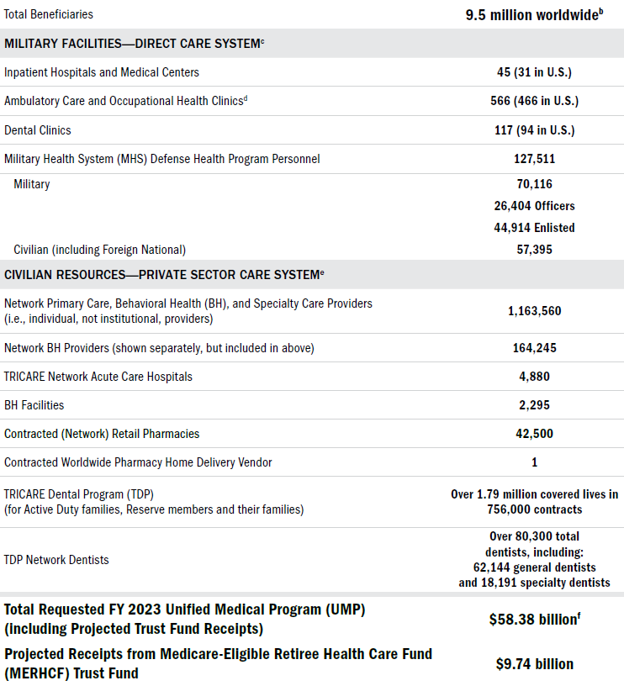
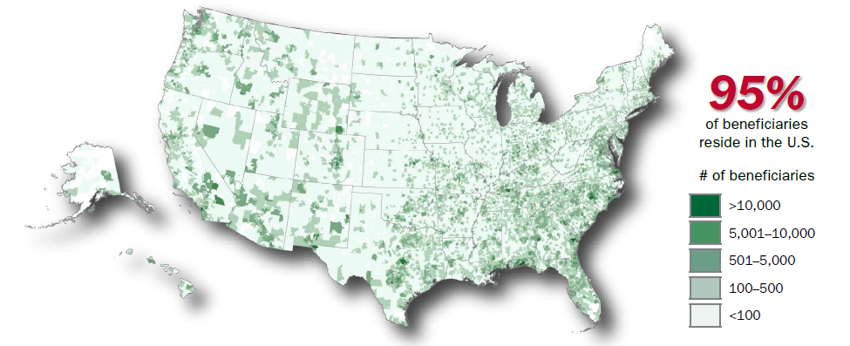
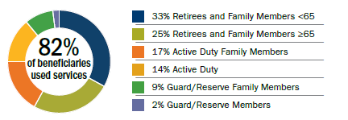
Key Data Points
Summarized from the Fiscal Year 2023 TRICARE Annual Evaluation

Slide 8
Stabilizing and Improving

Slide 9
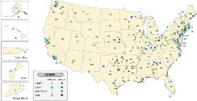
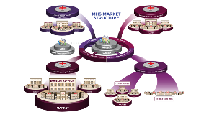
Timeline of Major Reforms
Twenty-five years of change in the MHS from 1998-2023
TRICARE Management Activity established as a field activity (1998)
Joint Task Force National Capital Region (2007)
Secretary of Defense directs the MHS Review (2014)
DoD begins deploying a new electronic health record
(2018)
1998
2023
5th Base Realignment and Closure (BRAC) consolidated Water Reed Army Medical Center and National Naval Medical Center Bethesda
(2005)
DHA replaces TRICARE Management Activity and Joint Task Force Capital Medicine
(2011-2013)
DHA authorities expand to manage MTFs and DTFs, research and development, public health, and education and training
(2017-Present)

Slide 10
Directives for 2024
From the Deputy Secretary memo “Stabilizing and Improving the Military Health System”
Requirements Determination (i.e., mission analysis)
Comprehensive review of all medical manpower and staffing.
Add medical force generation to the Defense Readiness Reporting System (DRRS).
Update DoD policy to reflect these directives.
Military Manpower
Primarily prioritize assignment of uniformed medical and dental personnel to MTF/DTFs.
Business rules to more holistically adjudicate risk to MTFs, DTFs, and operational medical readiness.
MTFs and DTFs become the primary choice of assignment absent specific, validated operational and training requirements identified by the Service Secretary of exigent circumstance.
Civilian Manpower
Prioritize implementation of chapter 74 of title 38, U.S. Code, authorities to improve recruitment and retention of health care personnel.

Slide 11
Specific Mitigation

Slide 12
Network Provider Shortages
TRICARE, like Medicare and other health plans, is opt-in for providers and health care organizations.
The current Managed Care Support Contractors are meeting all contractual requirements for network adequacy
Medical provider shortages in the local communities have been linked to high medical liability insurance, driving them to practice in neighboring states (e.g., TX, CO, and AZ).
In the next TRICARE Managed Care Support Contract (T-5), enrolled beneficiaries will have broader access to telehealth to mitigate local shortages.
Improving reimbursement rates and opening the aperture on value-based care arrangements will also increase access to care in the longer term.

Slide 13
Increasing Reimbursement
The next generation TRICARE Managed Care Support Contacts (T-5) changes to cap on reimbursements to incentivize providers and health delivery systems to stay in or even join the TRICARE network.
T-5 introduces Alternate Payment Models (APMs), which reward health care providers for delivering high quality and coordinated care. APMs can apply at the population level or by specific health condition
Pay for Reporting
Pay-for-Performance
Supplement fee-for-service (FFS) payments with shared savings and/or downside risk
Replace some or all FFS payments with capitation or a similar population-based, two-sided risk arrangement
Locality–Based Waivers carry-over from T-2017
If it is determined that access to specific health care services is severely impaired, higher payment rates could be applied to all similar services performed in a locality

Slide 14
Rotator Model
A circuit rider for manning assists
The Defense Health Agency is leveraging its reorganization into Defense Health Networks to prioritize rotator/circuit rider opportunities to maximize available capacity across the military medical treatment facilities (MTFs).
Impending OSD-level policy will streamline rotator/circuit rider requests.
Requests Assistance
Manages Request
Backstops Request
Defense Health Network A
Directs resources within its network
Coordinates across networks
Defense Health Network B

Slide 15
Discussion

Slide 16
Discussion
Discussants
Principal Deputy Assistant Secretary of Defense for Health Affairs
Chief of Staff, Office of the Assistant Secretary of Defense for Health Affairs
Topics for Consideration
Relationship between military family readiness and routine health service delivery
Tradeoff and integration between operational medical readiness and health service delivery
Impact of national health care personnel shortages on military family readiness

