Slide 1
Department of Defense (DoD)
Military Family Readiness Council (MFRC)
A Federal Advisory Council -- Providing Independent Advice to SecDef Sponsored by USD(P&R) and Supported by ASD(M&RA)
March 27, 2024
Council Meeting
Please feel free to visit the MFRC webpage on Military OneSource (www.militaryonesource.mil)

Slide 2
Agenda
Military Family Readiness Council Meeting March 27, 2024 (1300-1530 Eastern Time Zone)
1300 | Opening Remarks
1315 | Council Chair Opening Remarks
1325 | Roll Call
1330 | Food Security
1345 | Break
1405 | Childcare Update
1425 | Break
1430 | Spouse Employment Update
1440 | Break
1445 | Compensation and Financial Readiness
1455 | Break
1500 | Military Service Panel
1525 | Closing Remarks

Slide 3
Department of Defense
Military Family Readiness Council (MFRC)
Focus Areas FY24
BUCKET 1 - Economic Security
Food/Economic insecurity
BUCKET 2 - Medical/Health
Changes in Dependent Healthcare Systems and Implications for Military Family Readiness
Health Care for Military, Family and Civilians both OCONUS and CONUS
Medicaid Waiver Portability for Military Families
Medical care challenges just inside the reimbursable range authorized by the JTR (100 miles), placing a financial and time burden on families requiring specialty medical care. A waiver and/or permanent change to the JTR to allow for reimbursement for travel based on frequency of miles per month
Medical provider shortages in the local communities have been linked (in news sources) to high medical liability insurance driving them to practice in neighboring states (for example TX, CO, and AZ). This has led to reduced access-to-care locally. Accessing telehealth across state lines would help curb this negative trend.
Manning assist (specialists assigned TDY on a rotational basis) and creating localized reimbursements (like Alaska, North Dakota, NM) to increase the rates at isolated MTFs where patients must drive long distances to access care.
CV19 (Pandemic) - Capture Lessons Learned - Successes/Failures/Recommendations
BUCKET 3 - Employment
Employment of childcare professionals, especially in overseas locations.
Military Spouse Employment
Childcare on drill weekends is very challenging, and affordable childcare for service members is a challenge. Ability to offer subsidies for service members on drill weekends (could be incentive for local day care providers).
Expand Military Spouse Employment Preference (MSP) to be used in conjunction with the transition process leading to retirement (see attached).
Accurate Military Spouse Unemployment tracking through the BLS (tied to Unemployment Insurance/Financial Security)
Civilian Hiring
Child and Youth Services staff expressed interest in increasing the grade of APF billets to increase salary and incentivize applications for APF vs NAF. Currently, NAF employees make more than APF employees, so some GS employees opt to transition to NAF positions, causing a strain on MWR fund.

Slide 4
Department of Defense
Military Family Readiness Council (MFRC)
Focus Areas FY24
(Cont’d)
(Cont)’d
BUCKET 4 - Technology
Leveraging technology to meet needs of modern military families
Investigate the feasibility of establishing a department-wide, e-tool to collect real-time statistics regarding service/family member knowledge/awareness of services and their satisfaction rates after receiving services.
Overseas WIC is currently administered using paper drafts/checks vice EBT to redeem for items at the commissary. Modernize the process so EBT can be used at the point of sale at a commissary. The stigma of using paper vouchers or checks, vice a more discrete system through EBT, has been cited by Service members as one reason WIC isn't as widely used as it could be.
BUCKET 5 – Support Services
Personal and Family Life Education

Slide 5
Department of Defense (DoD)
Military Family Readiness Council (MFRC)
A Federal Advisory Council -- Providing Independent Advice to SecDef Sponsored by USD(P&R) and Supported by ASD(M&RA)
March 27, 2024
Council Meeting
Please feel free to visit the MFRC webpage on Military OneSource (www.militaryonesource.mil)

Slide 6
Strengthening Food Security in the Force:
An Update on Departmental Actions
27 March 2024
Program Analyst, OSD MC&FP

Slide 7
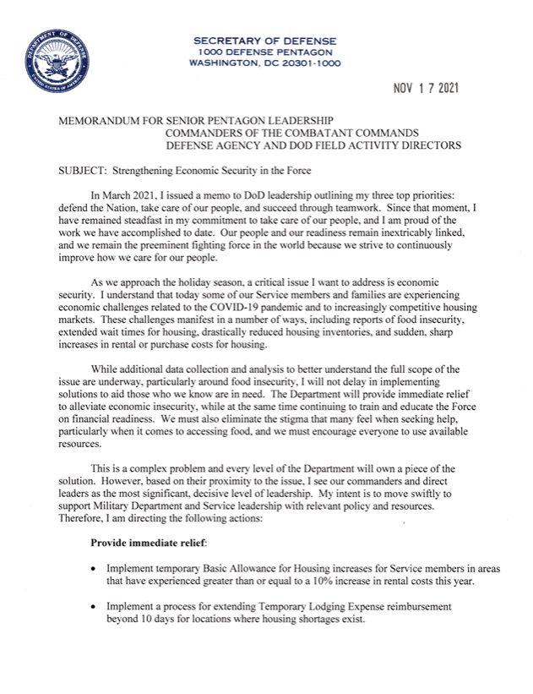
Strengthening Food Security in the Force: A Brief History
Secretary of Defense Memorandum, Strengthening Economic Security in the Force (November 2021)
Announced official release of the Military Leaders Economic Security Toolkit
Required Under Secretary of Defense for Personnel and Readiness to provide a strategy on food security
Office of the Under Secretary of Defense for Personnel and Readiness, Strengthening Food Security in the Force: Strategy and Roadmap (July 2022)

Slide 8
Strengthening Food Security in the Force: Building on Our Progress
Published to Military OneSource on 20 December 2023: https://download.militaryonesource.mil/12038/MOS/Economic-Security/strengthening-food-security-in-the-force-strategy-and-roadmap-2023.pdf
Follow-on to the original, Strengthening Food Security in the Force: Strategy and Roadmap (July 2022)
6 Lines of Effort (LOEs):
Increase access to healthy food
Enhance spouse employment opportunities
Review service member pay and benefits
Reinforce financial resources and awareness
Encourage service members and families to seek available resources and services
Expand data collection and reporting

Slide 9
Strengthening Food Security in the Force: Building on Our Progress
Examples of actions taken between July 2022 and December 2023:
Implemented the Basic Needs Allowance, and increased the Basic Allowance for Housing and the Basic Allowance for Subsistence
Increased savings for Service members shopping at commissaries
Expanded child care options and announced a new child care fee schedule that will significantly reduce fees for many military families
Implemented a 4.6% basic pay raise in January 2023
Introduced a Military Spouse Career Accelerator Pilot
Initiated a qualitative study, to better understand the causes of food insecurity among junior enlisted Service members

Slide 10
Strengthening Food Security in the Force: Building on Our Progress
Examples of new actions outlined in the report:
(1) Actions focusing on junior unaccompanied Service members living on installations include:​
Expanding campus-style dining (Air Force)​
Providing access to 24/7 minimarts (Navy/NEXCOM)​
(2) Actions focusing on enlisted, single-earner families with children include:​
Reinforcing the availability of federal nutrition assistance programs to those who may be eligible to receive benefits (All Services)​
The Defense Health Agency is expanding food security screening capabilities within the military’s electronic health record (DHA)​
Piloting online WIC payments at commissaries in Nevada (DeCA)​
Encouraging spouses and other dependents of enlisted personnel to patronize dining facilities at the discount rate (Army)

Slide 11
Featured Food Security Tools for Leaders and Providers
Military OneSource: Military Leaders Economic Security Toolkit (November 2021)
OneOp Food Security in Focus Series (September 2022)
Defense Organizational Climate Pulse (DOCP) Survey (February 2024)

Slide 12
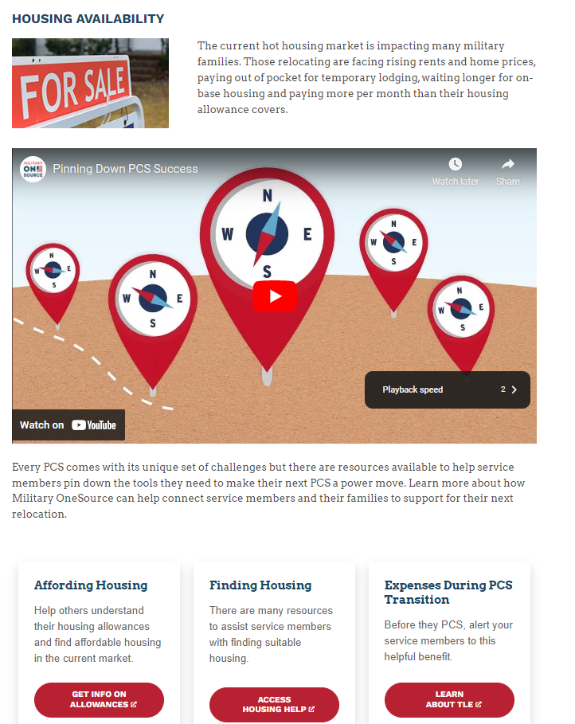
Military Leaders Economic Security Toolkit

Slide 13
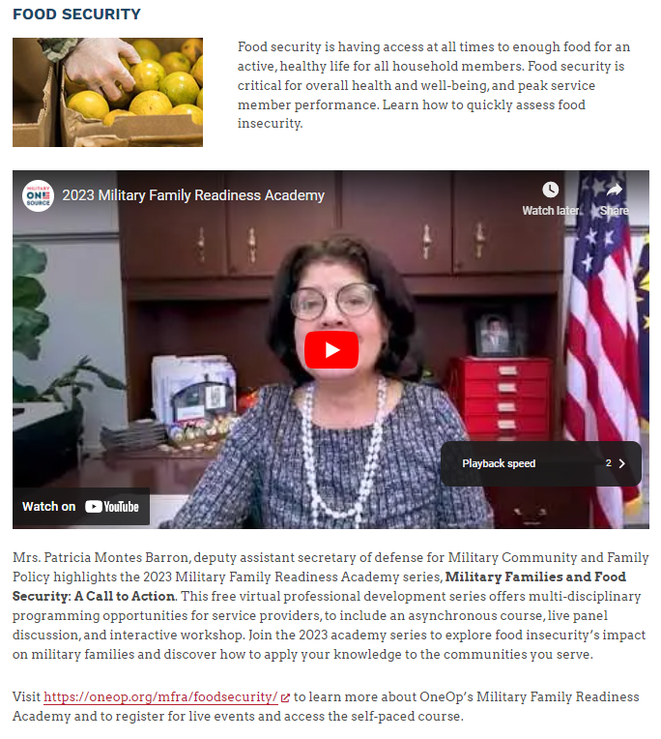
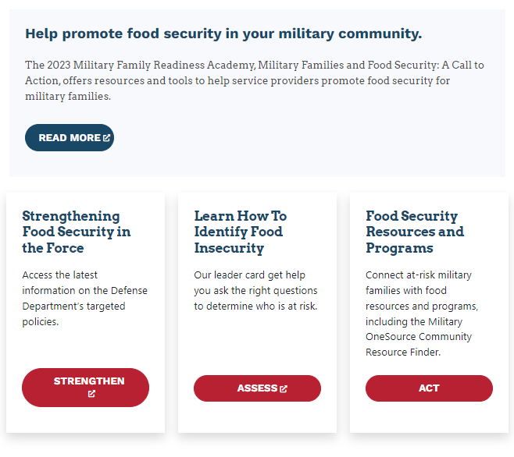
Military Leaders Economic Security Toolkit

Slide 14
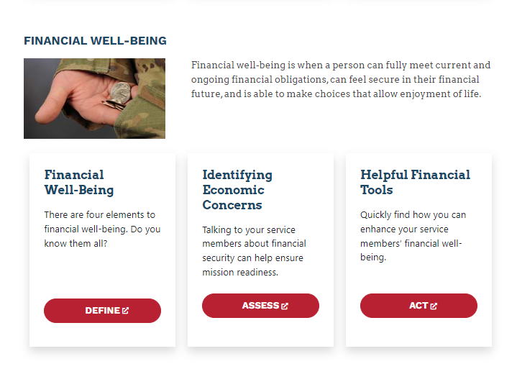

Slide 15
Thank you!
Program Analyst, OSD MC&FP

Slide 16
Child Development Program Update
March 2024

Slide 17
Child Development Program Fee Policy SY 23/24
The Department is required to annually review and issue a child care fee policy based on total family income (TFI) for use by programs in the DoD child development system of care.
Child care fees were restructured to make them more equitable and more affordable for families with the greatest economic need by reducing the percentage of income that families with TFI in the lower income/fee categories devote to their child care needs.
Under the SY 23/24 fee policy, families should expect their child care fees to be approximately 7% of their annual income for one child in full-time care.
Most families with TFI at or below $120,000 per year are expected to see a decrease as compared to SY 22/23 fees.
Installation commanders have the authority to grant case-by-case exceptions to individual fees if financial hardship warrants.
The SY 23/24 Fee Policy also increased the community-based fee assistance provider rate cap from $1700 to $1800/month/child increasing the amount of fee assistance for which families may quality.

Slide 18
Military Child Care In Your Neighborhood- PLUS
Military Child Care in Your Neighborhood (MCCYN) is the Department’s child care fee assistance program for military families using civilian providers in the local community.
Civilian providers must obtain a state license with annual licensing agency inspections, conduct employee background checks, and achieve national accreditation.
MCCYN-PLUS is an MCCYN initiative to expand eligibility to providers participating in state quality rating and improvement systems (QRIS).
Achieving a designated QRIS level is an indicator of provider quality in lieu of the requirement for national accreditation.
Participating states include Arkansas, Colorado, Kentucky, Maryland, Michigan, Minnesota, Nebraska, Nevada, New York, North Carolina, Oklahoma, Texas, Virginia, Washington, and Miami-Dade Co, FL.
MCCYN-PLUS served 6,816 children through 2,032 providers (4 Mar 24).
MC&FP is currently engaged with 18 additional states to join MCCYN-PLUS and continues outreach efforts across the country.

Slide 19
Child Development Program Workforce Initiatives
Recruitment, Retention, and Compensation Task Force
Established to conduct a foundational review of the current 30 year-old Child Development Program (CDP) compensation and staffing model framework.
Comprised of a multi-disciplinary team of subject matter experts in the fields of CDP, Human Resources, Policy, and Resourcing from OSD, Military Departments, Service Headquarters, and Installations.
After identifying challenges and recommendations, developed a comprehensive five-year plan to phase-in modernization of the CDP compensation and staffing model.
Initial phasing of recommendations for year-one included in FY25 budget :
Redesign compensation to support increases for mid to senior level direct care staff- update current duties and responsibilities to accurately reflect current performance and expectations.
Redesign compensation to support increases for management staff- update current duties and responsibilities to accurately reflect current performance and expectations.
Implement new position of Lead Educators to improve classroom environment/climate with added supervision, coaching, and expertise to the classroom.
Continuation of Special Needs Inclusion Coordinator Pilot.

Slide 20
Child Development Program Workforce Initiatives
Child Care Discounts for Direct-Care Staff
The Secretary’s “Taking Care of Our Service members and Families” September 2022 memorandum directed a 50 percent employee child care discount for the fist child of direct-care workers.
Nearly 28 percent of direct-care staff receiving discount as of Q1 FY24.
Incomplete Q1 FY24 data shows a minimum of $2.8M in fee discounts to military spouses.
The average weekly discount per employee is approximately $90, for a total annual cost savings of over $4,500.
Since implementation, the total number of direct-care staff increased by 14.6 percent.
The Military Services have authority to offer up to 100 percent discount.
The Military services are implementing additional workforce initiatives such as: advanced training opportunities, improved work center facilities, recruitment bonuses in hard to fill locations, and increased subsidies to incentivize and retain Family Child Care providers.

Slide 21
Child Development Program Update
March 2024

Slide 22
Military Family Readiness Council
Military Spouse Career Accelerator Pilot (MSCAP)
27 March 2024
Notes:
Hello and welcome to today’s Military Spouse Employment Partnership Potential Partner Overview
I cannot emphasize how appreciative we are that you are not only taking the time out of your schedules to join us today, but that your organization is considering joining more than 600 employer partners that have committed to recruiting, hiring, retaining, and promoting military spouses
As mentioned, my name is Eddy Mentzer and I serve within the Office of the Deputy Assistant Secretary of Defense for Military Community and Family Policy as an Associate Director
In my role, I oversee the Department of Defense’s spouse employment portfolio
I also happen to be a military spouse myself of 2e years and counting and have experienced many of the same challenges that military spouses around the world face in achieving and maintaining meaningful careers
Throughout the presentation, you will see a lot of acronyms because that is how we speak in the DoD…keep me honest and if I do not explain an acronym or spell it out, use the chat pod to let me know
And do not hesitate to put any questions you might have in the3 chat pod. Today’s presentation is about giving you additional background as you move through the vetting process and if you have a question, I guarantee others probably are thinking the same thing.
We also have a great team in the background that will be answering your questions in the chat, but we will also save some time at the end for additional questions.

Slide 23
Military Spouse Career Accelerator Pilot (MSCAP)
Leveraging authority provided in the 2022 National Defense Authorization Act, Secretary of Defense Austin directed the development of a military spouse fellowship with industry as part of the “Taking Care of People” priority
MSCAP was launched in December of 2022 with the first military spouse fellows being placed in January of 2023
While engaged in the fellowship, military spouses are compensated through funding provided by the Defense Department
The fellowship was initially designed to support career ready military spouses; those spouses that have the education and/or experience to move into the workforce rapidly
Eligible spouses include those whose Service member is currently serving in the active, national Guard, or reserve component
MSCAP only supports CONUS fellowships
There are 278 MSCAP “Host Companies”
Notes:
Our newest initiative is MSCAP, or the Military Spouse Career Accelerator Pilot
This one might be of particular interest to you as employers.
MSCAP is a competitive, 12-week, paid fellowship where employer hosts can select from an amazing talent pool of military spouses
We currently have more than 600 spouses fully registered in MSCAP and being pushed to employer hosts each month
Let me tell you about the participating spouses
These are career ready military spouses …of the more than 170 that have been placed into fellowships since January of this year, more than 90% have a 4 year degree and more than 30% have advanced degrees.
This is a great opportunity to bring in a potential candidate and have the Department of Defense pay them for 12 weeks.
The goal of the initiative is to have spouses converted from fellow to employed at the conclusion of the fellowship
We are looking for employer hosts who have employment opportunities and want to host MSCAP fellows
The team has dropped information on becoming an MSCAP host in the chat.
MSCAP is a separate initiative from MSEP, but many of our MSEP partners are hosting fellows or becoming employer hosts

Slide 24
Military Spouse Career Accelerator Pilot (MSCAP)
Year 1: December 22 through December 23
Total Fellowships Placed: 347
Traditional Fellowships: 288
Salesforce Fellowships: 28
Career Forward Fellowships: 18
Skills-based Fellowships: 13
Total Direct hires: 111
Traditional direct-hire: 110
Career Forward direct-hire: 1
Overall Successful Employment Opportunities: 357
Fellowships Completed*: 309
Employment Opportunities*: 246
Direct-hires: 111
Job-offer rate: 85%
Average Salary Offer: ~$65k
*Employment opportunities are reported as of 3/19/2024. Employment opportunities are tracked 90 following fellowship completion
Notes:
Our newest initiative is MSCAP, or the Military Spouse Career Accelerator Pilot
This one might be of particular interest to you as employers.
MSCAP is a competitive, 12-week, paid fellowship where employer hosts can select from an amazing talent pool of military spouses
We currently have more than 600 spouses fully registered in MSCAP and being pushed to employer hosts each month
Let me tell you about the participating spouses
These are career ready military spouses …of the more than 170 that have been placed into fellowships since January of this year, more than 90% have a 4 year degree and more than 30% have advanced degrees.
This is a great opportunity to bring in a potential candidate and have the Department of Defense pay them for 12 weeks.
The goal of the initiative is to have spouses converted from fellow to employed at the conclusion of the fellowship
We are looking for employer hosts who have employment opportunities and want to host MSCAP fellows
The team has dropped information on becoming an MSCAP host in the chat.
MSCAP is a separate initiative from MSEP, but many of our MSEP partners are hosting fellows or becoming employer hosts

Slide 25
Military Spouse Career Accelerator Pilot (MSCAP)
In year two, we are focusing on expanding MSCAP into two new sectors
Creation of Skills Based Fellowships
Supports spouses that may not have the needed experience or education but want to enter the workforce
Over the 12-week fellowship, spouses will receive the necessary training to move into an employed role
We have 20 spouses currently participating in these new fellowships
Expansion into the public sector
We recognize that federal employment is a great opportunity for military spouses
We are working across federal agencies to overcome some of the differences between the private and public sector; mainly access to facilities and moving into an employed status at the end of the fellowship
Notes:
Our newest initiative is MSCAP, or the Military Spouse Career Accelerator Pilot
This one might be of particular interest to you as employers.
MSCAP is a competitive, 12-week, paid fellowship where employer hosts can select from an amazing talent pool of military spouses
We currently have more than 600 spouses fully registered in MSCAP and being pushed to employer hosts each month
Let me tell you about the participating spouses
These are career ready military spouses …of the more than 170 that have been placed into fellowships since January of this year, more than 90% have a 4 year degree and more than 30% have advanced degrees.
This is a great opportunity to bring in a potential candidate and have the Department of Defense pay them for 12 weeks.
The goal of the initiative is to have spouses converted from fellow to employed at the conclusion of the fellowship
We are looking for employer hosts who have employment opportunities and want to host MSCAP fellows
The team has dropped information on becoming an MSCAP host in the chat.
MSCAP is a separate initiative from MSEP, but many of our MSEP partners are hosting fellows or becoming employer hosts

Slide 26
Office of Military Family Readiness Policy
Office of the Deputy Assistant Secretary of Defense
(Military Community and Family Policy)

Slide 27
Military Family Readiness Council
Military Spouse Career Accelerator Pilot (MSCAP)
27 March 2024
Notes:
Hello and welcome to today’s Military Spouse Employment Partnership Potential Partner Overview
I cannot emphasize how appreciative we are that you are not only taking the time out of your schedules to join us today, but that your organization is considering joining more than 600 employer partners that have committed to recruiting, hiring, retaining, and promoting military spouses
As mentioned, my name is Eddy Mentzer and I serve within the Office of the Deputy Assistant Secretary of Defense for Military Community and Family Policy as an Associate Director
In my role, I oversee the Department of Defense’s spouse employment portfolio
I also happen to be a military spouse myself of 2e years and counting and have experienced many of the same challenges that military spouses around the world face in achieving and maintaining meaningful careers
Throughout the presentation, you will see a lot of acronyms because that is how we speak in the DoD…keep me honest and if I do not explain an acronym or spell it out, use the chat pod to let me know
And do not hesitate to put any questions you might have in the3 chat pod. Today’s presentation is about giving you additional background as you move through the vetting process and if you have a question, I guarantee others probably are thinking the same thing.
We also have a great team in the background that will be answering your questions in the chat, but we will also save some time at the end for additional questions.

Slide 28
Financial Well-Being and Education - Key Findings
2022 Status of Forces Survey
A majority of Service members reported a comfortable financial condition, but the percentage declined markedly compared to past years. Findings consistent with other national surveys administered at time.
More Service members reported financial challenges, but very few reported a serious financial challenge, such as a bankruptcy or adverse personnel action.
Only a small proportion reported they spent more than their income, substantially lower than the percentage of U.S. adults who reported spending more than their income in national surveys.
Service members exhibited higher levels of financial literacy and reported establishing positive financial goals and using credit responsibly. Better financial management was a top reason cited for those who reported a positive change in their financial condition.
Full report available at: /https://finred.usalearning.gov/assets/downloads/FINRED-2023-FinancialLiteracy-R.pdf.pdf
Notes:
Financial Condition
Current financial condition, financial situation compared to 12 months ago, and reasons situation was better/worse than 12 months ago
Financial Management Activities
Activities used routinely to manage finances
Saving or Investment Habits and Routine Expenses
Saving or investment habits, financial goals, payment of credit card debt, emergency savings fund, financial problems in past 12 months, and financial products/services used to cover routine expenses in past 12 months
Consumer Financial Protection Bureau (CFPB) Financial Well-Being Scale
Research-based tool developed by CFPB to measure an individual’s level of financial wellbeing. 5 questions are used to generate a score from 1 to 100.
Financial Literacy Quiz
10-item financial literacy declarative knowledge quiz that has been administered on surveys of the civilian population.

Slide 29
Financial Readiness Update
Training and Education
Sen$e Updates
Enhanced user interface and navigation successfully launched
Focus is on content review and alignment with enhancements
Learning Resources Library
Single repository for DoD Financial Readiness Resources
Expansion to complete Phase II underway
Homebuying Basics video series
Final edits in-progress
Release April 2024
Multiple curricula in development and review
Million Dollar Service Member
Financial Planning for Transition
Yellow Ribbon Reintegration
Curriculum Evaluation Form
https://finred.usalearning.gov/assets/downloads/FINRED-CurriculumEval-TK.pdf
29

Slide 30
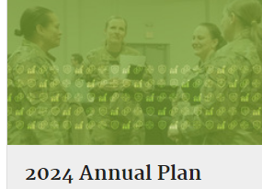
Financial Readiness Update
Outreach and Communications
LinkedIn Launch
DoD expanded its financial readiness community outreach efforts https://www.linkedin.com/company/dodfinred
Financial Considerations of PCS Podcast
Planned for April recording
April Financial Capability Month (FINCAP)
Media kit at https://community.apan.org/wg/finred-lrl/w/wiki_sr/39569/financial-capability-month/
July Military Consumer Month
Annual campaign in coordination with CFPB and FTC, plus interested stakeholders
Website Usability Studies
Card Sorting Study to determine taxonomy and updates
Reimagining content based on previous study results
30

Slide 31
Military Compensation Update
Pay Increases
Today’s military compensation package is robust and competitive. In 2024:
A new member (E-1 <4 months) earns more than $20/hour.
By the end of the 1st year as an E-2, this same member earns more than $25/hour.
By the end of year 3 the member is an E-4 and earning more than the median income of all U.S. workers.
By the end of year 4, when promoting to E-5, this member earns about the equivalent of U.S. median household income.
Military Basic Pay
Service Members received a 4.6% pay raise in 2023 and a 5.2% raise in 2024.
This equates to a 10 percent increase in basic pay since 2023.
With the 4.5% percent raise in 2025, members will have received a 15% increase since 2023.
Basic Allowance for Housing and for Subsistence
In 2023, members received an average 12.1% increase in BAH and another 5.4% increase in 2024. That’s more than an 18.1% increase in BAH rates in 2 years.
It’s been a similar story for BAS. In 2023 BAS went up by 11.2% and in 2024 by 1.7%. That’s a combined increase of over 13% the past 2 years.
31

Slide 32
Military Compensation Update
Basic Needs Allowance
Basics
A monthly taxable allowance for active-duty members with dependents. Implemented in January 2023.
Gross household income (GHI) must fall below 150% of federal poverty guidelines (FPG) for the household size and geographical area.
Members must apply and reapply at least annually.
Usage
Relatively few members qualify because majority of members receive military pay and allowances alone that place them well above 150% of FPG and eligibility is based upon household income.
Primarily benefits junior enlisted members with large families.
Way Ahead
DoD working to exclude Supplemental Nutrition Assistance Program (SNAP) benefits from GHI calculation.
 | Average Enlisted Grade | Average Household Size | Average Number of Months in Receipt | Average Monthly Payment
CY 2023 | E-4 | 8 | 4.25 | $1,511
32

Slide 34
Financial Well-Being Military Family Readiness Council 27 March 2024
ORGANIZATION: Deputy Chief of Staff, G-9

Slide 35
Agenda
Purpose: Army’s Best Economic Security Practices/Policies
Financial readiness within Integrated Primary Prevention
Economic security as a holistic approach (Army Response)
Conclusion and Recommendations

Slide 36
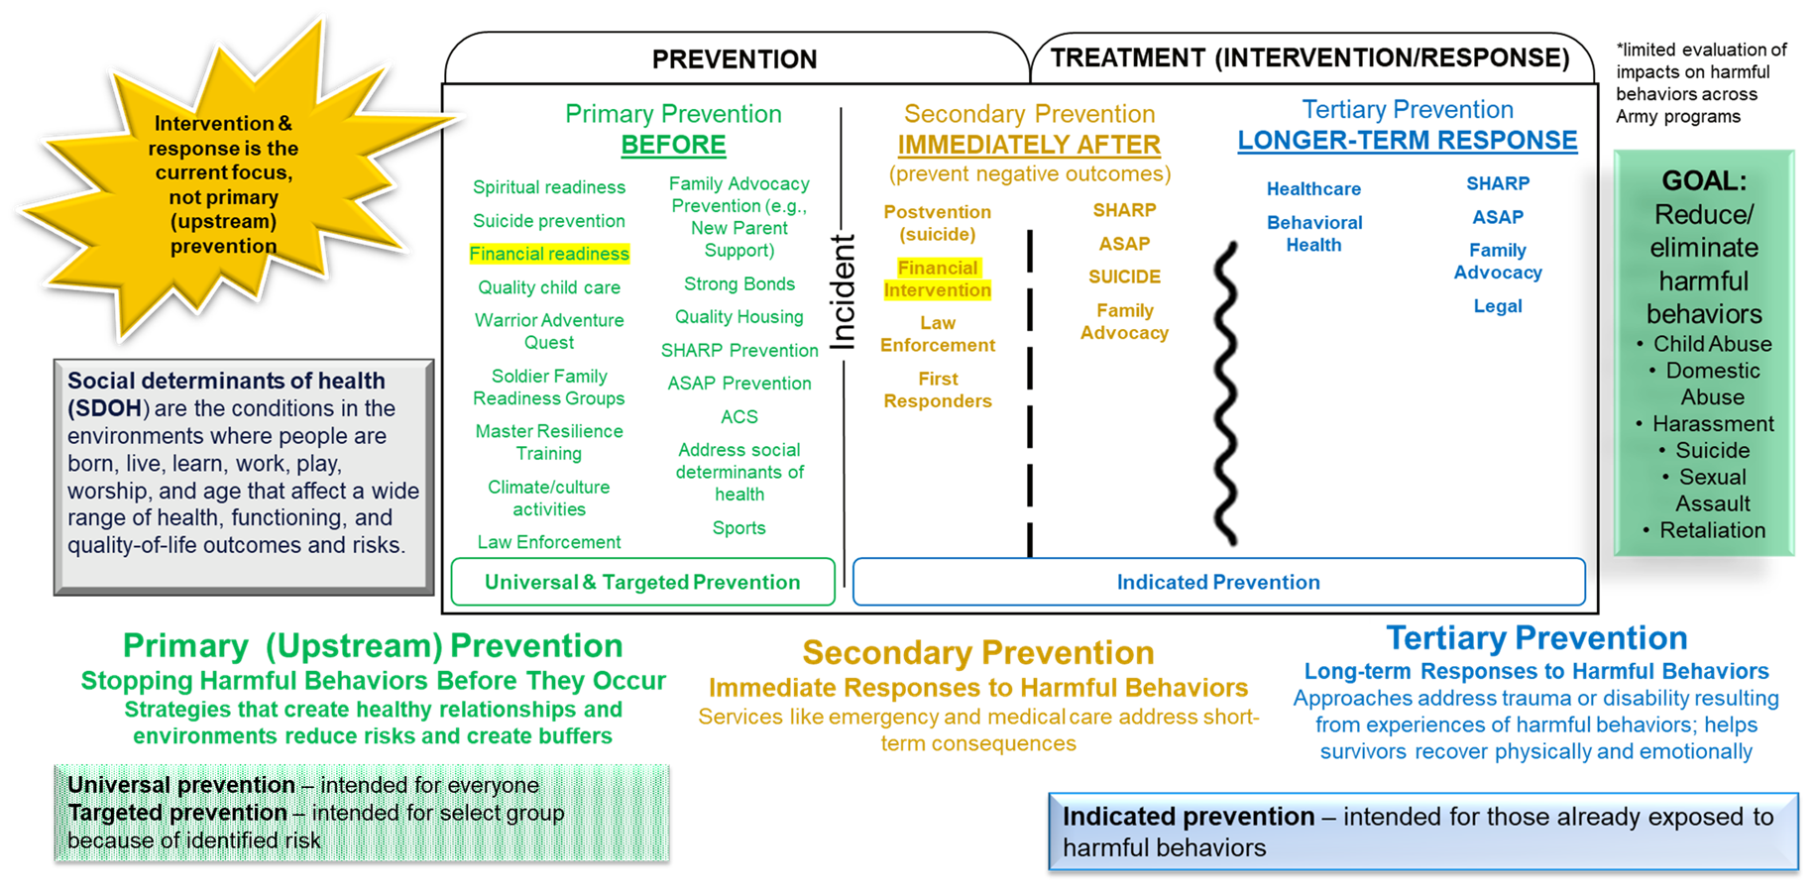
Financial readiness within Integrated Primary Prevention
DATE: 15MAR24

Slide 37
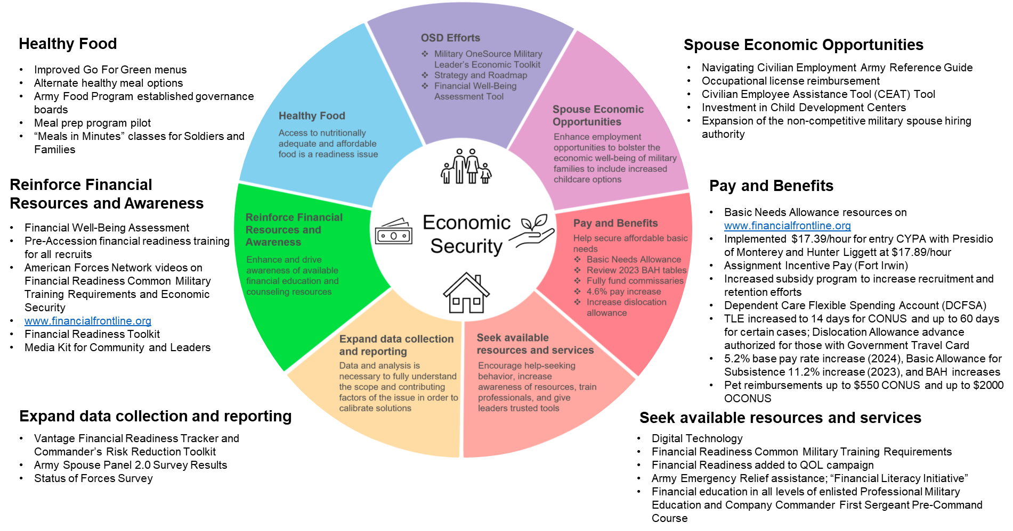
Economic security as a holistic approach (Army Response)
DATE: 15MAR24

Slide 38
Financial Well-Being Military Family Readiness Council 27 March 2024
ORGANIZATION: Deputy Chief of Staff, G-9

Slide 39
Military Family Readiness Tom Yavorski
Council Brief
Released by Family Readiness Program

Slide 40
Military Family Readiness
PAY & BENEFITS
ACCESS TO HEALTHY FOODS
Basic Needs Allowance screening and notification
Dependent Care Flexible Spending Accounts
Unaccompanied Quarters cooking appliances policy
Unaccompanied Quarters cookbook
Ashore Galley Grab & Go
Navy Exchange Micro Markets shore & afloat
Fleatery Food Truck and Outpost
Navy Exchange Student Meal Program
Navy Standard Core Menu Expansion
MWR & Navy Exchange installation initiatives
PAY &
BENEFITS
ACCESS TO HEALTHY FOODS
SPOUSE ECONOMIC SECURITY & CHILDCARE
Family Employment Readiness Program
Spouse Licensure Reimbursement
Spouse Engagement Sessions
Child & Youth Program Employee Child Care Discount
Expanding Child Care Enrollment Options Off-base
Navy Exchange Military Family Member Continuity Program
Navy Exchange Veteran Employment – Skillbridge
SPOUSE
ECONOMIC SECURITY & CHILDCARE
SEEKING RESOURCES
ECONOMIC
SECURITY
SEEKING RESOURCES
Fleet & Family Support Center Food Bank Directory
MyNavy Financial Literacy App
MyNavy Family App
Personal Financial Manager
Fleet & Family Support Center Economic Security Screening
DATA COLLECTION & REPORTING
FINANCIAL RESOURCES & AWARENESS
DATA COLLECTION & REPORTING
FINANCIAL RESOURCES & AWARENESS
Fleet & Family Support Center Economic Security Screening
Naval Post-graduate Study of Food Security
Navy Financial Readiness Program
Debt Destroyer Workshop
Million Dollar Sailor Course
Financial Readiness Touchpoint Training
Personal Financial Managers & Command Financial Specialists
Complex problem which requires integrated solutions

Slide 41
Military Family Readiness
Council Brief
Released by Family Readiness Program

Slide 42
DAF Food 2.0 Program
Overview
Performance Foods
Station Menu Variety
Feature 5-7 feeding stations
Contract Updates
High nutrient dense foods and less processed
Featured in both 2.0 and legacy operations
Scratch Cooking
Facilitates introduction of new menus such as plant-based & chef inspired offerings
Strengthening contract language to enhance Go for Green compliance
Highlighting nutrient vs. calorie dense foods
Food 2.0 Concept
Transforms Dining Facility (DFAC) servery area to university style feeding stations
Centrally managed Mission Essential Feeding Fund (MEFF) and contracts supported by Aramark & Sodexo
Expands access to DFAC to the entire installation
Increased access to healthy food
Operating hrs average 84 hrs/week (vs 42 hrs/week Legacy)
Campus Dining System (CDS) extends Essential Station Messing (ESM) entitlement to participating Nonappropriated Fund (NAF) Food & Beverage (F&B) outlets
Podsand Kiosks strategically located on or near flight line
Implemented at 28 installations/transitioning 5 bases in FY24/25
Holloman/Shaw/Offutt/Eielson/Luke

Slide 43
Military Family Readiness Council
Personal and Professional Readiness
Marine and Family Programs (MF)
Manpower and Reserve Affairs (M&RA)

Slide 44
ECONOMIC SECURITY - MAJOR AREAS OF FOCUS
Integrated Prevention Efforts
Incorporated financial assessments in Behavioral Programs (NPSP, FAP, SAP, CCP) to identify financial challenges
OPT with command and installation personnel to develop an Integrated Prevention and Response framework
Fosters cross collaboration across the enterprise
Shares data to better inform commanders of trends and opportunities for a more proactive approach to support
Spouse Employment
Initiated CDC Spouse Transfer program (180 spouses transferred)
Released MARADMIN 259-23 Hiring Authorities for Military Spouses….for Marine Corps NAF Positions
Working to add capability in HR system for spouse working in MCCS to identify new duty station prior to PCS
Training
Utilize MOL for notifications to Marines of required Financial Education Action Point (FEAP) training
Refreshed FEAP curricula and other training materials to meet new requirements in DoDI 1322.34
Updating the Personal Readiness Seminar to include scenario-based learning about finances and resources
Collaborating with other programs to incorporate financial training/information where appropriate
Communication/Messaging
Partnering with M&RA Divisions to ensure timely dissemination of information (e.g. BNA, Dependent Care Flexible Spending Accounts, access to healthy food)
Incorporated monthly financial information in the MF Strategic Communication Plan which includes a quarterly Prevention in Action newsletter
Partnering with Food and Hospitality to disseminate financial information in facilities (i.e. lodging)

Slide 45
Military Family Readiness Council
Personal and Professional Readiness
Marine and Family Programs (MF)
Manpower and Reserve Affairs (M&RA)

Slide 46
Department of Defense (DoD)
Military Family Readiness Council (MFRC)
A Federal Advisory Council -- Providing Independent Advice to SecDef Sponsored by USD(P&R) and Supported by ASD(M&RA)
March 27, 2024
Council Meeting
Please feel free to visit the MFRC webpage on Military OneSource (www.militaryonesource.mil)

