Slide 1

Deployment Support:
Thriving Throughout
Notes:
So what is Military OneSource? Many things to many people.
Military OneSource is your OneSource, available 24/7, providing information, resources and assistance for your best MilLife.
A community with a deep understanding of Military Life – powered by people with extensive training and experience in military culture.
It’s all about helping our entire community — service members and military families — take advantage of all the resources and services you have available, for the most positive and fulfilling military experience.
Today, we’re going to talk about how Military OneSource can help you maintain a mission-focus during deployment.

Slide 2
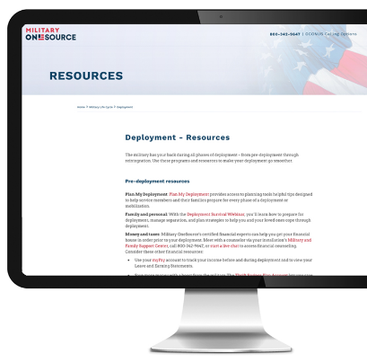
Resources to Help During Deployment
As service members and families face the realities of deployment, Military OneSource is there to help:
With the Plan My Deployment tool, find tasks and considerations, articles and resources dedicated to considerations from support groups to staying connected
Stay healthy with Military OneSource — access personal health and wellness coaching, resilience tools like CoachHub and Chill Drills
Get info and tips on staying strong
www.PlanMyDeployment.MilitaryOneSource.mil
Notes:
During deployment, service members and their loved ones face the realities of being separated. Military OneSource offers resources that can help service members stay focused and ready, maintain connections with loved ones and manage your physical and emotional health.
With the Plan My Deployment tool, you can find a section with tasks and considerations, articles and resources dedicated to during-deployment considerations
• Get ideas for staying connected to loved ones
• Check OPSEC guidelines to see what information you can – and cannot – share
• Learn how to make the most of your rest and recuperation leave with travel discounts and more
• Find financial aid if a money emergency arises at home
To access Plan My Deployment, go to www.PlanMyDeployment.MilitaryOneSource.mil
Access personal health and wellness coaching
Military OneSource offers personal health and wellness coaching for service members and their family members.
Get resilience tools like CoachHub and Chill Drills
Help you maintain a positive attitude during deployment and beyond. (We’ll dive into these resilience tools in the next slide.)
Get info and tips on staying strong
Our website has articles with practical tips for staying strong
Let’s look more closely at some specific resilience tools and then dive into additional resources available through Military OneSource.

Slide 3
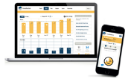


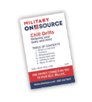
Resilience Tools and Products for Your MilLife
MoodHacker
Don’t let stress rule your life. This self-management tool helps
you track and improve your mood.
CoachHub
Personal online coaches help you manage stress and reach goals with online support.
Love Every Day
Rekindle the romance. Text messages encourage couples to connect in a fun and meaningful way.
Chill Drills
Reduce stress and improve resilience with simple exercises that lower your blood pressure.
Notes:
Military OneSource offers resources to help service members and their families remain resilient through the deployment cycle. Here are a few resilience tools for you to try out - even during deployment:
MoodHacker is scientifically-tested and evidenced-based. You enter your activities and mood levels throughout each day, and MoodHacker tracks and compares activities to help you understand which activities boost your mood and which ones drag you down.
You can use this tool for as long as you like. It:
Provides charts to show your top mood-boosting and mood-lowering activities
Reminds you of new activities to try to lift your mood
Offers access to a library of activities proven to increase your happiness
CoachHub This is different from the health and wellness coaches we mentioned. If you don’t have time to meet up with a coach at a specific time, CoachHub may be the coaching experience for you.
You can communicate through the interactive website when you have time and the coach will respond when they are online. Topics that coaches address include:
Physical fitness testing
Nutrition
Weight loss
Stress reduction
You select your coach through a listing that matches coaches with the goal you are trying to achieve. Coaches will help you stay on track to meet your goals, by:
Making appointments
Posting answers to your questions
Viewing your progress
Holding you accountable for each step you say you are going to take toward your goal
Setting alerts if you start to decrease your efforts or reverse direction
Love Every Day texts you and your partner a question each morning for 21 days. You both respond when it’s convenient and you’ll be notified when your partner’s answer is ready to view. Love Every Day helps you get to know your partner better, learn new ways to show your love for each other, and discover “did you know” facts about relationships. It’s a fun way to create a new normal for your relationship.
Chill Drills
Chill Drills are available as audio files on the Military OneSource website. Click “Products” in the website footer – it’s the first link under “Quick Access” – then search “Chill Drills” to view available exercises. Different drills help you:
• Become focused, calm, relaxed and alert
• Fall asleep
• Release stress
• Ease back pain

Slide 4
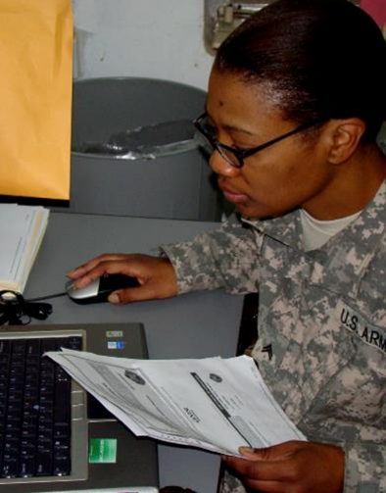
Manage Your Finances from Anywhere
We can connect you to financial services including:
MilTax e-filing software and phone support from trained tax consultants for easy tax prep and filing
Better budgeting with MyPay
Free financial counseling in-person, by phone or video.
Calculators for loans, investments and more
Information on benefits and savings options
Emergency financial assistance
Resources like podcasts and videos to help you make the most of your money
Notes:
Military OneSource offers counseling, tools and educational materials to help you mange your money wisely during deployment.
MilTax easy-to-use tax preparation and e-filing software and trained tax consultants to help by phone
MyPay tells you how much you’re earning so you can budget accordingly
• Easily access MyPay to see how your earnings are different while you’re deployed
• Get advice from financial counselors on how to allocate special and incentive or family separation pay
Free financial counseling in-person, by phone or video.
Specialized counseling from on-staff, accredited financial counselors, available in person and by phone, can help you address:
• Budgeting
• Credit-card debit management
• Foreclosures and mortgages
• Identity theft
• Permanent change of station housing issues
Financial calculators help you run the numbers on loans, investments and more
Financial calculators can help you in many aspects of financial decision-making so you can answer questions like:
• Should I refinance?
• How much car can I afford?
• Should I rent or buy?
• What will my investment be worth in the future?
• How long will it take me to pay off my loan?
• Should I consolidate my loans?
• How long will my retirement savings last?
Information on benefits and savings options like the Savings Deposit Program and Thrift Savings Plan
Read articles or talk to an expert to learn about special savings plans and programs available to service members like the Savings Deposit Program and Thrift Savings Plan and how they can help you meet your financial goals.
Connections to emergency financial assistance
Different organizations help each branch’s service members and families when they face times of financial hardship – Military OneSource can put you in touch with the organization/s that can help you.
Resources like podcasts and videos teach you how to make the most of your money
• Deployment pay podcasts explain deployment pay considerations for single service members and those supporting families on the homefront
• In addition to one-on-one support, Military OneSource has videos, articles, booklets, recordings and other materials that explain your options to help you make advantageous financial decisions during deployment

Slide 5

Holding Down the Homefront
Military OneSource helps MilSpouses when their partners are deployed:
Take advantage of our financial counseling
Make use of Spouse Education and Career Opportunities
Tap into counseling and specialty consultations on topics like relationships, health and wellness, caregiver support and more
Find stress relief and resilience tools
Connect with the Blog Brigade
Access resources and ideas for helping kids through deployment
Notes:
Deployment is a demanding time for everyone. Military OneSource can help.
Manage money using helpful articles and financial calculators or by talking to financial counselors
Milspouses can also make use of all of Military OneSource financial resources, from filing taxes to finding a job – Military OneSource can connect you with SECO (Spouse Education and Career Opportunities)
Make use of specialty consultations on topics like health and wellness, education for special needs students, eldercare and more
Find stress relief and resilience tools
• The resilience resources mentioned earlier aren’t just for service members. These tools like, Love Every Day and Moodhacker, can also help MilSpouses maintain personal resilience and interpersonal connections throughout the deployment journey.
Connect with the Blog Brigade
• Read stories from other military spouses
• Learn how they handle the difficulties of deployment and other parts of MilLife
• Get tips, tricks, ideas and reassurance from people who have experienced deployment
Access resources and ideas for helping kids through deployment
• Get advice on how to talk to kids about deployment extensions
• Find activities, youth groups and other happenings around your home installation to keep kids active and engaged
• Get ideas for helping kids stay connected to the parent who is deployed

Slide 6

Resources to Keep Kids and Teens on Course
Military OneSource connects parents to help through deployment:
Information, articles and tools for parents
Youth programs to keep kids active and connected
Resources for locating and affording childcare
MilitaryINSTALLATIONS for programs and facilities at your installation
Notes:
Military OneSource has tools to help make deployment easier for kids and teens.
Info for parenting through deployment
• Access “Over There” books that help explain a parent’s absence
• Find “Military Youth Coping with Separation,” a video program designed to help older adolescents and teens cope with their feelings in healthy ways
• Access Sesame Street’s “Talk, Listen and Connect,” which follows Elmo’s experience as his father deploys and returns home Young kids can relate, and parents can extract useful language to turn to when discussing tough topics
• Find other multimedia materials that help kids deal with deployment
• MilParent Power tips for upping your parenting skills
• Read actionable tips that help you connect with your kids in a positive way
Youth programs to keep kids connected
• Help your kids connect with other military kids in similar situations for socializing and support, through online forums and face-to-face groups
Resources for finding and affording childcare
• Military OneSource offers many resources including child care locators and articles on how to choose a caregiver. Extra help can keep regular routines on track during deployment
A list of programs and facilities your installation offers: MilitaryINSTALLATIONS
• Find fun activities and hobbies to try at your home installation

Slide 7
Support When and Where You Need It
Military OneSource is here 24/7 with:
Confidential non-medical counseling
Tips for self-care and staying positive
Support in maintaining relationships
Do’s and don’ts of communicating information about deployment
Help with preparing for reunions and reintegration
Notes:
Military OneSource is here 24/7 to support service members and their families with:
Confidential Non-medical Counseling
• Non-medical counseling is available in-person, via telephone, live video or online chat, no matter where you are.
• Secure, live video sessions make it convenient to schedule time with a non-medical counselor from anywhere in the world
• Spouses or service members can get counseling alone or in sessions together
Tips for self-care and staying positive
• Access to Morale, Welfare and Recreation programs
• Online resilience tools and resources
Maintaining connections and relationships
• Ideas for different ways to stay in touch and maintain relationships
• Tips for productive and satisfying conversations
Do’s and don’ts of communicating information about deployment
• Find crucial quick-reference information about what you can and can’t say and what kind of information could be sensitive
• Families can see a list of people who can give you information and updates about their service member
Guidance on planning for reintegration
• Learn what to expect during different stages of reintegration
• Read about common points of tension and how to navigate them gracefully
Connect with us by calling 800-342-9647 or head to www.MilitaryOneSource.mil for personalized support.

