Slide 1
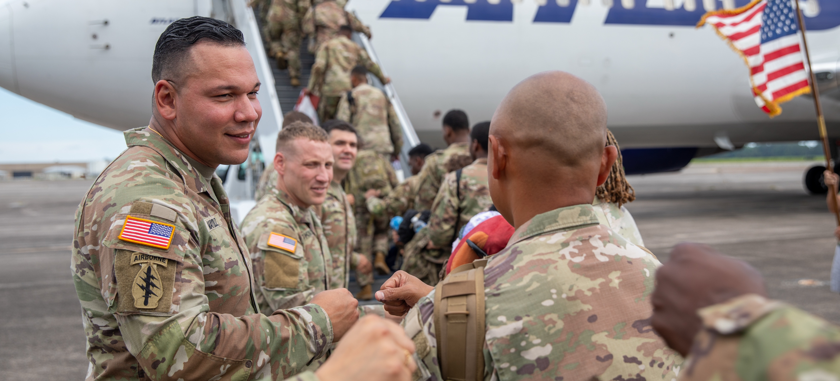

Deployment Support Overview
Notes:
So, what is Military OneSource? Many things to many people.
Military OneSource is your OneSource, available 24/7, providing information, resources and assistance for your best MilLife.
A community with a deep understanding of military life – powered by people with extensive training and experience in military culture.
It’s all about helping our entire community – service members and military families ‒ take advantage of all the resources and services you have available, for the most positive and fulfilling military experience.
Each phase of a military deployment is unique. Today, we’re going to talk about how Military OneSource can help you prepare for all phases of deployment.

Slide 2
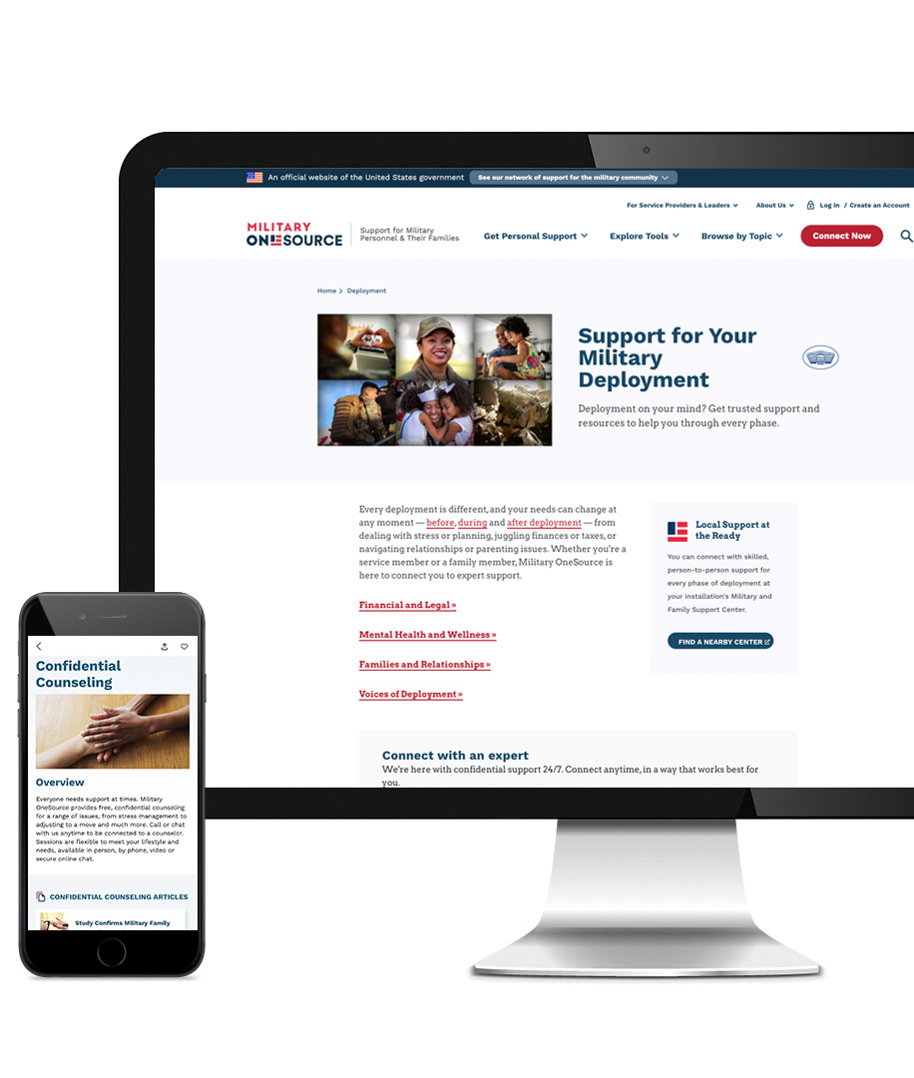
Resources for Every Phase of Deployment
Preparedness is key to deployment readiness for both service members and their families. Use Military OneSource tools and support to plan ahead and reduce complications:
MilitaryOneSource.mil helps you understand your benefits and resources.
Plan My Deployment Checklists keep you organized during each phase of deployment with clear and actionable steps and direct links to
helpful resources.
24/7 personal support is available through the Military OneSource contact center. Call or live chat to connect to resources for managing stress, finances and more.
MilitaryINSTALLATIONS quickly connects you to your installation’s Military and Family Support Center and other local programs, resources and services to support you and your family during deployment.
Notes:
A successful deployment begins with getting ready for your mission AND getting the homefront ready for your absence.
Military OneSource can help.
The Military OneSource website has information about benefits and resources.
• Explanations of your benefits and protections under the Servicemembers Civil Relief Act
• Information about eligibility for other benefits
• MilLife Guides with tips to ease the challenges of deployment
• Webinars to help you and your family get ready
Plan My Deployment Checklists offer tasks and considerations, resources, information and tips for success.
• Information about every phase of deployment
• Checklists, guidelines and worksheets for you to tackle before you ship out
• Tips to ease challenges during deployment
• Access to programs and organizations designed to help service members and their families throughout deployment and reintegration
Military OneSource confidential help gives you 24/7 access to expert support.
• Military OneSource can connect you with free legal assistance for appointing a power of attorney or updating a will.
• Military OneSource offers free access to confidential counseling. It’s available for all service members and their families, all over the world.
• Call 800-342-9647 or get help via live chat at www.MilitaryOneSource.mil.

Slide 3
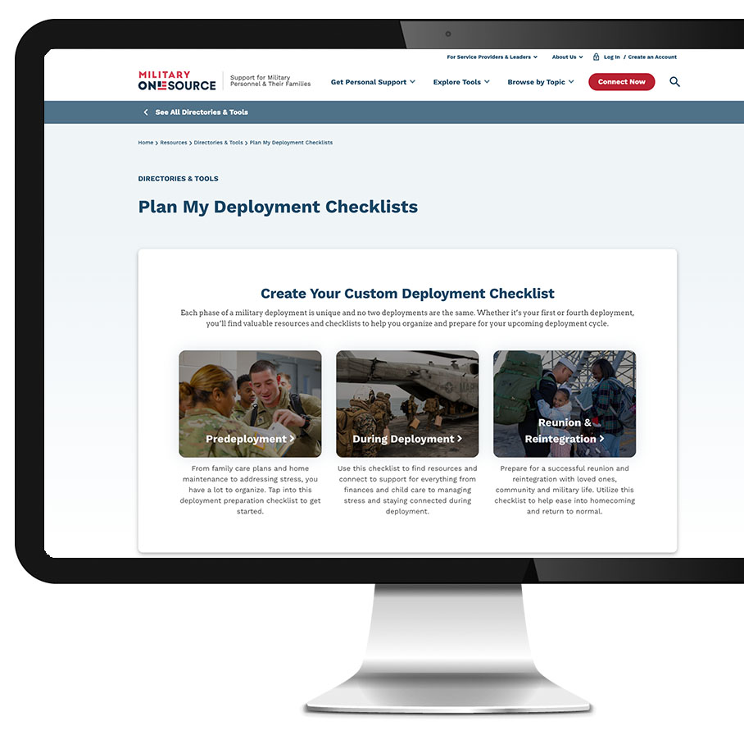
Plan My Deployment Checklists
Stay organized with clear and actionable steps before, during and after deployment — for service members and their families.
Create customized tasks for everything from communication planning to securing pet care.
Find expert tips to help you get legal, financial and family affairs in order.
Access helpful resources like MyPay, the TRICARE Beneficiary Enrollment area and branch-specific support programs.
Get information and connect to expert support services, such as confidential counseling and peer-to-peer support.
Plan for a successful reunion and reintegration.
https://www.militaryonesource.mil/resources/tools/military-deployment-checklists/
Notes:
Plan My Deployment Checklists were built to help service members and family members before, during and after deployment.
Predeployment Checklists
See a list of tasks and considerations such as setting up auto pay for bills and securing storage for your vehicle.
Download a home maintenance checklist and an auto maintenance checklist.
Get expert guidance to get legal, financial and family affairs in order.
Easily navigate to resources such as MyPay, where you access your leave and earning statements or the TRICARE Beneficiary Enrollment area.
During Deployment Checklists
Find resources and connect to support for everything from finances and child care to managing stress and staying connected during deployment.
Check OPSEC guidelines to see what information you can, and cannot, share.
Learn how to make the most of your rest and recuperation leave with travel discounts and more.
Find financial aid if a money emergency arises at home.
Reunion and Reintegration Checklists
Prepare for a successful reunion and reintegration with loved ones, community and military life.
Get an overview of what to expect during reintegration.
See tips on adjusting to changes in home life.
Access legal help revoking powers of attorney.
Access the Plan My Deployment Checklists at https://www.militaryonesource.mil/resources/tools/military-deployment-checklists.
OR, from the Military OneSource website select “Deployment” under the “Browse by Topic” tab on the homepage. You’ll find a link to Plan My Deployment Checklists from each of the deployment categories: Preparing for Deployment, During Deployment and Returning Home From Deployment.

Slide 4
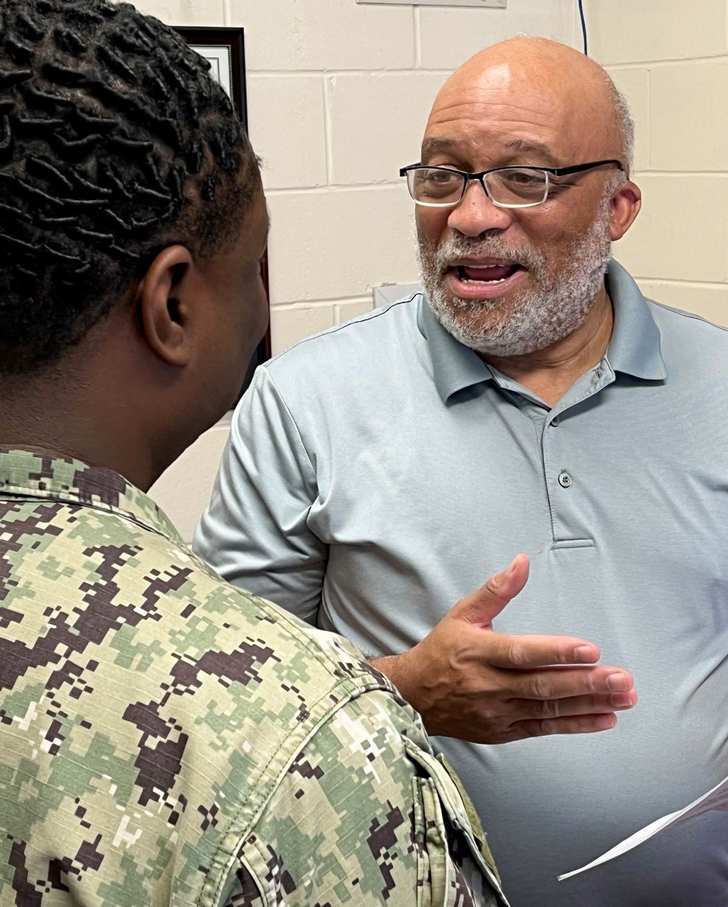
Ease Deployment-Related Stress
Free resources from the War Department can help you manage deployment-related stress in healthy ways:
Confidential counseling from Military OneSource and the Military and Family Life Counseling Program can help you navigate stress, adjust to change, strengthen relationships and more.*
Peer-to-peer counselors can address your deployment concerns and share preparation strategies and self-care tips.
Notes:
Military OneSource offers free support, resources and tools to help service members and their families remain resilient through the deployment cycle.
Military OneSource confidential counseling is available in person, by phone, secure video sessions or secure online chat.
The Military and Family Life Counseling Program provides free, confidential counseling to service members, their families and survivors on or near installations. MFLC is not available on Coast Guard installations, so Coast Guardsmen and their family members receive counseling through Military OneSource.
Personal health and wellness coaching will help you reach fitness goals, help with life transitions, manage stress and more.
Chill Drills are audio exercises that help you become focused, calm and relaxed. Find Chill Drills at https://www.militaryonesource.mil/chilldrills.
Love Every Day is a digital app that texts you and your partner a question each morning for 21 days to encourage connection in a fun and meaningful way. Access it through https://www.militaryonesource.mil/benefits/love-every-day.
Info and tips on managing stress
The Military OneSource website has articles and guides with practical tips for staying strong.
*Coast Guardsmen and family members receive confidential counseling through Military OneSource.

Slide 5

Get Money Matters Squared Away
Counseling, calculators and educational materials help you master your finances.
Meet with financial counselors in person,
by phone or video to reassess your finances and budgets.
Prep and file your taxes online with Military OneSource MilTax services and e-filing software.
Learn about eligibility for special pay and the Savings Deposit Program.
Understand how the Servicemembers Civil Relief Act applies to you for smart choices concerning housing and property.
Get help adjusting to your return to employment after deployment (for members
of the Guard and reserve).
Notes:
Military OneSource offers counseling, calculators and educational materials to help you get money matters squared away and manage your finances.
Financial counselors can help you reassess your finances and budgets.
• Find out how your pay will change when you’re deployed.
• Get expert guidance regarding pre and postdeployment financial decisions.
• Learn about the financial assistance programs available to service members and their families.
• Schedule confidential financial counseling by calling or live chatting with Military OneSource. Counseling sessions can be in person, by phone or video to help with budgeting and more.
MilitaryOneSource.mil also has calculators to help you crunch numbers for buying or renting, refinancing, investing, retirement, saving and other financial matters.
**Reserve and National Guard service members should be especially attentive to pay changes since their active-duty pay rate could differ significantly from their civilian salary.
Take command of your taxes with free Military OneSource MilTax.
• Made for the military life. Easy-to-use tax preparation and e-filing software.
• Prepare and file your federal and up to five state returns.
• Trained tax consultants to help by phone.
Information about eligibility for special pay and the Savings Deposit Program.
• Learn about special savings plans and programs available to service members and how they can help you meet your financial goals.
• Get information on how to allocate special and incentive or family separation pay.
Tips explaining how the Servicemembers Civil Relief Act applies to you so you can make smart choices concerning housing and property.
• Understand your financial rights under the Servicemembers Civil Relief Act.
• Learn about your options for managing home and property leases; get help weighing the possibilities.
In addition to one-on-one support, you’ll find videos, articles, MilLife Guides, podcasts and other materials on the Military OneSource website that explain your options to help you make advantageous financial decisions as you prepare to deploy.

Slide 6

Support on the Homefront
Military OneSource offers 24/7 resources and support to military spouses through all phases of deployment
  Get helpful advice on transitioning into new routines and balancing solo parenting through new MilParent consultations.
  Learn about quality, affordable child care benefits and resources.
  Take care of your health and well-being with health and wellness coaching.
  Further your career goals with the Spouse Education and Career Opportunities program.
  Learn ways to connect with your community, tighten your bond with loved ones and reconnect after deployment with building healthy relationships consultations.
Notes:
Military spouses are eligible for the same support services, resources and tools as service members, including parenting support, resources to help you search for nearby child care, confidential counseling, health and wellness coaching, document and translation services and more. In addition, spouses can take advantage of:
The Spouse Education and Career Opportunities program*
• Explore career options.
• Learn about educational options and credential requirements.
• Network to find career opportunities.
• Get help from SECO career coaches.
*Coast Guard spouses may be connected to alternative career support resources.
Making home-life adjustments after deployment.
Sign up for a building healthy relationships specialty consultation and explore the Deployment topic center on MilitaryOneSource.mil.
• Learn what different stages of reintegration can mean for home life and routines.
• Get tips for understanding and addressing the conflicting emotions often experienced during reintegration.
Getting the most out of time off with travel discounts and on-base activities.
Check out the Recreation, Travel & Shopping topic center on MilitaryOneSource.mil.
• Learn about and access discounts on airfare, lodging, sporting events and other fun experiences.
• Get information about activities and programs happening around your home installation with MilitaryINSTALLATIONS.
Reconnect with each other using proven communication techniques.
Military OneSource provides a wealth of resources to help strengthen your relationships. See the Re the We page, https://www.militaryonesource.mil/relationships/married-domestic-partner/military-relationships-support/; sign up for a building healthy relationships consultation and visit the Relationships topic center on MilitaryOneSource.mil.
• Learn about balancing your time after coming home.
• Get tips for discussing tough topics.
• Learn how to talk about changes, needs and stressors with the people you care about.
• Use tips for rebuilding a loving and supportive partnership with your spouse.

Slide 7

Help Children and Teens Through Each Stage of Deployment
Connect with Military OneSource for smooth transitions.
Get tips and materials to help with communication, setting expectations and helping children prepare mentally and emotionally for each phase of deployment.
School liaisons help children cope during deployment by checking in on their well-being, connecting them with counselors or support groups and making sure parents, teachers and schools have the resources they need.
Military and Family Support Centers offer on-installation programs that help families and children manage the stressors of deployment, including after-school support through partnerships with Boys & Girls Clubs of America and 4-H.
Notes:
Military OneSource has information and tools to help make each phase of deployment easier for children and teens.
Info for parenting through deployment
Get ideas for spending quality time together before you deploy, staying connected during deployment and easing back into routines after deployment.
Access “Over There” books that help explain a parent’s absence.
Find Sesame Street for Military Families multimedia materials that help young children deal with deployment.
Read actionable tips that help you connect with your children in a positive way.
Military OneSource consultants can connect you with resources for a wide variety of topics
Youth programs to keep children and teens connected
• Help your kids connect with other military kids in similar situations for socializing and support through online forums and face-to-face groups.

Slide 8
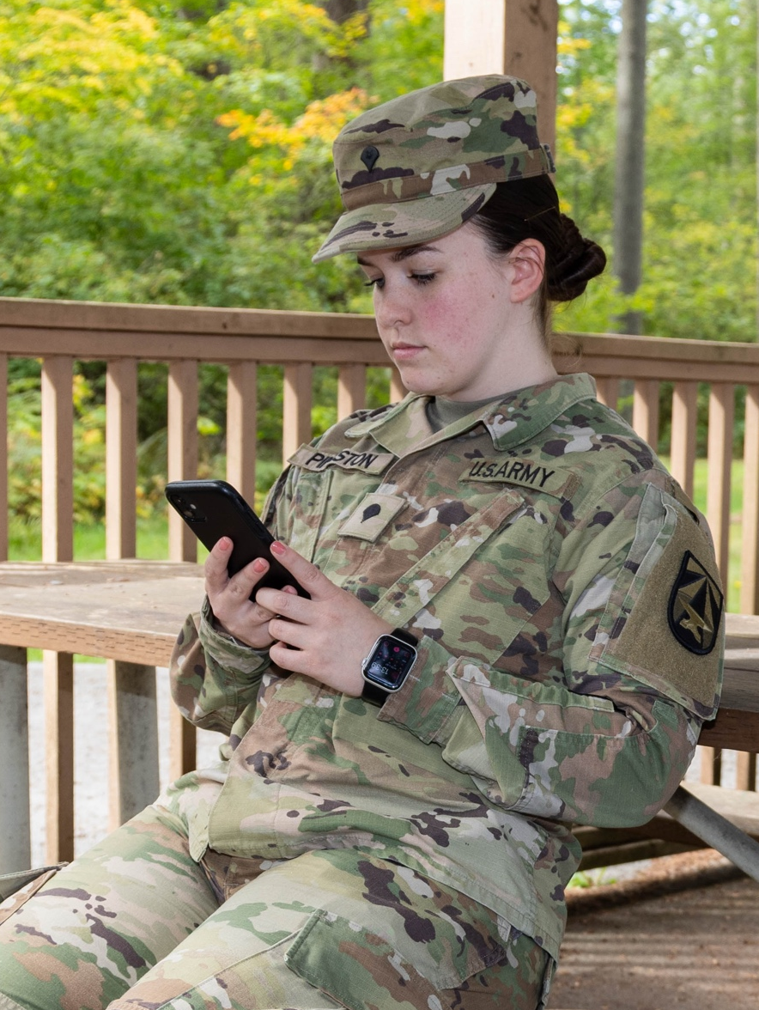


24/7 Support With Military OneSource Apps
Gain 24/7 access to powerful tools and help from the War Department — in your hands, anytime, anywhere.
Download the My Military OneSource app and quickly connect to support and personalized answers for you and your military life.
Digital resilience tools like Chill Drills and Love Every Day can help you manage your mood, strengthen your relationships, set goals and become more mission ready.
Notes:
Download the My Military OneSource app and connect fast to support and personalized answers.
The app features a homescreen that allows you to display your installation along with personalized benefits and resources.
Chill Drills is a free collection of simple audio mindfulness exercises created specifically for the military community.

Slide 9

Real Stories from Military Spouses
Check out the Blog Brigade where military spouses open up about their lives and share what they’ve learned along the way.
“All you can do is plan for the unknown, ride the emotional rollercoaster, and — if you’re like me — rely on coffee and salty humor.”
— Kristi
“We end every day with a prerecorded bedtime book to hear his voice as he tells us how much he loves and misses us, calling us each by name.”
— Tanecia
“… working through reintegration challenges doesn’t necessarily mean your relationship has long-term issues. It’s just another difficult stage in military life.”
— Lizann
Notes:
Blog Brigade brings you a range of experiences from those who’ve walked in your shoes.
Learn from military spouses about how they have managed each phase of deployment.

Slide 10
Support When and Where You Need It
Military OneSource is here 24/7.
Contact us whenever, wherever, by phone or secure
chat — for free, confidential support to help you and your family through every phase of deployment.
Notes:
We’re standing by, ready to serve you.
Military OneSource connects you and your family to that help with 24/7 support online and by telephone.
This free, confidential counseling can help you take charge and address issues that can come from stressors such as deployment and reintegration, parenting, relationship problems, loss and financial concerns.
Visit the Deployment Support Landing Page at https://www.militaryonesource.mil/deploy to connect with experts, access tools and explore services.
Military OneSource has support and resources to help make your deployment a success. Connect with us by calling 800-342-9647 or head to www.MilitaryOneSource.mil for personalized support.

