Slide 1


Financial and Tax Support
Staying Money Smart and Mission Ready
Notes:
Military OneSource is your one source, available 24/7, providing information, resources and assistance for your best military life.
Staffed by experts in military culture, we help you access the programs and services available to support your financial well-being.
Today, we’ll focus on how Military OneSource can help you take control of your finances.

Slide 2
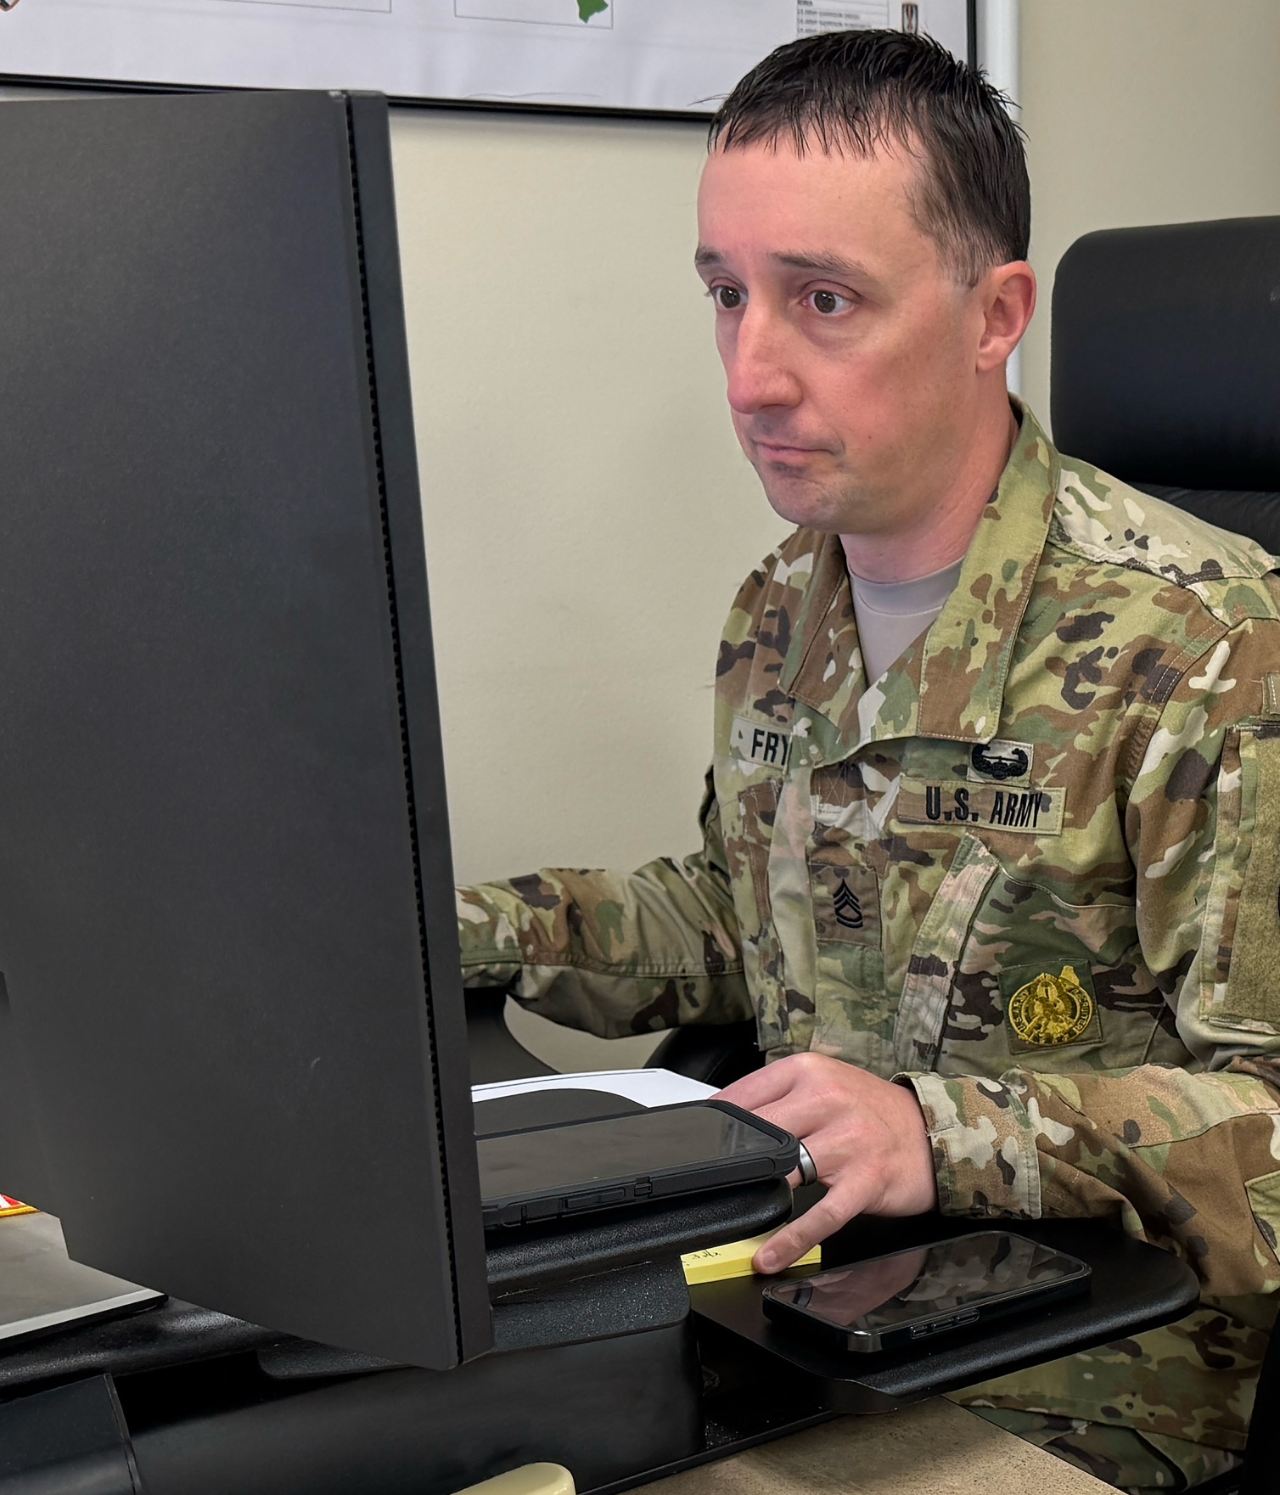
Information, Answers and Support
Get resources, information and support to take charge of your money and make better financial decisions:
Online articles and resources like financial calculators and fact sheets offering guidance on taxes, budgeting, financial planning, education financing
and more
Access to Certified financial counselors for sessions by phone or video
MilTax e-filing software for easy tax prep and filing
Access to Tax Consultants to answer your tax related questions
Notes:
When you’re financially stable, you can focus fully on your mission. Military OneSource offers a wide range of resources, information and access to experts who can help you make smarter financial decisions.
Online resources with information on taxes, financial planning and more
Learn about:
• Paying down debt, understanding good debt and bad debt
• The Blended Retirement System
• Avoiding identity theft
• And much more
Access:
• Calculators that help you crunch the numbers on purchases, investments and loans
Free consultations with financial experts
• One-on-one guidance from certified financial counselors.
Tax preparation and filing with free Military OneSource MilTax
• Made for the military life. Easy-to-use tax preparation and e-filing software
• Prepare and file your federal and up to five state returns
• Trained tax consultants to help by phone or video

Slide 3
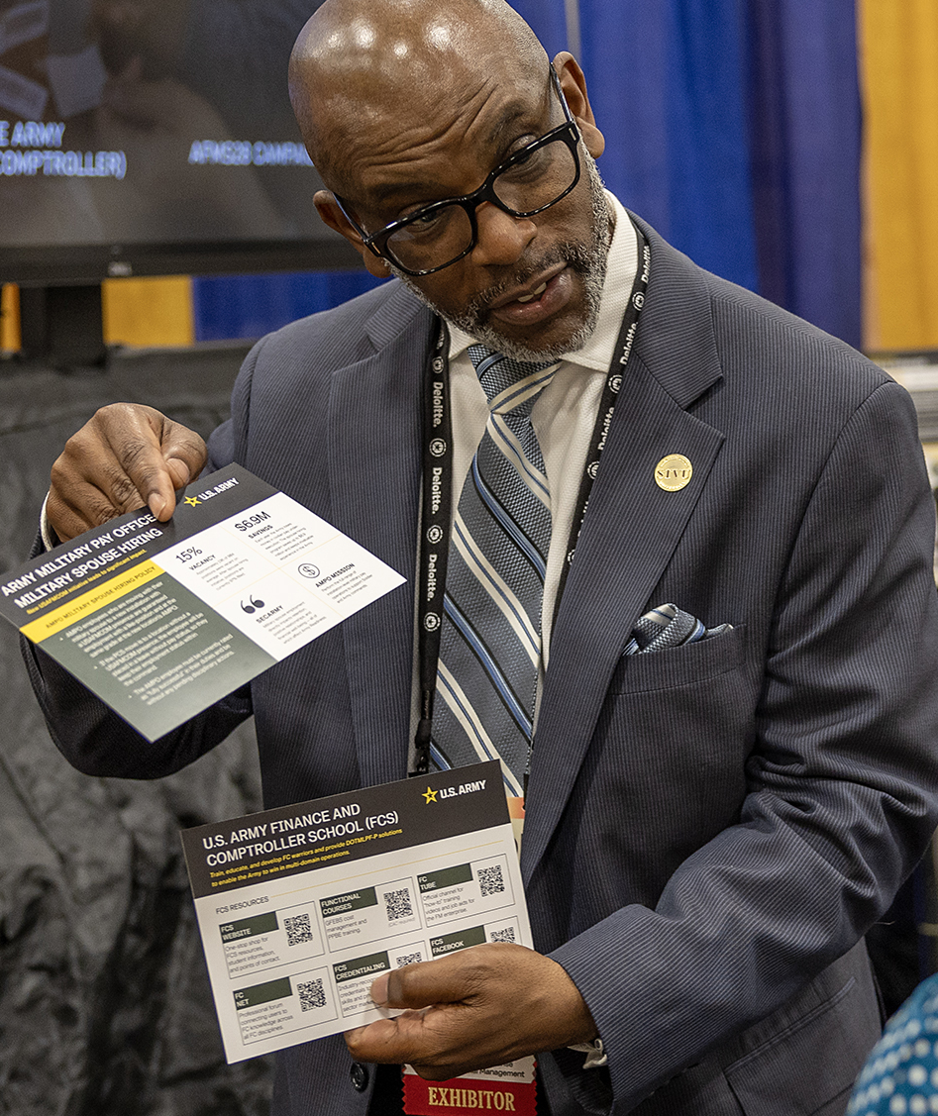
Connect With the Experts: Financial Counseling
Financial counselors can help you:
Set up a budget
Manage debt
Plan ahead
Maximize benefits
Free, confidential financial counseling is available— by phone or video. Call or live chat 24/7 to schedule an appointment.
Notes:
Whether you hope to get a handle on your finances in general or want to learn more about military-specific considerations and opportunities, our financial counselors can help you:
Set up a budget – Cover everyday expenses, plan for child care, save for big purchases and explore housing options
Manage debt – Resolve credit issues, rebuild credit, consolidate loans or negotiate with lenders
Plan ahead – Make informed choices about retirement, investments, insurance and education savings
Maximize benefits – Understand and use resources like the Thrift Savings Plan, Post-9/11 GI Bill, Servicemembers’ Group Life Insurance, and Servicemembers Civil Relief Act
Whatever your financial situation and goals, Military OneSource’s independent, certified counselors can help you understand and weigh options so you can make choices that are advantageous to you and your wallet.

Slide 4


MilTax: Built for Service Members and Families
Backed by the War Department and created exclusively for the military community, MilTax helps you:
File with confidence using software designed for the unique tax situations
of military life
Get free federal and up to five state
returns — no hidden fees, no surprises
Talk one-on-one with a tax professional trained in military-specific tax issues. Call anytime to set up a consultation or find a MilTax-approved Volunteer Income Tax Assistance office.
Notes:
Military OneSource MilTax is designed exclusively for our military community to take the hassle out of tax time. MilTax is tailored to military life and allows you to:
File with confidence
Handle deployments, combat pay and housing allowances
Account for PCS moves and multistate filings
Ensure military benefits and pay are filed correctly
File free
Submit one federal return and up to five state returns at no cost
File in multiple states with ease
Save money compared to commercial providers
Talk one-on-one with a tax pro
Speak with consultants trained in military-specific tax issues
Get guidance on combat zone extensions
Find support with Servicemembers Civil Relief Act benefits
Get help with unique situations like residency or multistate income
Access support
Schedule consultations anytime, through live chat or phone
Connect in person with consultants at installation-based VITA offices

Slide 5

Financial Resources at the Ready
MilitaryOneSource.mil offers tools, articles and MilLife Guides for financial well-being including:
Financial calculators for crunching
the numbers on investments, retirement and more
Links to programs that help with everything from financial aid to fraud
Explanations of benefits like basic housing allowance and VA loans
Podcasts that cover topics like budgeting, flexible spending accounts, managing finances during a PCS and more
Articles and MilLife Guides cover key financial topics in depth
Notes:
MilitaryOneSource.mil offers great resources for financial well-being including:
Financial calculators for crunching the numbers on investments, retirement and more
• Home finance: mortgages, rent vs. buy comparisons
• Personal finance (car loans, college savings, debt payoff)
• Retirement planning: compare savings scenarios, estimate income
• Investment (project savings growth and returns)
Links to programs that help service members with everything from financial aid to fraud
Find links to:
• MyPay: access pay and tax information
• Branch-specific resources: tailored financial tools per service branch
• Services that help with identity theft and fraud
• A summary of your financial entitlements under the Servicemembers Civil Relief Act
Explanations of benefits like housing stipends and VA loans
Understand financial benefits for service members like:
• The Post-9/11 GI Bill
• Housing stipends
• Thrift Savings Plans
• Servicemembers’ Group Life Insurance
• VA loans for housing
• The Savings Deposit Program
• The Blended Retirement System and more
Money management podcasts that cover paying down debt, avoiding scams and more
Learn best practices in a friendly format. Get information to help with:
• Paying down debt
• Creating a spending plan
• Repairing your credit
• Enhancing your financial stability
• Avoiding scams
Articles and MilLife Guides that cover key financial topics in depth
Budgeting and Saving - Create a financial plan, stick to your budget and save money with military discounts
Borrowing - Learn about loans, debt reduction and financial aid
Military Retirement - Explore the Blended Retirement System and TRICARE retirement options
Protecting Your Finances - Learn how to avoid scams and identity theft and read about financial benefits for service members
With these tools and resources, Military OneSource can help you make your MilLife a financially stable one.

Slide 6

Stay Connected and Take Charge of Your Finances
How to access Military OneSource financial support:
Access free, confidential financial counseling and resources from anywhere in the world
Call 800-342-9647 anytime or live chat at MilitaryOneSource.mil to set up counseling or find in-person support available at many installation-based offices
Visit the Military Financial & Legal Resources page to connect with
experts, access tools and explore valuable services
Notes:
Military OneSource is your go-to resource anytime you need financial guidance.
Military OneSource counselors are certified and understand military-specific financial situations.
You can get help with budgeting, debt, benefits and planning for the future.
You can call anytime to set up counseling or live chat on the website to schedule sessions.
You don’t need to worry about hidden fees — it’s completely free for service members and families.
Many installations also offer in-person support at VITA offices; perfect for those who prefer face-to-face guidance or have more complex questions.
Visit the Military Financial & Legal Resources page at www.militaryonesource.mil/financial-legal to connect with experts, access tools and explore services.

Slide 7

Questions?
Access our support when, where and how it’s convenient.
Call 800-342-9647 | Live Chat | My Military OneSource App
MilitaryOneSource.mil
Notes:
Does anyone have any questions?
[Let them know how long you will be around after the presentation and where they can find you if they think of a question they would like to ask later on.]
Direct additional questions to the Military OneSource call center at 800-342-9647.
[Point out the contact phone number and website to audience members and remind them to direct additional questions and concerns to a Military OneSource consultant through the call center.]

