Slide 1



Connecting you to your best MilLife
Notes:
Military OneSource puts a huge ecosystem of support at your fingertips. You can call or click anytime to connect.
Eligible service members and their dependents can call anytime, from anywhere to get personalized support, recommendations and referrals from a masters-level consultant.
Anyone, from service members' friends and extended family to military leaders and service providers, can click around the website and apps to discover tools, information, services and other support.
Whichever path you take, you'll find resources at the ready.

Slide 2
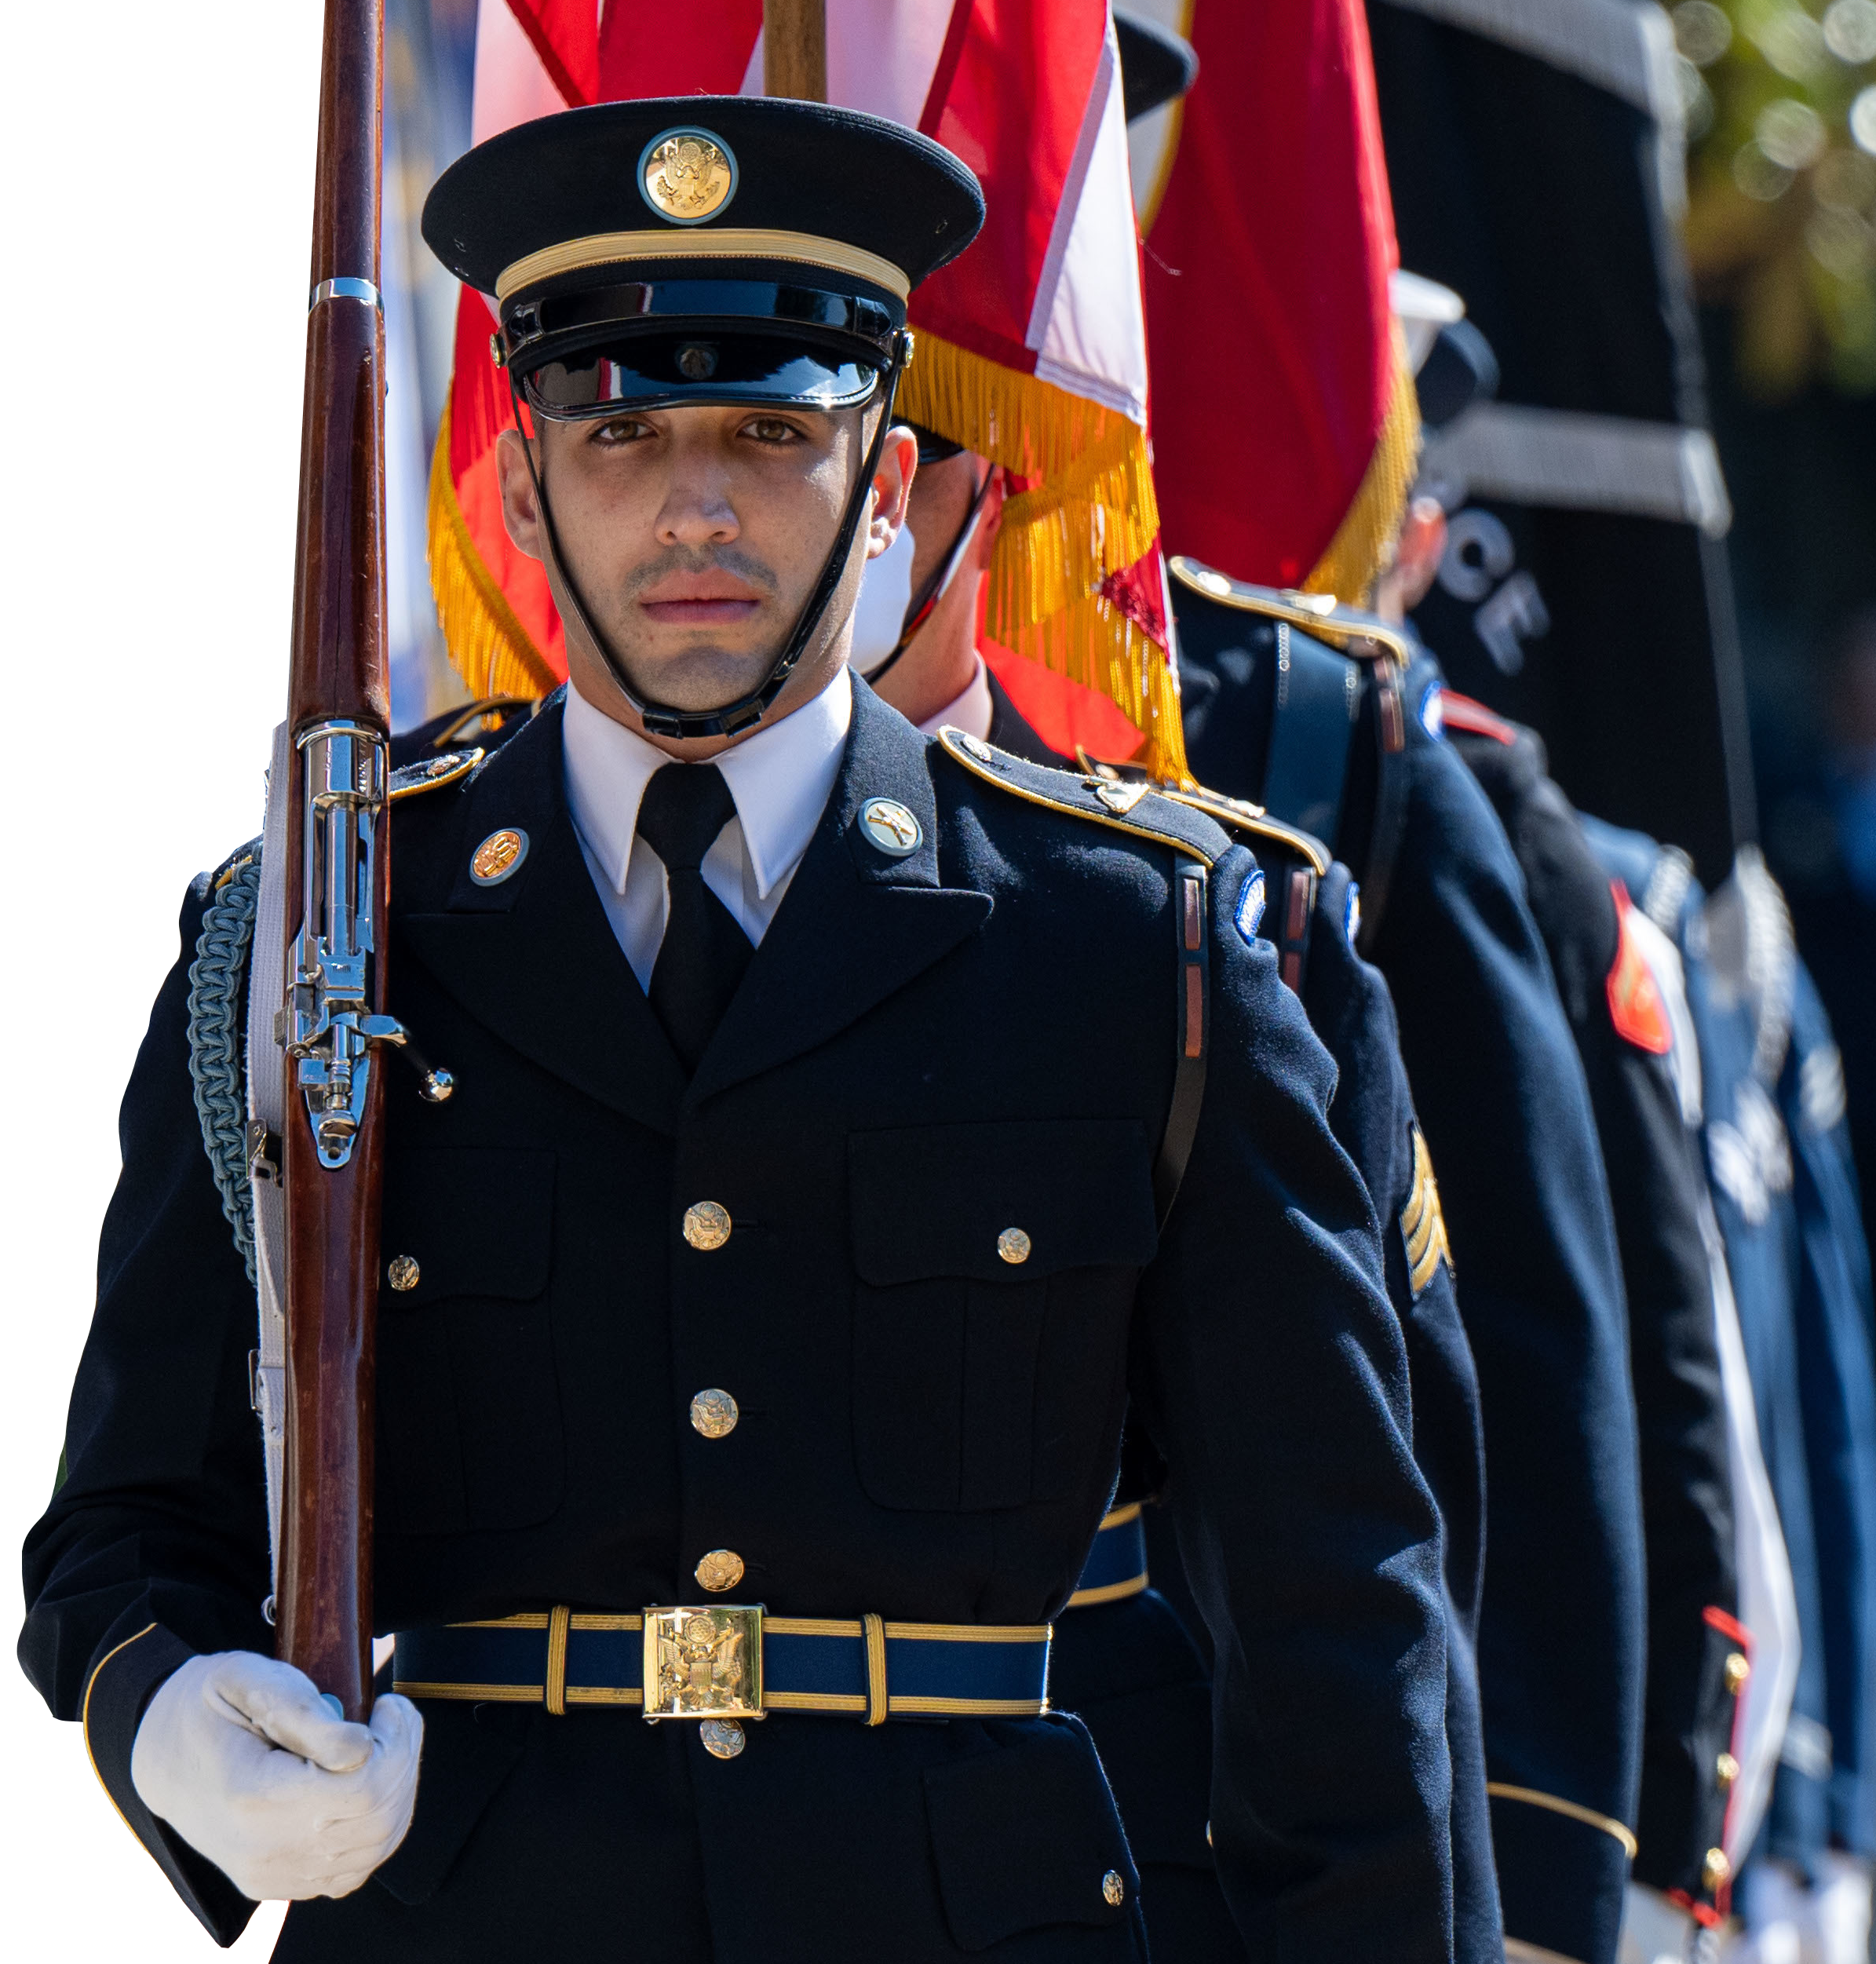
One Source for Our Military Community
Personal support is available for members of our military community including:
All active-duty, National Guard and reserve component service members, regardless of activation status
Immediate family members
Coast Guard when activated with the Navy
Expeditionary civilians, 90 days pre- until
180 days post-deployment
Retired or discharged, honorably or a general discharge, including Coast Guard veterans and their immediate family up to 365 days post separation or retirement
Survivors: non-remarried spouses and children
  Most digital resources are also open to service members’ friends and extended family.
Notes:
These groups are eligible for ALL Military OneSource services:
Active duty: All active-duty service members of the Army, Marine Corps, Navy, Air Force and Space Force
Active-duty immediate family members: includes spouses, children and anyone who has legal responsibility for the service member’s children during separation for the child’s benefit
National Guard and reserve service members and their immediate families: includes spouses, children and anyone who has legal responsibility for the service member’s children during separation for the child’s benefit
Coast Guard members who are activated as part of the Department of the Navy under Title 10 authority, as well as their family members
Designated Department of Defense expeditionary civilians and their families: includes spouses, children and anyone who has legal responsibility for the service member’s children during separation for the child’s benefit
Survivors (surviving spouses who have not remarried and children) of active duty, National Guard and reserve service members
Medically discharged service members and their immediate family members currently enrolled in their services’ wounded warrior or seriously ill and injured programs.
Retired service members until 365 days past end of tour of service, retirement date or discharge date, including service members on the Temporary Disability Retirement List. Coast Guard veterans and their immediate family are eligible from their separation date until 365 days past end of tour of service.
Discharged service members if discharged honorably, and their immediate family members, until 365 days past end of tour of service, retirement date or discharge date. Coast Guard veterans, if discharged honorably, and their immediate family are eligible from their separation date until 365 days past end of tour of service.
Military academy cadets.
Active-duty foreign military service members assigned to U.S. Army, Marine Corps, Navy, Air Force and Space Force installations who are registered in DEERS. Foreign military service members who have DOD-issued CAC with MWR/commissary/exchange privileges.
These groups are eligible for LIMITED Military OneSource support and services:
Parents and extended family members of active-duty, National Guard and reserve service members who need assistance with issues directly related to the service member or assistance on behalf of the service member
Reserve Officers’ Training Corps students
Delayed-entry recruits and future recruits and their parents and immediate family members seeking support directly related to or on behalf of the future recruit
Non-military/non-spouse (for example, partner or former spouse) who is the parent of an eligible child is eligible if the service member is being serviced under an injured soldier program as well as his or her immediate family, including anyone who has legal responsibility for a service member’s children during separation; eligibility extends to language translation services for documents and telephone translation

Slide 3
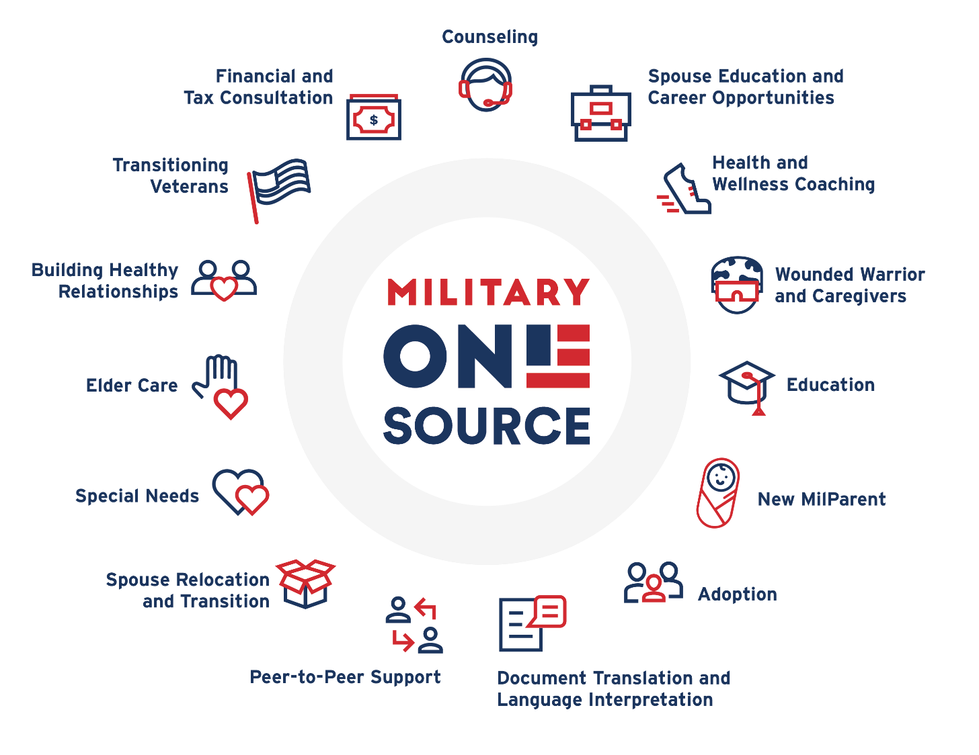
Military OneSource
Counseling
Spouse Education and Career Opportunities
Health and Wellness Coaching
Wounded Warrior and Caregivers
Education
New MilParent
Adoption
Document Translations and Language Interpretation
Peer-to-Peer Support
Spouse Relocation and Transition
Special Needs
Elder Care
Building Healthy Relationships
Transitioning Veterans
Financial and Tax Consultation
All these consultations and services are just a phone call or chat away. Need other support? We can connect you!
Notes:
Military OneSource connects service members and their families to a range of personalized support, individual counseling and consultations, coaching and counseling to help you live your best MilLife:
Counseling: For help managing life’s stressors.
Spouse Education and Career Opportunities: Career coaching, tools and information to gain meaningful employment.
Health and Wellness Coaching: Personalized support for your fitness, nutrition and well-being.
Wounded Warrior and Caregivers: Timely assistance for issues related to health care, benefits and more.
Education: Solutions from pre-K through grad school.
New MilParent: Support for parenting challenges for expectant parents and those with children up to age 5.
Adoption: Help navigating the adoption and foster care process.
Document Translation and Language Interpretation: Free language interpretation and document translation for qualifying documents.
Peer-to-Peer Support: Support from a peer consultant with firsthand knowledge of military life.
Spouse Relocation and Transition: Free, personalized support for every step of the process.
Special Needs: Answers about the care and education of your family member with special needs.
Elder Care: Resources to support service members and spouses caring for aging family members.
Building Healthy Relationships: Education-based consultation to strengthen your relationships.
Transitioning Veterans: Personalized support as you transition to civilian life.
Financial and Tax Consultation: Expert answers to your financial and tax questions.
This list is just a sampling of the different areas we can help with. Reach out or visit the website to explore more. Anyone who needs personal support on an issue not addressed here can still contact us – we can arrange to connect them with the right help.

Slide 4

What Is Confidential Counseling?
Free and confidential short-term counseling face to face, by phone, secure chat or video to address stressors like:
  Relationship issues
  Parenting stress
  Money troubles
  Isolation or loneliness
  Adjusting to a new community
  Decision-making
  Life changes or loss
Notes:
Confidential Counseling
Confidential counseling is free and confidential.
Military OneSource eligible participants can talk through challenges like the stress of deployment, relationship rough patches, adjusting after a move and more.
This support doesn't cover assault, abuse or addiction BUT those who need help can reach out to MOS for referral to appropriate resources.

Slide 5

Military and Family Life Counseling
Find free and confidential
in-person counseling at your installation’s Military and Family Support Center.
  Military and Family Life Counselors specialize in the challenges of military life
  Available for service members and their families
  Child and youth behavioral military and family life
  counselors support kids’ well-being
Notes:
The Military and Family Life Counseling Program supports service members, their families and survivors with confidential counseling worldwide.
Counselors are trained to work with the military community.
They offer face-to-face counseling services, briefings and presentations to the military community both on and off the installation.
Child and youth behavioral military and family life counselors:
Provide support to military children for a variety of issues.
Have a positive effect on general behavior, performance in school and relationships.
Work with kids to address:
Self-esteem issues
Communication and relationships at home and school
Life skills, such as problem solving and adjustment
Behavioral issues, including bullying and anger management
Changes at home, such as deployment, reunion, divorce and grief

Slide 6

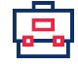

More Support for MilSpouses
Spouse Education and Career Opportunities
The SECO program provides military spouses free access to:
  Career and education coaching with
  mock interviews and resume reviews
  Scholarships and fellowships
  Networking opportunities
  Exclusive job opportunities
  through the Military Spouse
  Employment Partnership…
  and more!
Notes:
Spouse Education and Career Opportunities
SECO and its associated programs offer military spouses:
Free career and education coaching
Up to $4,000 in financial assistance toward a license, certification or associate degree
Job opportunities through the Military Spouse Employment Partnership
Other free resources and support for achieving goals (resume help, self-assessments, free memberships)

Slide 7
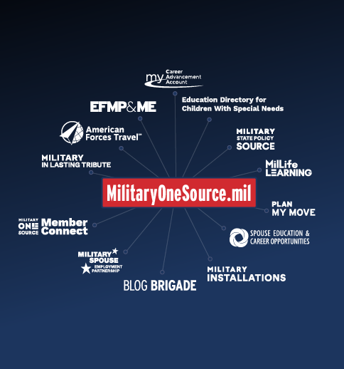



Digital Resources at the Ready
Find a digital hub of trusted information on a range
of benefits and tools. At your fingertips 24/7.
  Discover programs and
  services for travel, eLearning, moving, scholarships, job hunting, installation info, deployment and more
  Subscribe to eNewsletters
  about specific topics
  Download apps for fast access
Military OneSource
Notes:
Military OneSource connects service members and their families to a range of support for military life, including online tools and apps.
This list is a sampling of the different resources; reach out or visit the website to explore more.
Plan My Move
Users can answer a few questions and the Plan My Move tool will populate a checklist with information about the tasks they need to complete, and how and when to complete them.
MilitaryINSTALLATIONS
Helps service members and their families get to know a new location
Search by installation or program
Find contact information for different support programs – address, hours, phone number and more
See pictures of an installation and learn about resources in the surrounding community
Spouse Education and Career Opportunities
SECO and its associated programs offer military spouses free career and education coaching as well as other free resources and support for achieving goals (resume help, mock interviews, self-assessments, free tools and more)
Military Spouse Employment Partnership
Military spouses can find job openings and networking opportunities with employers committed to hiring, retaining and promoting military spouses
My Career Advancement Account
Military spouses might qualify for $4,000 in financial assistance toward a license, certification or associates degree through the My Career Advancement Account.
MilLife Learning
This online learning platform helps service members, their families, survivors and those who support them get key info about military life and support
Take courses at your own pace anytime, from anywhere.
Anyone with a slow internet connection can take select courses in Word format.
EFMP & Me
This online tool provides checklists, resources and referrals to help families enroll in EFMP and connect to support.
Blog Brigade
Military spouses can read about range of experiences from those who've walked in their shoes.
Education Directory for Children With Special Needs
Provides military families who have children with special needs the resources they need to make informed assignment decisions and experience easier transitions.
The Early Intervention Directory provides information on early intervention services for children birth through 3 years old.
The School-Age Directory provides information on special education services for children ages 3 through 21 years old.
My Military OneSource App
This free app helps users connect quickly and easily to support for navigating the MilLife.
Anytime, anywhere support for well-being and resilience.
Users can quickly connect with someone who can help them via live chat, or schedule an online consultation.
MilProvider
This mobile app makes it easy for military service providers to find and share resources, products and materials with the people they support.
Chill Drills
This mobile app offers a free collection of simple audio mindfulness exercises to relax the body and mind.
eNewsletters
Get curated intel in your inbox:
Military OneSource eNewsletter - updates and information highlighting timely issues, events and resources that matter most to service members and their families.
Friends & Family Connection eNewsletter - written specifically for the friends, extended family and loved ones who make up a service member’s support network; includes useful insights and information about all aspects of military life.
MilProvider eNewsletter - designed for military service providers and leaders; provides information, resources and tools to support their work on behalf of the military community.
Spouse Education and Career Opportunities eNewsletter - provides updates and information highlighting timely issues, events and resources for military spouses.
The Exceptional Advocate eNewsletter - for military families with special needs and those who support them; focuses on updates and information from the Exceptional Family Member Program.
The Survivor Connection eNewsletter - for those survivors whose loved one died while serving on active-duty status; provides resources, tools and information about sources of support.

Slide 8
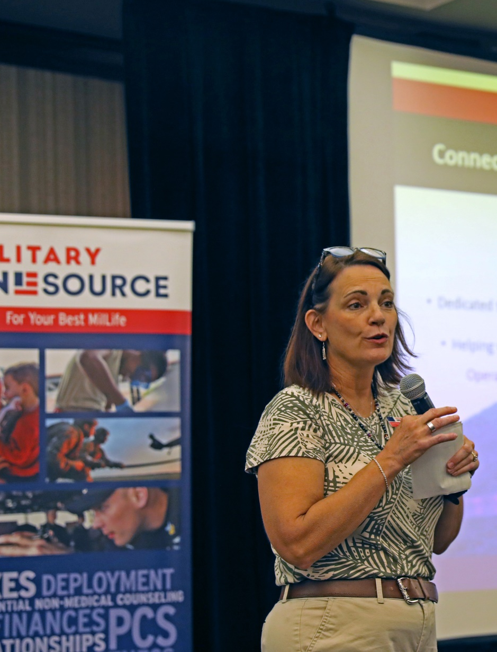
Need more info? Let us help!
Military OneSource state consultants are here to help support your outreach. They can:
  Provide presentations in person
  or host webinars
  Talk about a variety of topics
  tailored to your community
  Dive into details about benefits, services and resources
State consultants have a vast range of experience in military life. You can request a visit or presentation at:
supportrequest.militaryonesource.mil
Notes:
Anybody in the military can request support from state consultants at no cost: service providers, leaders, communities that serve the military. To learn more or request support, go to BOSS, the Business Operations Support System at support request.militaryonesource.mil

Slide 9


Access our support when, where and how it’s convenient.
Call 800-342-9647 | Live Chat | My Military OneSource App
MilitaryOneSource.mil

