Slide 1


24/7 Personalized Support and Resources
Notes:
If you haven’t explored Military OneSource, now’s the time to discover this world of assistance all in one place and at your fingertips.

Slide 2



24/7 Connection to Information, Answers and Support
Military OneSource:
Helping you take full advantage of
all the benefits and resources you
have available
A single source of information
and assistance for service members, military spouses, families
and survivors
Private, discreet, individualized support
Free, tailored, confidential
Trustworthy information and resources — from the War Department
www.MilitaryOneSource.mil • 800-342-9647
Notes:
So, what is Military OneSource? Many things to many people.
Military OneSource is your one source, available 24/7, providing information, resources and assistance for your best military life.
A community with a deep understanding of military life – powered by people with extensive training and experience in military culture.
It’s all about helping our entire community — service members, military spouses, families and survivors — take advantage of all the resources and services you have available, for the most positive and fulfilling military experience.
A single source of information and assistance for service members and military families alike – because families are critical to readiness.
We offer private, discreet, individualized support through confidential counseling and consultations.
Our services are no cost and tailored to the situation
Our information and resources are trustworthy, because they come from the War Department

Slide 3
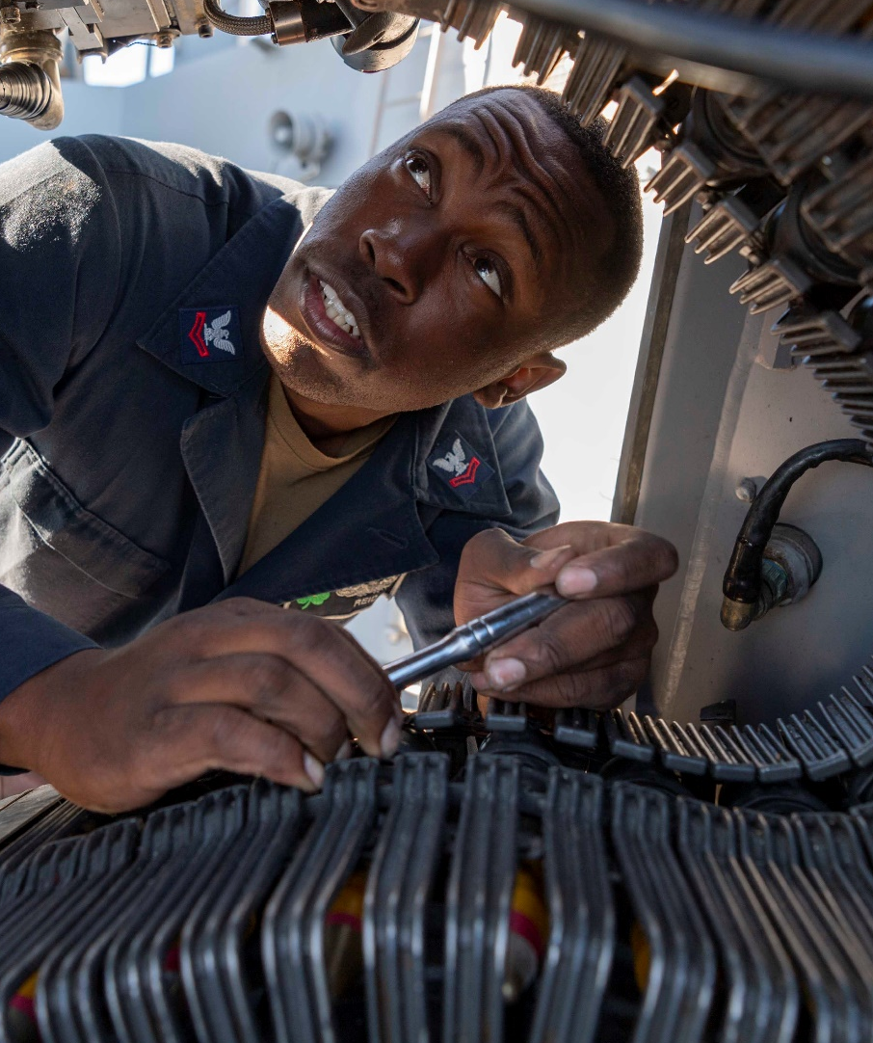
Serving Our Military Community Worldwide
Here’s who is eligible for
Military OneSource services:
All active duty, Coast Guard, National Guard and reserve component service members, regardless of activation status
Immediate family members
Expeditionary civilians, 90 days predeployment until 180 days after returning home
Retired or discharged honorably to include a general discharge, up to 365 days postseparation or retirement
Survivors: non-remarried spouses and children
www.MilitaryOneSource.mil • 800-342-9647
Notes:
Military OneSource serves our total force.
Here’s who is eligible for Military OneSource services:
All active duty, Coast Guard, National Guard and reserve component service members, regardless of activation status
Immediate family members
Expeditionary civilians, 90 days predeployment until 180 days after returning home
Retired or discharged honorably to include a general discharge, up to 365 days postseparation or retirement
Survivors: non-remarried spouses and children
Active-duty foreign military service members assigned to U.S. installations and registered in DEERS and their immediate family members who are registered in DEERS
Note: In-person counseling for Coast Guard will be provided exclusively through Military OneSource counselors instead of Military and Family Life Counselors. Coast Guard spouses seeking career support may be referred to an alternative resource other than the War Department's SECO program.
Eligibility begins when the service member enters the military and typically, up to 365 days postseparation.
Extended program eligibility reaches anyone who is enrolled in the Defense Enrollment Eligibility Reporting System — more commonly known as DEERS.
There are more details about eligibility at the Military OneSource website.

Slide 4

Personalized Confidential Support
Counseling
Counseling
Spouse Education and
Career Opportunities
Health and
Wellness Coaching
Wounded Warrior and Caregivers
Education
New MilParent
Adoption
Document Translation & Language Interpretation
Peer-to-Peer Support
Spouse Relocation
and Transition
Special Needs
Elder Care
Building Healthy Relationships
Transitioning
Veterans
Financial and
Tax Consultation
Financial and
Tax Consultation
Spouse Education and
Career Opportunities
Transitioning
Veterans
Health and
Wellness Coaching
Building Healthy Relationships
Wounded Warrior and Caregivers
Elder Care
Education
Special Needs
New MilParent
Spouse Relocation
and Transition
Adoption
Peer-to-Peer Support
Document Translation & Language Interpretation
Notes:
• Military OneSource offers a wide range of individualized consultations, coaching and counseling for many aspects of military life.
• [READ SLIDE OR POINT OUT HIGHLIGHTS]
• Everything from financial counseling to education to confidential counseling
• All to help our military community and families live resilient and ready
• And connect you to the support and resources you need to thrive

Slide 5
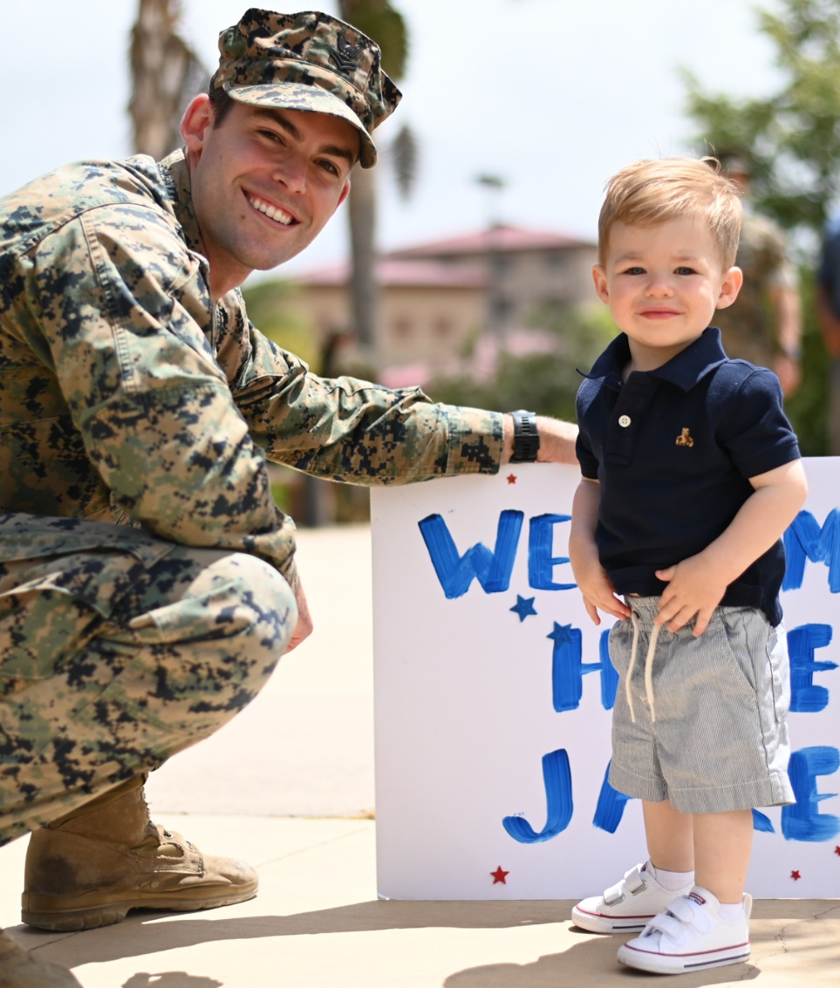
Confidential Counseling to Help You Be Your Best
Military OneSource counseling:
For service members and military families
Private, at no cost, not reported to command
    Short-term, up to 12 sessions
Connects you — or immediate family members — to counseling from licensed mental health clinicians
Helps with issues such as:
    Improving relationships at home and work
    Stress management
    Marital and communication issues
    Adjustment and deployment challenges
    Parenting skills
    Grief or loss
    Transitions, such as PCS moves and
    other challenges
www.MilitaryOneSource.mil • 800-342-9647
Notes:
Confidential counseling:
For service members and military families
Private, at no cost and not reported to command
Short-term and available for up to 12 sessions per issue per eligible family member.
Connects you — or your immediate family members — to counseling from licensed mental health clinicians
Helps with issues such as:
Improving relationships at home and work
Stress management
Marital and communication issues
Adjustment and deployment challenges
Parenting skills
Grief or loss
Transitions, such as PCS moves and other challenges
• Someone could receive 12 sessions for one issue, perhaps something like adjusting to a deployment alone, and then, once those sessions are completed, 12 more sessions for couples-communication issues that may be experienced after deployment.
• But it’s also important to mention what confidential counseling does NOT address.
Confidential counseling is NOT appropriate for:
Issues requiring long-term support — more than 12 sessions
Post-traumatic stress disorder or other behavioral trauma
Psychological fitness for duty evaluations
Addictions such as drug, alcohol or other addictions
Other mental health conditions that require medical treatment or medication
It does not provide or determine any medical diagnosis.
It does not address dangerous situations such as child abuse or neglect, domestic violence, or thoughts of suicide. These need to be handled by crisis professionals. It is important to note that if issues fall outside the scope of confidential counseling, persons will be referred to a treatment center, TRICARE or another appropriate service.
PRIVACY PROTECTIONS:
Contacts with Military OneSource are private.
Privacy protections ensure your personal information will not be:
Provided to the military or chain of command
Shared with family or friends
Released to other agencies
• This means that a family member may seek confidential counseling without the knowledge or consent of the service member.
• Or a service member may seek confidential counseling without the knowledge of command.
There are some exceptions. Military OneSource consultants — including counselors — have a duty to report some situations to appropriate military and civilian authorities.
Privacy exceptions include the following duty-to-warn situations:
Suspected family maltreatment (domestic violence,
child or elder abuse or neglect)
Harm to self or others
Illegal activity
If you have questions regarding a situation, a Military OneSource consultant can provide details.

Slide 6

How to Access Confidential Counseling
You can connect with Military OneSource 24/7/365 from anywhere in the world to arrange your session:
Connect via phone or secure chat.
Counseling services are offered via:
Telephone
Secure online chat
Secure, live video session
Face-to-face
Face-to-face sessions are also available through the Military and Family Life Counseling Program at installations worldwide.
www.MilitaryOneSource.mil • 800-342-9647
Notes:
You can call or contact Military OneSource via secure online chat at any time to arrange individual, couples and family confidential counseling.
Four ways to participate in confidential counseling:
• Telephone: This is for those who are unable to attend sessions in person.
• Online: Chat in real time. Online sessions are secure and scheduled chats (they’re not on demand).
• Live video: You and your counselor can see and hear each other via video. Keeping conversations and location private is the responsibility of both parties.
• Face-to-face: Meet face-to-face with a professional counselor in your community. In-person counseling is available for CONUS locations in the continental U.S., Alaska, Hawaii, Puerto Rico and the Virgin Islands. You may have to check about services in remote locations.
Note: In-person counseling for the U.S. Coast Guard is provided exclusively by Military OneSource counselors instead of military and family life counselors.

Slide 7



Coaching, Consultations and Other Services (1 of 6)
Health and Wellness Coaching
Personal coaches to help you set and reach goals to lose weight, manage stress, tackle transitions or make more healthy lifestyle changes.
Peer-to-Peer
These free, confidential consultations provide opportunities for you to discuss personal or career challenges or aspirations with someone who’s been there
Wounded Warrior
Get immediate assistance for issues related to health care, resources, facilities and benefits — for eligible wounded, ill or injured service members, veterans and their caregivers.
www.MilitaryOneSource.mil • 800-342-9647
7
Notes:
All Military OneSource specialty consultations are:
Individualized, confidential support on specific issues.
From experts at master’s level education or higher.
Here’s a little more about what specialty consultations we offer:
Health and wellness coaching. Personal coaches to help you set and reach goals to lose weight, manage stress, tackle transitions or make more healthy lifestyle changes.
• Work with your health and wellness coach over the phone, in an online chat, or through a video session, typically once a week.
Health and wellness coaching is:
Participant driven and coach supported. With your coach, you’ll discuss goals, challenges and barriers that are unique to you and develop strategies to be successful.
Education and practice-based, with a focus on the future and what you need to do now. You and your coach bring a wealth of knowledge and experience to the partnership. Capitalizing on that partnership to bring about change can be very powerful.
Goal oriented with the coach inspiring you to build self-reliance, empowerment and confidence.
A way to improve your lifestyle by partnering to creatively break old habits and replace them with healthier ones.
Coaches understand and acknowledge the struggles and difficulties you can have with trying to change behaviors that you may have had for a long time. Coaches are there to help you be your best self and not to judge you.
Participants work with coaches to gain:
Control and a sense of personal responsibility.
Energy and motivation.
Positive attitude and emotional health.
Support to help you navigate through your health and wellness changes.
Self-confidence that you can make healthy changes.
Resilience and strategies for how to bounce back from setbacks and challenges along your journey to health.
Health and wellness coaching is available free of charge in three formats:
Video coaching — participants and coaches can see and hear each other in real time. You’ll need a video-enabled computer or mobile device. Contact Military OneSource and be directed to download software for video.
Coaching by phone. The coach listens carefully to help you strategize ways for achieving their vision for health and well-being.
Online coaching. Meet to instant message online in real time. Register on the Military OneSource website.
Peer-to-peer support. These free, confidential consultations provide opportunities for you to discuss personal or career challenges or aspirations with someone who’s been there.
• A peer-to-peer consultation is a relaxed conversation about the challenges of military life such as deployments or frequent relocation.
• Peer consultants have firsthand life experience as service members or military spouses.
Wounded warrior. Get immediate assistance for issues related to health care services, resources, facilities and benefits — for eligible wounded, ill or injured service members, veterans, their families and their caregivers.
Wounded warrior specialists provide personal assistance related to:
Military facilities concerns.
Health care services.
Information on VA benefits and other entitlements.
Everyday issues such as confidential counseling, dependent care, etc.
• Consultants focus on connecting the service member or family member to the resource that best addresses each situation.
• We continue to collaborate and communicate until the issue or concern is resolved.
This is available to anyone who has ever served, and does not replace the specialized wounded warrior programs established by each of the military services.

Slide 8



Coaching, Consultations and Other Services (2 of 6)
Special Needs
Consultants are knowledgeable about the range of military programs and assistance for caregiving, education and more for family members with special needs – both children and adults.
Adoption
Adoption consultants are specially trained in military adoptions and can help you navigate the process.
Elder Care
Trained consultants can answer questions and help you access resources and support services for your older family member. Get help understanding benefits from the VA and Medicaid, learn how to find in-home care and facilities and get referrals for programs.
www.MilitaryOneSource.mil • 800-342-9647
8
Notes:
Special needs. Consultants are knowledgeable about the range of military programs and assistance for caregiving, education and more for family members with special needs.
• With moves and deployment, having a family member with special medical or education needs can create unique challenges.
• Military OneSource offers an unlimited number of consultations with a consultant who specializes in special needs.
Frequent moves can make navigating the many resources difficult, and there are also times when you will have to be an advocate, a cheerleader and a pillar of strength. Military OneSource is committed to giving you personal, high-quality support.
Along with specialty consultations and numerous educational materials, we also provide:
Information about adult day care programs and financial assistance for medical equipment (wheelchairs, helmets, walkers, etc.)
Links to many resources all in one place
Adoption. Consultants are specially trained in military adoptions and can help you navigate the process. They will provide you with adoption agency information, support groups and general literature on adoption and can offer assistance and provide information on:
Starting the process
Finding military-related financial assistance
Identifying adoption agencies that can help you with your specific adoption needs
Elder care. Consultants can answer questions and help you access resources and support services for your older family member who needs care.
Consultants can provide members with information on:
In-home care, housing, handicap accessibility resources
Housing, home health services, respite care
Home safety, assistive devices, insurance
Benefits from the VA and Medicaid
How to get referrals for programs

Slide 9



Coaching, Consultations and Other Services (3 of 6)
Building Healthy Relationships
Consultants provide personalized support tailored to strengthen your relationships by helping you set goals and boost your communication skills.
Education
From preschool to college tuition, education consultants can connect you to resources for service members, for military spouses and military children.
Spouse Relocation and Transition
Personalized help with moving and transition for military spouses. Get help with managing moving plans, housing allowances, shipment and storage, and more.
www.MilitaryOneSource.mil • 800-342-9647
9
Notes:
Building healthy relationships. Consultants provide personalized support to strengthen your relationships by helping you set goals and boost your communication skills. A variety of tracks are available for different relationship dynamics, such as family, friends and others.
Consultants help you make your most important relationships even stronger through:
Personalized coaching sessions
Practical and educational tools and resources
Problem-solving techniques
Empowering skills
Education From preschool to college tuition, education consultants can connect you to resources for service members, for military spouses and military children. This very broad topic starts with preschool and continues as lifelong learning. You’ll find:
Help for early childhood education: how to choose a school, help your child with homework or home school resources.
Access to school locators, the Morale, Welfare and Recreation online library resources,
College guidance for your child or for yourself. Trained consultants will help you get the answers and support you need for questions like:
“How am I going to pay for it?”
“Is this the right time to go back to school?”
“Can I handle college life?”
“Which school should I go to?”
Spouse relocation and transition Personalized help with moving and transition for military spouses. Get help with managing moving plans, housing allowances, shipment and storage, and more.
• These consultations assist military spouses with moving and transition.
Consultants help military spouses by:
Conducting a family assessment to determine needs
Assisting with organizing and prioritizing their needs
Developing an action plan to overcome barriers to securing services
Connecting spouses with relevant installation-based services
Facilitating smooth transitions during relocations and transitions
Initiating three-way calls with service providers, such as TRICARE or SECO
• They will help with whatever makes the move smoother.

Slide 10


Coaching, Consultations and Other Services (4 of 6)
New MilParent
Expectant parents and parent of children age 5 and under can get personalized consultant support and resources for self-care, sleep issues, toilet training, managing difficult behaviors, solo parenting, finding child care and more.
Transitioning Veterans
Consultants provide personalized support to service members in the process of transitioning to civilian life. Get help identifying goals, navigating benefits and resources like VA assistance, and preparing for civilian career and education opportunities.
www.MilitaryOneSource.mil • 800-342-9647
10
Notes:
New MilParent. Expectant parents and parents of children age 5 and under can get personalized consultant support and resources for topics such as:
Self-care
Sleep issues
Toilet training
Managing difficult behaviors
Solo parenting
Finding child care and more.
Transitioning veterans. Consultants provide personalized support to service members transitioning to civilian life.
Consultants help you to:
Identify goals
Navigate benefits and resources like VA assistance
Prepare for civilian career and education opportunities
Remember:
• There’s no limit to the number of specialty consultations you can receive.
Just call or contact Military OneSource to set up an appointment to speak with a specialist.

Slide 11



Coaching, Consultations and Other Services (5 of 6)
Spouse Education and Career Opportunities Program
This program provides education and career guidance to military spouses worldwide. SECO career coaches can help at any stage of a spouse’s life, from finding the right school or connecting with employers to starting a business.
Language Services
Free translation and interpretation services for eligible service members and family members moving overseas and for non-English-speaking family members.
Caregiver Support Services
Tailored information and resources for military caregivers. Support includes Military Caregiver PEER Forums and virtual forums, specialized resources and monthly events.
www.MilitaryOneSource.mil • 800-342-9647
11
Notes:
Spouse Education and Career Opportunities program* Military OneSource is your connection to SECO — employment and education for military spouses worldwide.
Personalized guidance from career coaches
Get assistance with:
Career exploration
Education, training and licensure
Employment readiness
Career connections
Comprehensive resources and tools
You can go to myseco.militaryonesource.mil to learn more.
* Coast Guard spouses seeking career support may be referred to an alternative resource other than then the War Department's SECO program.
Language services. Whether you are a non-English-speaking spouse or relocating to an overseas location, this service can help you deconstruct language barriers.
For eligible service members and family members moving overseas
Non-English-speaking family members
Simultaneous language interpretation services via phone for Military OneSource consultations
Document translation for more than 150 languages
Notarized, certified translations of many official documents — such as leases, marriage licenses, birth certificates, school transcripts and more
Turnaround time for shorter documents (under 17 pages) is within a few business days.
A couple of exclusions: Medical information cannot be discussed or delivered using Military OneSource translation services. Not all documents qualify for Military OneSource translation, but we will find you additional assistance if needed.
Caregiver support services
When your spouse or loved one suffers a severe injury or debilitating illness, you may experience a range of emotions, including grief and anger. It is important to take care of yourself as much as possible while caring for your loved one.
While we do not provide health care services, we do offer information about the services and benefits available and provide resources for caregivers to assist them in their role.
Caregiver support services provides military caregivers with information and resources specifically for them
• Support includes Military Caregiver PEER Forums and virtual forums. PEER stands for Personalized Experiences, Engagement and Resources. These include informal gatherings on installations where caregivers can share knowledge, experience and support.
You’ll also get connected with experts in education, the military health care system and TRICARE, and special needs estate planning.

Slide 12


Coaching, Consultations and Other Services (6 of 6)
Financial and Tax Consultation
Learn how to take control of your finances. Accredited financial counselors can assist with setting up a budget, evaluating savings, retirement plans and investment plans, reviewing college savings and tuition programs, understanding housing finances and learning how to manage debt.
MilTax: Free Tax Services
MilTax is a suite of free tax services provided by Military OneSource. It includes tax prep and filing software tailored for military life and comes with personalized support from tax consultants trained in military-specific tax situations.
Financial and Tax Consultation
Learn how to take control of your finances. Accredited financial counselors can assist with setting up a budget, evaluating savings, retirement plans and investment plans, reviewing college savings and tuition programs, understanding housing finances and learning how to manage debt.
MilTax: Free Tax Services
MilTax is a suite of free tax services provided by Military OneSource. It includes tax prep and filing software tailored for military life and comes with personalized support from tax consultants trained in military-specific tax situations.
Notes:
Financial and tax consultation. Learn how to take control of your finances. Accredited financial counselors can assist with:
Setting up a budget
Evaluating savings, retirement plans and investment plans
Reviewing college savings and tuition programs
Understanding housing finances
Learning how to manage debt — such as negotiating late fees, payment plans
These independent, certified counselors can help you understand and weigh options for the best fit.
MilTax: 100% free tax services. Take command of your taxes with free tax services:
Easy-to-use software for FREE preparing and e-filing your taxes online
No hidden fees or surprises – MilTax is always 100% free
Free support from expert consultants trained in tax considerations for the military
MilTax software accounts for military life – everything from multiple moves to combat pay

Slide 13


Interactive Resilience Tools and Apps
Love Every Day
Rekindle the romance. Text messages encourage couples to connect in a fun and meaningful way for a few minutes a day for 21 days.
https://www.militaryonesource.mil/benefits/love-every-day/
Chill Drills
Relax your body and mind with this free collection of simple audio mindfulness exercises developed for the military community.
https://www.militaryonesource.mil/resources/mobile-apps/de-stress-and-relax-with-chill-drills-by-military-onesource/
Love Every Day
Rekindle the romance. Text messages encourage couples to connect in a fun and meaningful way for a few minutes a day for 21 days.
https://www.militaryonesource.mil/benefits/love-every-day/
Chill Drills
Relax your body and mind with this free collection of simple audio mindfulness exercises developed for the military community.
https://www.militaryonesource.mil/resources/mobile-apps/de-stress-and-relax-with-chill-drills-by-military-onesource/
Notes:
Military OneSource offers mobile solutions through your smartphone, mobile tablet or computer.
Love Every Day texts you and your partner a question each morning for 21 days. You both respond when it’s convenient and you’ll be notified when your partner’s answer is ready to view. Love Every Day helps you get to know your partner better, learn new ways to show your love for each other, and discover “did you know” facts about relationships. It’s a fun way to create a new normal for your relationship.
Get started at https://www.militaryonesource.mil/benefits/love-every-day.
Chill Drills
This free collection of simple audio mindfulness exercises were developed for the military community to reduce stress and create calm. You can access Chill Drills at https://www.militaryonesource.mil/resources/mobile-apps/de-stress-and-relax-with-chill-drills-by-military-onesource/

Slide 14
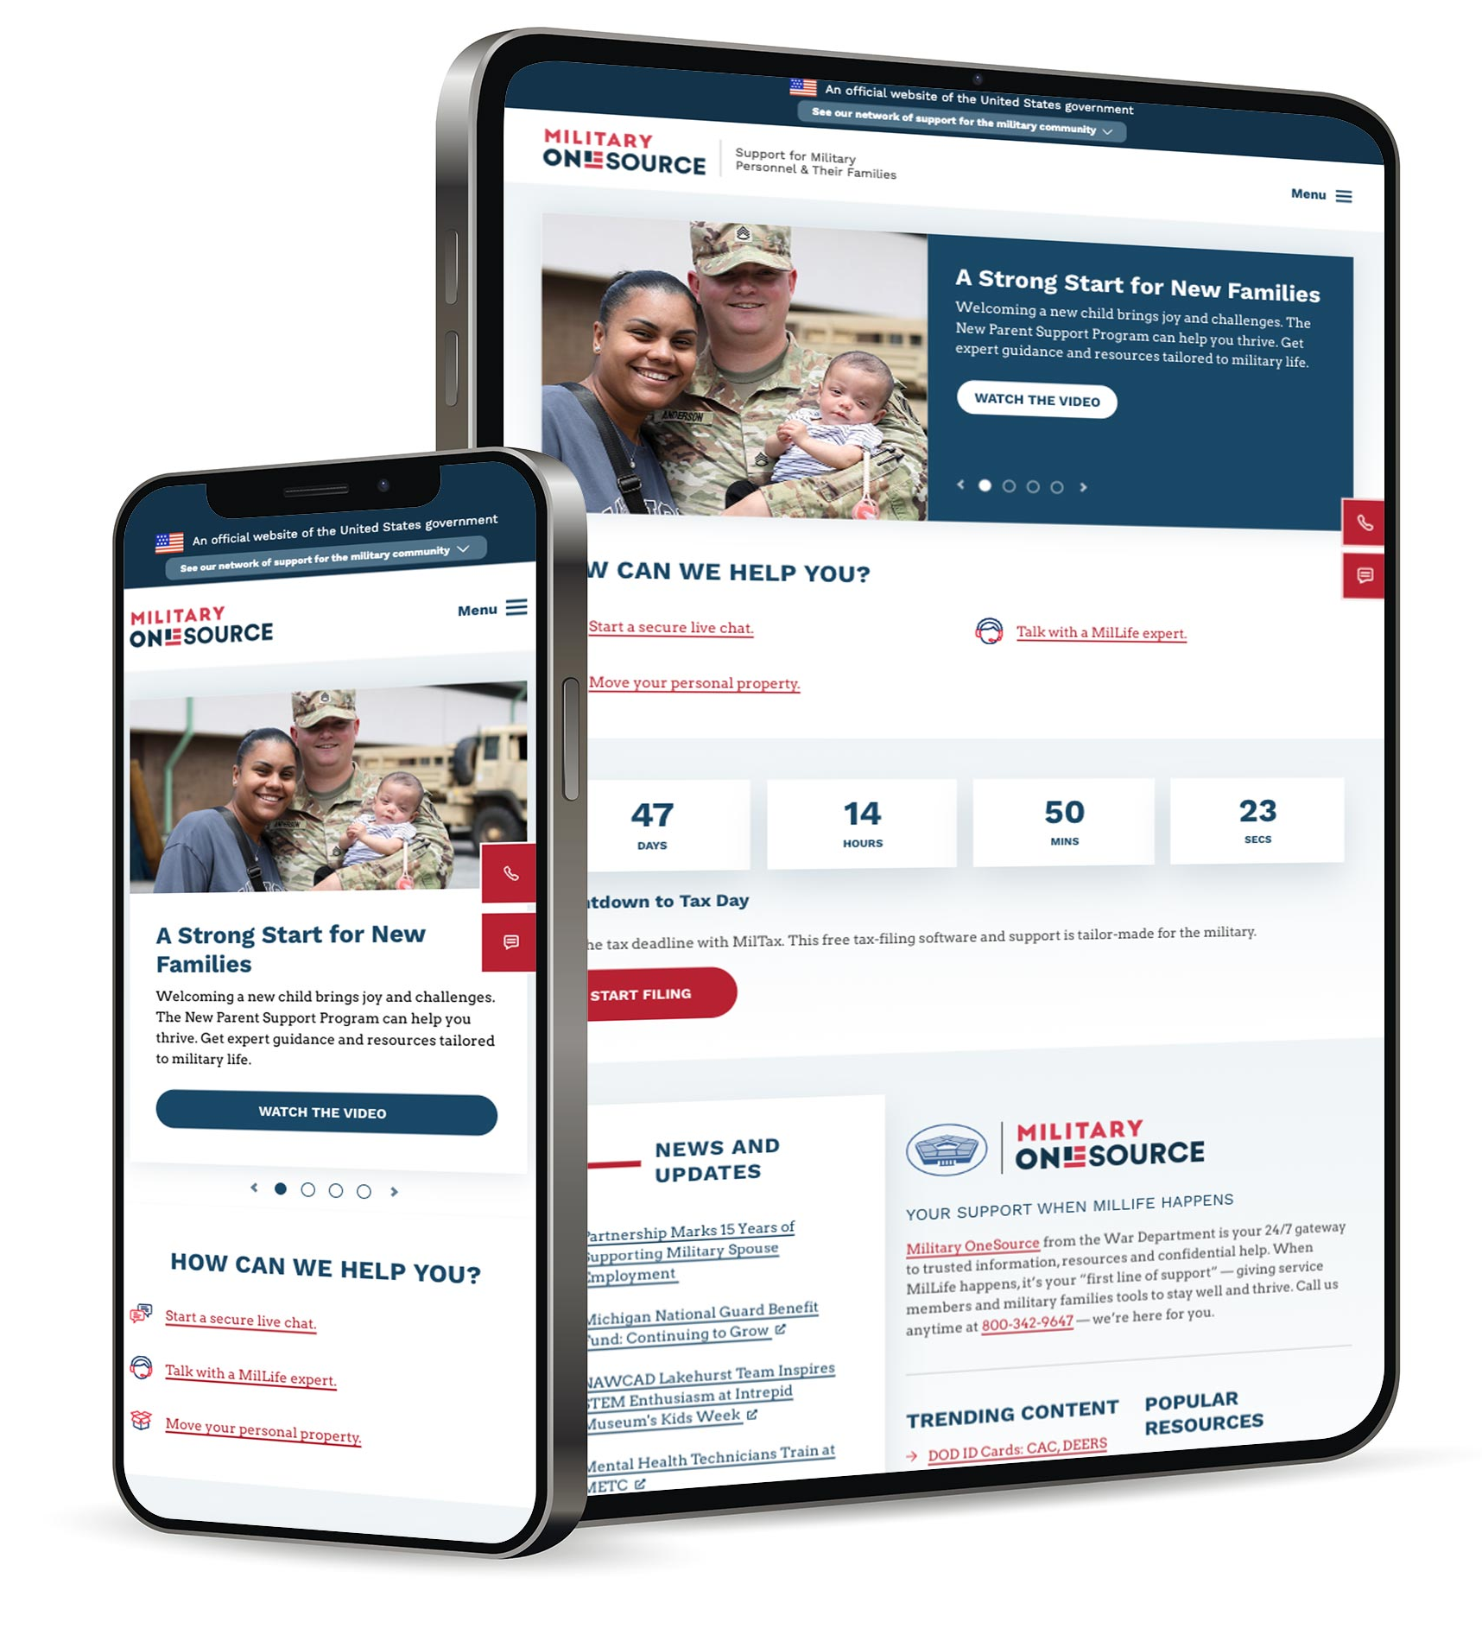
MilitaryOneSource.mil
Is your 24/7/365 connection to
even more resources, services
and information.
On the homepage:
Quickly connect to the 800 number, OCONUS calling options and to secure online chat
Optimized search function
Browse topics and tools
Confidential help through “Get Personal Support”
www.MilitaryOneSource.mil • 800-342-9647
Notes:
In addition to all these resources we’ve talked about, the Military OneSource website has lots more assistance and information. The site has a responsive design to readily accommodate users on their mobile, tablet and desktop devices, so that you can access the extensive resources and support 24/7, from anywhere in the world.
Here’s how to connect to help and services, starting at the homepage.
[DEMONSTRATE WITH CURSOR]
Click the “Get Personal Support” menu item for a dropdown with information for:
Contacting Military OneSource for guidance & answers
Military OneSource coaching and consultations
The Military and Family Life Counseling Program and Military OneSource confidential counseling
Click the “Explore Tools” menu item for a dropdown with the following digital tools and resources:
Benefits Finder
Resources Finder
MilTax: Free Tax Services
Spouse Education and Career Opportunities program
Plan My Deployment Checklists
Military and Family Life Counselor Locator
Relationship Resource Tool
Defense Personal Property System
Military Funeral Honors Directory
Click the “Browse by Topics” menu item for the following topics:
Military Basics
Deployment
Education & Employment
Financial & Legal
Health & Wellness
Military Funeral Honors
Moving & Housing
National Guard & Reserves
Parenting
Recreation, Travel & Shopping
Relationships
Separation & Retiring
Special Needs
Click the red “Connect Now” button to:
Call our 800 number on your mobile device 24/7/365.
See international dialing instructions from outside the continental U.S.
Call TTY/TDD
Start a secure chat
The magnifying glass takes you to search.

Slide 15
The Military OneSource Website, continued
Categories:
In addition to confidential help, check out these categories for articles, information, tools and services
Military Basics — new to the military, training and logistics, basics for extended family and friends, information for wounded, ill or injured and their caregivers
Casualty & Mortuary Affairs — bereavement and grief, casualty assistance
Deployment— preparing for, during and returning home from deployment
Education & Employment — for spouses, service members, youth and teens
Emergencies & Disasters — personnel accountability, disaster preparedness, evacuation operations
Financial & Legal — personal finance, taxes, legal issues
Health & Wellness — mental health, nutrition and fitness, prevention and care
Military Funeral Honors — information for families, funeral directors and planners, Authorized Provider Partnership Program
Moving & Housing — preparing to move, personal property, housing, overseas living
National Guard & Reserves — resources and support for navigating life in the Guard or reserves
Parenting — new parents, child care, children, youth and teens, adoption and foster care
Recreation, Travel & Shopping — MWR and libraries, travel and lodging, commissary and exchange
Relationships — friendships and single life, married life and domestic partnerships, separation and divorce, safety from violence and abuse
Separating & Retiring — Military separation, transitioning to civilian life, recent veterans
Special Needs — Exceptional Family Member Program, medical needs, educational needs
www.MilitaryOneSource.mil • 800-342-9647
Notes:
There are 15 categories of information, resources and benefits on the site.
Military Basics — New to the military, training and logistics, basics for extended family and friends, wounded, ill or injured and their caregivers
Casualty & Mortuary Affairs — Bereavement and grief, casualty assistance
Deployment — Preparing, during and returning home from deployment
Education & Employment — For spouses, service members, and youth and teens
Emergencies & Disasters — Personnel accountability, disaster preparedness, evacuation operations
Financial & Legal — Personal finance, taxes, legal
Health & Wellness — Mental health, nutrition and fitness, prevention and care
Military Funeral Honors — information for families, funeral directors and planners, Authorized Provider Partnership Program
Moving & Housing — Preparing to move, moving your personal property, housing, overseas living
National Guard & Reserves — Joining the Guard and reserves, National Guard, reserves
Parenting — New parents, child care programs, children, youth and teens, adoption and foster care
Recreation, Travel & Shopping — MWR and libraries, travel and lodging, commissary and exchange
Relationships — Friendships and single life, married life and domestic partnerships, separation and divorce, safety from violence and abuse
Separating & Retiring — Military separation, transitioning to civilian life, recent veterans
Special Needs — Exceptional Family Member Program, medical needs, educational needs

Slide 16
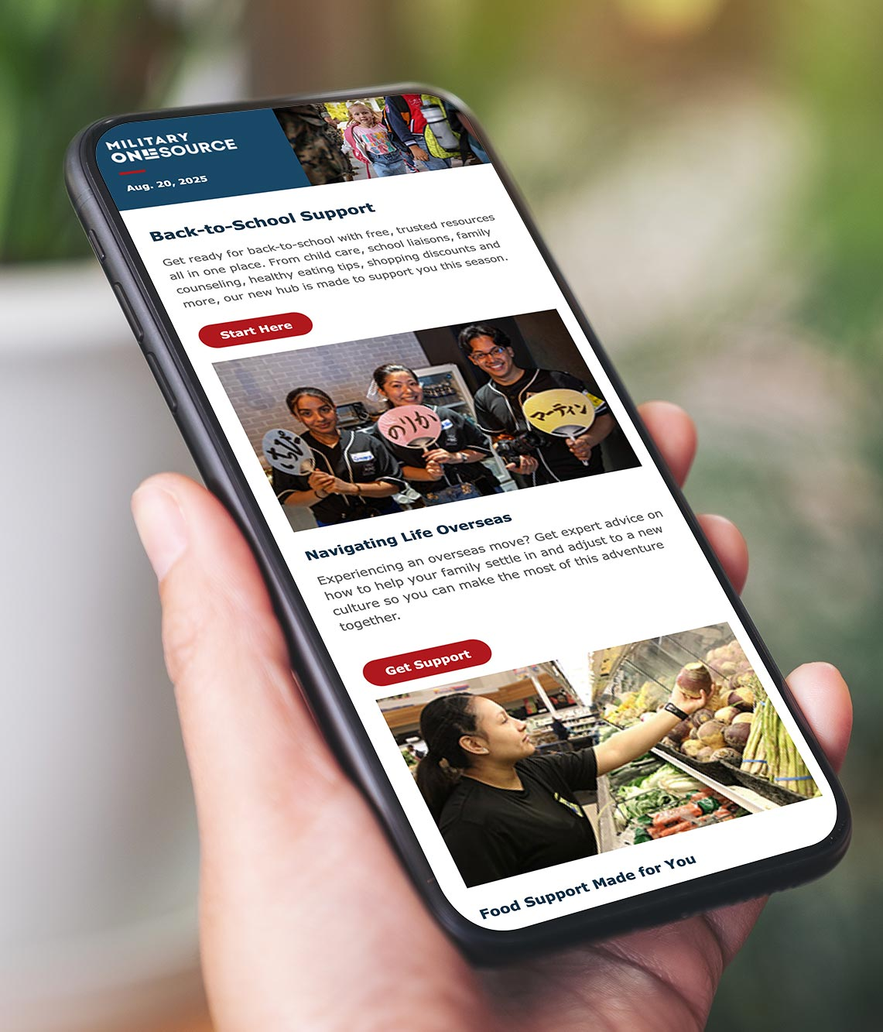





Connect to More Services
Blogs and podcasts — for the latest information and timely help:
Read Blog Brigade for military spouses
Listen to our podcast on topics important to military life
Visit us on social media
Outreach support
Arrange for a field consultant to provide in-person presentations and host webinars about Military OneSource services, benefits and resources.
www.MilitaryOneSource.mil • 800-342-9647
Notes:
You can also connect with the community through blogs and social media. These platforms ensure you’re the first to know about resources as they become available — including information that matters to both service members and military families.
Read Blog Brigade for military spouses for a “boots on the ground perspective”
Listen to podcasts featuring topics important to military life
Also, visit us on social media
Military OneSource field consultants are here to help support your outreach. They can:
Provide presentations in person or host webinars
Talk about a variety of topics tailored to your community
Dive into details about benefits, services and resources
Field consultants have a vast range of experience in military life. Anybody in the military can request support from field consultants at no cost: service providers, leaders, communities that serve the military. To learn more or request support, go to BOSS, the Business Operations Support System at https://supportrequest.militaryonesource.mil

Slide 17
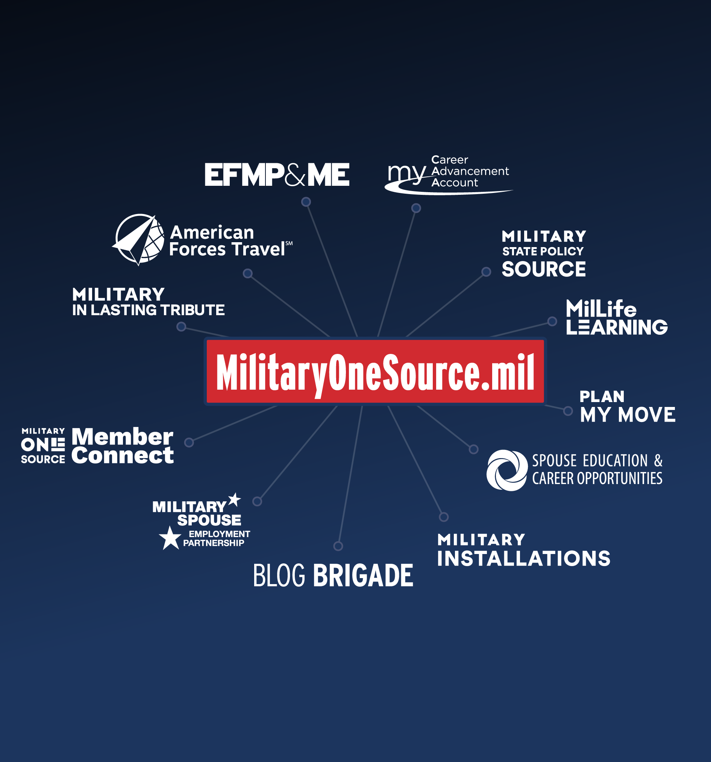



Digital Resources at the Ready
Find a digital hub of trusted information on a range of benefits and tools. At your fingertips 24/7.
  Discover programs and
  services for travel, eLearning, moving, scholarships, job hunting, installation info, deployment and more
  Subscribe to eNewsletters
  about specific topics
  Download apps for fast access
Military OneSource
www.MilitaryOneSource.mil • 800-342-9647
17
Notes:
Military OneSource connects service members and their families to a range of support for military life, including online tools and apps.
This list is a sampling of the different resources; reach out or visit the website to explore more.
Plan My Move
Users can answer a few questions and the Plan My Move tool will populate a checklist with information about the tasks they need to complete, and how and when to complete them.
MilitaryINSTALLATIONS
Helps service members and their families get to know a new location
Search by installation or program
Find contact information for different support programs – address, hours, phone number and more
See pictures of an installation and learn about resources in the surrounding community
Spouse Education and Career Opportunities and its associated programs offer military spouses free career and education coaching as well as other free resources and support for achieving goals (resume help, mock interviews, self-assessments, free tools and more)
Military Spouse Employment Partnership
Military spouses can find job openings and networking opportunities with employers committed to hiring, retaining and promoting military spouses
My Career Advancement Account
Military spouses might qualify for $4,000 in financial assistance toward a license, certification or associates degree through the My Career Advancement Account.
MilLife Learning
This online learning platform helps service members, their families, survivors and those who support them get key info about military life and support
Take courses at your own pace anytime, from anywhere.
Anyone with a slow internet connection can take select courses in Word format.
EFMP & Me
This online tool provides checklists, resources and referrals to help families enroll in EFMP and connect to support.
Blog Brigade
Military spouses can read about range of experiences from those who've walked in their shoes.
The Early Intervention Directory provides information on early intervention services for children birth through 3 years old.
The School-Age Directory provides information on special education services for children ages 3 through 21 years old.
My Military OneSource App
This free app helps users connect quickly and easily to support for navigating the MilLife.
Anytime, anywhere support for well-being and resilience.
Users can quickly connect with someone who can help them via live chat, or schedule an online consultation.
MilProvider
This mobile app makes it easy for military service providers to find and share resources, products and materials with the people they support.
Chill Drills
This mobile app offers a free collection of simple audio mindfulness exercises to relax the body and mind.
eNewsletters
Get curated intel in your inbox:
Military OneSource eNewsletter - updates and information highlighting timely issues, events and resources that matter most to service members and their families.
Friends & Family Connection eNewsletter - written specifically for the friends, extended family and loved ones who make up a service member’s support network; includes useful insights and information about all aspects of military life.
MilProvider eNewsletter - designed for military service providers and leaders; provides information, resources and tools to support their work on behalf of the military community.
Spouse Education and Career Opportunities eNewsletter - provides updates and information highlighting timely issues, events and resources for military spouses.
The Exceptional Advocate eNewsletter - for military families with special needs and those who support them; focuses on updates and information from the Exceptional Family Member Program.
The Survivor Connection eNewsletter - for those survivors whose loved one died while serving on active-duty status; provides resources, tools and information about sources of support.

Slide 18

Connect 24/7/365
You can expect:
Worldwide access 24/7/365
Free and confidential support
Objective and experienced experts
Current and practical information and tools
A commitment to help service members and military families thrive
www.MilitaryOneSource.mil • 800-342-9647
Notes:
That’s a quick tour through the very large universe of Military OneSource and all that’s waiting for you.
Turn to us anytime. You can rely on us for:
Worldwide access 24/7/365
International calling options at https://www.militaryonesource.mil/resources/international-calling-options/. If you are overseas, simply select your country of origin for specific dialing instructions.
Free and confidential support
Objective and experienced experts
Current and practical information and tools
A commitment to help service members and military families thrive

Slide 19

Questions?
Access our support when, where and how it’s convenient.
Call 800-342-9647 | Live Chat | My Military OneSource App
MilitaryOneSource.mil
Notes:
Does anyone have any questions?
[Let them know how long you will be around after the presentation and where they can find you if they think of a question they would like to ask later on.]
Direct additional questions to the Military OneSource call center at 800-342-9647.
[Point out the contact phone number and website to audience members and remind them to direct additional questions and concerns to a Military OneSource consultant through the call center.]

