Slide 1
Multidisciplinary Team Roles, Responsibilities and Primary Managing Authority
For Incidents Involving Problematic Sexual Behavior in Children and Youth
Notes:
OSD slides cannot be altered. Service-specific slides can be added to the presentation.

Slide 2
MDT Process
Referral > MDT activation > Team meets regularly > Case review process
During the process, be prepared to:
Add additional meetings, as needed.
Establish a communication plan.
Share information.
Fulfill your role and responsibilities.
Be flexible.
Notes:
Reference DODI 6400.10 4.1.

Slide 3
Problematic Sexual Behavior in Children and Youth
Multidisciplinary Team
The PSB-CY multidisciplinary team is composed of designated members with varied but complementary experience, qualifications and skills that contribute to the achievement of the team’s specific objectives, which include:
Cooperative, open information-sharing
Collaborative and coordinated decision-making and response
Promoting effective case management
Constructive parent and family engagement strategies
The installation MDT should meet before any incident occurs to build relationships. In addition, the MDT should meet regularly to review all open cases until closure to ensure continuity of care.
Notes:
Reference DODI 6400.10 4.1. INSTALLATION PSB-CY MDT

Slide 4

PSB-CY MDT Shared Responsibility
Synchronizes parent/guardian engagement
and child-focused advocacy
Ensures that prevention, outreach and response will, at all times, reflect and accommodate a diversity in cultural norms, ethnicities, religions, socioeconomic status, disabilities, gender, gender identity and expression, and sexual orientation
Coordinates the response of community helping agencies, monitors ongoing risk while addressing the safety of the installation
Recommends and coordinates interventions, supportive services and case management
Notes:
Reference DODI 6400.10 1.2. POLICY.

Slide 5
MDT Members
Family Advocacy Program
Military Law Enforcement
MDT
DODEA
Children and Youth
Ad Hoc Members
Expanded Members
Always part of the MDT
Part of the MDT, as needed
Notes:
Reference: DODI 6400.10 4.3. CORE PSB-CY MDT.
The core members of the PSB-CY MDT includes representatives from:
a. FAP, as chair: meaning they coordinate the meeting time, location, invite participants and document the MDT in the PSB-CY data base.
b. Military LE (e.g., MCIO): The MCIO helps clarify/establish jurisdiction, and update on status of investigations
c. CDP/YP, when CDP/YP is the referral source or if the child or youth’s PSB occurred in a CDP/YP-sponsored setting or when child or youth attend their programs and safety/supervision plans should be coordinated and shared.
d. DODEA, when DODEA is the referral source or if the child or youth’s PSB occurred in a DODEA-sponsored setting setting or when child or youth attend their programs and safety/supervision plans should be coordinated and shared.

Slide 6
Family Advocacy Program
Use the Non-Clinical Referral Tool to classify all referrals of sexual behavior.
Provide recommendations for immediate safety/supervision to referral sources.
Document every referral of sexual behavior, immediate safety steps taken by referral sources, case management and clinical actions in the PSB Information System.
Notify core MDT members within 24 hours of an identified PSB incident.
Coordinate and facilitate a PSB MDT meeting within 72 hours of a PSB incident.
Orient PSB MDT members to their role and responsibilities prior to their first MDT meeting.
Coordinate child-focused advocacy for parents, clinical screening, assessment and clinical services.
Establish a MDT review of all open PSB-CY cases until case closure.
Keep the MDT updated with all relevant information.
Notes:
Reference DODI 6400.10 4.1.

Slide 7

Military Law Enforcement Agencies
Act as a first responder to gather initial information and make required notifications when called about sexual behavior concerns.
Address immediate safety concerns.
Engage with parents and/or child and youth servicing agency.
Coordinate/liaise with civilian law enforcement.
Notify FAP of reports involving problematic sexual behaviors between children and youth within 24 hours.
Provide updates to PSB MDT.
Share LE next steps with PSB MDT.
Notes:
Reference DODI 6400.10

Slide 8

Military Criminal Investigative Organizations
Determine if a report warrants a criminal investigation.
Conduct an investigation, when warranted.
Determine the jurisdiction and investigative lead agency.
Coordinate with federal, state and local law enforcement agencies.
Provide updates and communicate with MDT members to allow coordination.
Notify command and provide ongoing updates and communication per policy procedures.
Ensure that parents/guardians are informed as to the status of the investigation.
Work with local prosecutors (when the civilian justice system is involved) until case closure or adjudication.

Slide 9
Expanded/Ad Hoc MDT Members
The most common expanded/ad hoc members of PSB MDT include:
Department of Defense Education Activity*
Child Development Program/Youth Program*
Command assets:
  Public Affairs Office
  Servicing Legal Office
Child-focused advocate for parents/guardians
FAP clinical provider
Installation command (when incidents impact installation safety and/or are high interest)
Active-duty member command (when families need additional support, such as in cases of early return of dependents or humanitarian assignments)
Military Treatment Facility (HCP/FHE)
Parents
Child Protective Services
Child Advocacy Center
*When not the referral source
Notes:
Reference DODI 6400.10

Slide 10
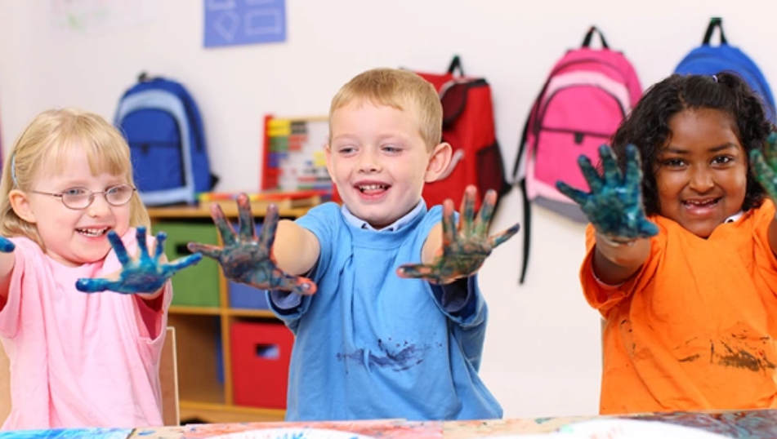
Child Development Program/Youth Program
Respond to the immediate safety needs of the child in accordance with current policy and procedures.
Establish and sustain parental engagement.
Categorize incidents of sexual behavior using the Non-Clinical Referral Tool.
Refer/consult about child sexual behavior with FAP, as needed.
Attend MDT meetings and share information and updates.
Follow up by coordinating and implementing safety and supervision plans and behavior intervention plans.
Interact with parents and explain and engage them in program-specific processes in a positive manner.
Notes:
The Non-Clinical Referral Tool was created for FAP, DODEA and CDP/YP to categorize sexual behaviors that occur in their programs or are referred to them, and aids in determining when to make a referral to FAP or coordinate the PSB MDT. DODEA and CDP/YP are valuable resources to the MDT. They have information in reference to the children and family involved and have the children in their care for a large portion of the time.
Reference DODI 6400.10
DODI 6060.02
This DODI is pending update.

Slide 11



Role of the School Liaison
School transition and deployment support
Installation school communication
Home-school support
Partnerships in education
  Academic enhancement
  Family/community involvement
  School outreach support services
  Building community capacity
Postsecondary preparatory opportunities
Notes:
The Non-Clinical Referral Tool was created for FAP, DODEA and CDP/YP to categorize sexual behaviors that occur in their programs or are referred to them, and aids in determining when to make a referral to FAP or coordinate the PSB MDT. School liaisons are valuable resources for the MDT. Participation in the MDT adds no additional reporting requirements for the school liaison. Because they work in public school settings, they should be aware of and follow existing reporting requirements.

Slide 12

Role of the School Liaison as Expanded MDT Member
Provide need-to-know information after the core MDT meets to identify needs.
Provide linkage to external stakeholders who assist with the
K-12 educational needs of families identified by the core MDT.
Serve as an expert when it comes to local programs and services.
Work within established guardrails with the MDT, parents and/or caregivers, as needed.
Participate in MDT meetings on an ad hoc basis.
Contribute to brainstorming.
Share resources/support options with MDT and families.
Utilize specific expertise (where applicable) to provide support on an ad hoc basis.
Notes:
Provide updated vital information on resources, processes, contacts and brainstorming.
Serve as the link between schools and military parents.
Provide the installation MDT with subject matter expertise on educational supports.
Serve as a critical information resource to the MDT and parents.
Support families who face transitional issues (e.g., relocating, or moving on, off or between installations).
Assist families in need of information on available school options, programs, and resources on and off the installation.
Help connect parents with special education and homeschool support.

Slide 13

Department of Defense Education Activity
Respond to the immediate safety needs of the children in accordance with current policy and procedures.
Establish and sustain parental engagement.
Categorize incidents of sexual behavior using the Non-Clinical Referral Tool.
Refer/consult about child sexual behavior with FAP, as needed.
Attend MDT meetings and share information and updates.
Follow up by coordinating and implementing safety, supervision and behavior intervention plans.
Coordinate school-based assessments/evaluations according to the program implementing guidance.
Notes:
The Non-Clinical Referral Tool was created for FAP, DODEA and CDP/YP to categorize sexual behaviors that occur in their programs or are referred to them, and aids in determining when to make a referral to FAP or coordinate the PSB MDT. DODEA and CDP/YP are valuable resources to the MDT. They have information in reference to the children and family involved and have the children in their care for a large portion of the time.
Reference DODI 6400.10

Slide 14
Child-Focused Advocacy for Parents/Guardians Coordinated by the FAP
Role
Designated and appropriately trained FAP staff, including:
FAP manager
Prevention/outreach staff
Domestic abuse victim advocate
FAP clinician
FAP case manager
Responsibilities
Reinforce the central role the parents/guardians play in ongoing safety.
Facilitate access to resources.
Explain the services available through FAP.
Describe the PSB-CY MDT approach to coordinating a response to referrals.
Notes:
Reference DODI 6400.10

Slide 15

FAP Clinical Provider
For children who exhibit or are impacted by PSB and their families, a FAP clinical provider will coordinate access to:
  Specialized medical assessments and evaluations beyond the scope of FAP clinical intervention
  Clinical services
  Psychoeducational support
  Assessment
  Clinical intervention
In addition, FAP clinical providers will:
  Attend MDT meetings, when needed, or provide updates to the MDT through the chair of the MDT.
  Create and coordinate safety/supervision plans and treatment plans for children, youth and families engaged in clinical treatment.
  Use the Non-Clinical Referral Tool to classify sexual behavior.
  Document all PSB efforts in the PSB Information System.
Notes:
Reference DODI 6400.10

Slide 16

Parents’ Unique Role in the MDT
Parents can be encouraged to:
Provide feedback.
Ask questions.
Share barriers.
Participate in treatment.
Advocate for their child.
Work with a child-focused advocate.
Attend meetings at the discretion of the MDT chairperson, as ad hoc members.
Communicate the needs of their family.
Notes:
Parents
DOD created this process because of parents, who are a key component as they advocate for their children.
Parental participation is not required for the MDT to convene.
Parental feedback is important.
Parental engagement is important and should be discussed and planned for within the MDT.
MDT members engage families throughout the process and establish ways parents can more actively participate in the process whenever necessary.
The MDT chairperson should ensure that the MDT has coordinated a plan to communicate with parents to include knowing which members are talking to the parents and what is being said.
Reference DODI 6400.10
“4.4. EXPANDED PSB-CY MDT.
(11) Parents and legal guardians as ad hoc attendees at the discretion of the MDT chair who will consider PII and PHI disclosures when determining parental or legal guardian attendance.”
“SECTION 7: PSB-CY PARENT(S) AND LEGAL GUARDIAN(S) ENGAGEMENT AND CASE MANAGEMENT
7.1. ACTIVE PARENT(S) AND LEGAL GUARDIAN(S) INVOLVEMENT.
Helping children and youth with PSB requires active engagement of the family to:
a. Improve and strengthen the parent(s) or legal guardian(s) and child relationship.
b. Inform parents and legal guardians on what to expect at each step in the CCR.
c. Empower parents and legal guardians with the skills and resources needed to successfully navigate through recommended or required CCR processes.
d. Update parents and legal guardians regularly on the PSB-CY MDT recommendations and when any changes or modifications are made to the intervention plan.
e. Implement parenting strategies that prevent and reduce behavior problems in general.
f. Address sexual education topics with their children and youth that support normative sexual development, healthy interpersonal boundaries, and a developmentally appropriate understanding of consent.
g. Develop and use community- and home-based prevention strategies and skills.
h. Apply safety, monitoring and supervision rules about sexual behavior in the home and in the children and youth’s social or school environment.”

Slide 17

Parents as Ad Hoc Members of the MDT
Meet with core members of the MDT first to think strategically about the safety of and value to the families.
MDT can consider discussing:
Whether the parents want to participate
The incident
The families involved (including personalities)
The potential for harm if the exhibiting
and impacted families are included/excluded
Whether parents would be better served
with an individual or clinical appointment
Other relevant concerns
When and if parents should attend

Slide 18
How to Include Parents as Ad Hoc Members of MDT
Include parents only after the MDT has met and decided that the benefits outweigh the risks for the parents to attend future meetings.
Best practice suggestions:
Set an agenda that structures the meeting so that parents attend only the necessary portion. Provide that agenda to the parents in advance of the MDT meeting.
Utilize your child-focused advocate to help prepare the parents prior to the MDT meeting to set expectations and, after the meeting to debrief, answer questions and provide support.
Have a follow-up plan with an identified point of contact who will communicate with the family, provide updates to include the date and time of the next meeting, if needed, and next steps.

Slide 19



Command Assets; Public Affairs Office and Staff Judge Advocate; Housing Office
Most common issues addressed by PAO, housing and/or SJA:
  Installation safety concerns, housing issues, installation access
  Public messaging, dealing with press inquires
  Installation communication (town halls, social media, etc.)
Servicing legal authorities, housing and the PAO operate under the direction of command
Service implementing guidance should be consulted when engaging command assets
Notes:
DODI 6400.03
Installation command may make a request to deploy a Family Advocacy Command Assistance Team as described in DODI 6400.03 to assist with incidents/cases of PSB when local resources are limited. SB-CY MDT and identifies
Reference Department of Defense Instruction 6400.10
“4.2. INSTALLATION FAMILY ADVOCACY COMMITTEE.
The installation Family Advocacy Committee develops and coordinates written guidance in accordance with service implementing policy that establishes the PSB-CY MDT and identifies core and expanded ad hoc members. To the greatest extent possible, all forms of written guidance will use person-first language when referring to children with PSB to maintain consistency with a developmentally appropriate focus and reflect best practices. This written guidance is reviewed annually, and upon change in policy, practice or leadership.”
The MDT chair does not direct PAO or legal, but instead works through service implementing guidance to coordinate with command.
Command makes the request to deploy the FACAT to assist with incidents/cases of PSB when local resources are limited, or the need exceeds the capacity of the installation to respond.

Slide 20
Engaging the Installation Commander
The MDT will establish processes and procedures for providing aggregate reports containing de-identified trend data to the installation commander through the Family Advocacy Committee or other committee at the direction of the installation commander. These reports will:
  Support the installation commander in assessing the effectiveness of current installation guidance, procedures and protocols.
  Promote collaboration and information-sharing among stakeholders.
  Guide decision-making and direct action related to the installation response to PSB-CY incidents and cases to align with DOD policy, service implementing policy and established best practices.
The MCIO and/or installation LEAs are responsible for notifying the appropriate level of command on all PSB-CY reports that warrant an investigation or involvement with additional federal or civilian LEAs or require command level action to promote the safety and security of the installation.
Examples include:
Housing/property issues (securing structures/sheds, constructing fences)
Managing public spaces in support of safety and supervision planning
Installation access
Relocation requests

Slide 21
Active-Duty Member’s Command
The active-duty member’s command may become an expanded member when:
Parents/guardians request it.
An emergency return of dependent, humanitarian reassignment, etc., is requested by the family or indicated from the installation commander.
The family experiences obstacles that require additional assistance.
The family faces barriers to implementing the recommended safety and supervision plan.
The active-duty member’s command involvement may require the release of information from the families involved, and best practices should include a prediscussion with MDT members to ensure appropriate information-sharing. Keep in mind the chain of command and the scope of the MDT. Defense Department and service implementing guidance should always be followed when determining when/how/what information is released.

Slide 22
MDT Case Review
The MDT will:
  Review all open problematic cases until FAP-related services are completed or discontinued, any juvenile or criminal court involvement has ended and community risk factors have been addressed.
Protocols and guidelines will include:
  Developing written protocols and guidelines for PSB-CY MDT case review in accordance with service implementing guidance
  Frequency of meetings for new and ongoing cases
  Process for adding cases to and deleting cases from the agenda
  Notification procedures for meetings

Slide 23
Frequently Asked Questions — 1 of 5
Who is the reporting point of contact for sexual behavior referrals?
  The Family Advocacy Program is the reporting point of contact and is required to receive and categorize all reported incidents CONUS and OCONUS using the NCRT.
What is FAP’s role?
  FAP is responsible for promoting awareness, supporting families, establishing and chairing the MDT, documenting all information pertaining to the incident/case, coordinating the safety and supervision of the children/youth involved through the MDT agencies, providing or coordinating intervention services and safety and supervision plans of children involved in FAP clinical services, managing an incident/case until termination and responding with culture competency in trauma-informed, developmentally attuned ways.
Who establishes the PSB-CY MDT?
  The installation Family Advocacy Committee, in accordance with service-implementing policy, establishes the PSB-CY MDT and identifies core and expanded ad hoc members.

Slide 24
Frequently Asked Questions — 2 of 5
What are some best practice tips for the MDT?
  All members: Be in consistent and open communication with other members of the MDT.
  LE/MCIO: Share with FAP/DODEA if an investigation is being opened or closed, or if new, relevant information is found.
  LE/MCIO: Share sexual behavior reports with FAP.
  FAP: Share all relevant information about open investigations with LE/MCIO.
  Have copies of MDT guidance at PSB MDT meetings (i.e., this slide deck or other resources).
  Establish with MDT (prior to incidents) who will speak with parents/caregivers, when the identified party will communicate, what they will communicate and when and how the MDT will be notified of the communication and reaction of the parents.
  Convene your MDT before a PSB incident occurs and share agency/program requirements with MDT members.

Slide 25
Frequently Asked Questions — 3 of 5
5. How long should LE/MCIO remain active in PSB MDT?
  LE/MCIO should remain active as long as investigations are open or the MDT needs additional support (i.e., increased patrols, town hall representations, community safety concerns, etc.).
  If an MCIO investigation is not opened, FAPM can convey relevant updates as they occur and LE/MCIO can stand by for consultation and continue to provide updates to command, but MCIO is not required to continue to attend MDT meetings.
When should MDT members be notified about expanded/ad hoc members attending a meeting?
  All MDT members should be notified prior to the MDT meeting regarding the participation of expanded/ad hoc members.

Slide 26
Frequently Asked Questions — 4 of 5
7. Do PSB-CY incidents managed by the MDT go to the installation
determination committee?
  To guard against the merging of adult-initiated and
  child-initiated behaviors, PSB-CY incidents do not go to the installation determination committee.
  Children and youth who engage in PSB are vastly different from adults who engage in the sexual abuse of children. Therefore, children and youth require different guidelines with respect to response, safety/supervision planning, assessment, evaluation and intervention.
When should an installation commander be immediately contacted?
  When there exists the likelihood of negative media attention or a threat of possible escalatory actions by community members in response to an incident; when a significant injury is sustained by a party or when significant action must be taken by one or more community agencies to safeguard the community and the service branch; or when civilian or other federal law enforcement agencies are involved.

Slide 27
Frequently Asked Questions — 5 of 5
9. What are steps an installation commander can take when there are elevated or immediate community safety issues at play?
  Removal of residents from installation housing
  Involvement of subordinate commands to coordinate action
  Enlist other relevant agencies to provide support to families and children.

Slide 28
Primary Managing Authority
The PMA is the installation FAP that is responsible for coordinating and communicating with the MDT throughout the duration of the PSB case.
If multiple service branches are located nearby and children from multiple services are involved, the FAPM with PMA will coordinate across all branches to ensure everyone is included, as necessary.
MDT representatives from all the services should be present and should collaborate and participate as they would in an MDT chaired by their service.
The PMA does not come into play on joint installations. If the incident occurs on a joint installation, the lead service will stand up and chair the MDT.
Best practice for joint installations: FAPMs meet and discuss their installations’ approach to PSB MDTs before an incident occurs.

Slide 29
How to Determine
Primary Managing Authority
When the child or youth exhibiting PSB has:
  A family member eligible to receive treatment at a military treatment facility
  A nonsponsored extra-familial member eligible to receive treatment at an MTF
  An extra-familial member not eligible for treatment in an MTF
  Is the only child involved
The PMA is the FAP that services their sponsor.

Slide 30
How to Determine the
Primary Managing Authority
When the children or youth exhibiting and impacted by PSB are either:
  Affiliated with the same service branch or
  Affiliated with different service branches
The PMA is the FAP that services the sponsor of the child or youth exhibiting PSB.
When the impacted child is the only child known or involved with a sponsor, the PMA is the FAP that services that child’s sponsor.

Slide 31
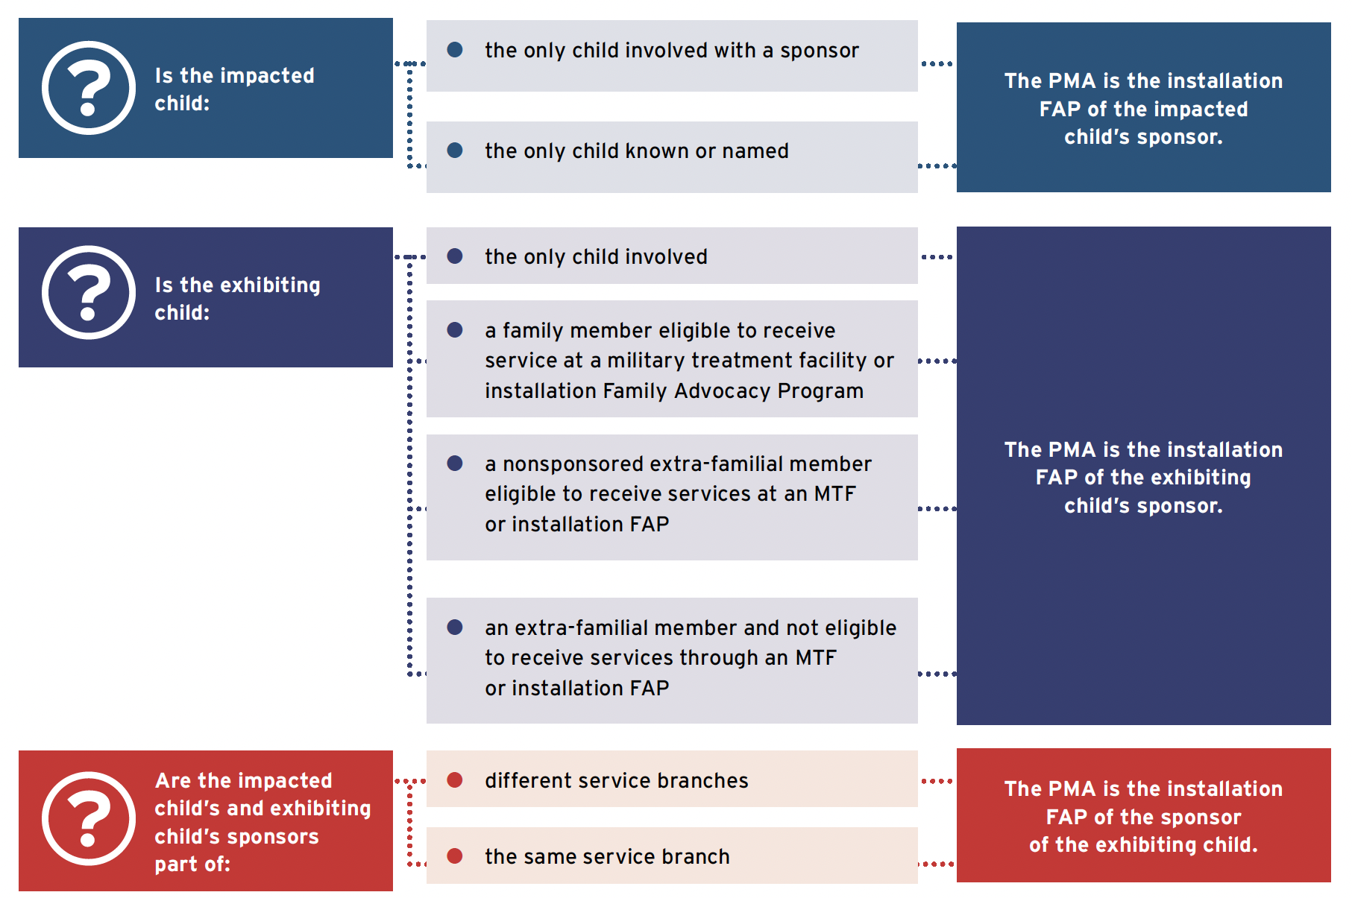
Primary Managing Authority Summary

Slide 32
Process Map For School Liaison MDT Participation
Core MDT meets to create a safety supervision plan.
Safety supervision plan is implemented.
Core MDT/families identify need to connect with external stakeholders.
Core MDT meets
to discuss the needs
of families.
Core MDT shares needs of families with the school liaison.
Families are provided with connections.
Core MDT continues to meet until case closure.
School liaison provides connection with external stakeholders.
Case is closed

