Slide 1


Thrive Program Introduction
Briefing Slides From the Office of Child & Youth Programs
Thrive Program Introduction
Briefing Slides From the Office of Child & Youth Programs

Slide 2
Introducing Thrive
Thrive is a parenting-education program for parents of children ages 0-18.
The Defense Department’s Office of the Deputy Assistant Secretary of Defense for Military Community and Family Policy developed it in collaboration with the Clearinghouse for Military Family Readiness at Penn State.
It is no cost and available online.
It is an evidence-informed program.

Slide 3

Thrive Supports Parents
Thrive was developed because:
The Defense Department is committed to supporting the health and well-being of all military-connected children and families.
Military parents face a range of challenges and often have different parenting needs because of military-life factors.

Slide 4




Thrive Has Four Age-Level Modules
Each module provides parents with evidence-informed, developmentally appropriate information:
take root: for children ages 0-3
sprout: for children ages 3-5
grow: for children ages 5-10
branch out: for children ages 10-18

Slide 5

Thrive’s Approach Focuses on Parents
Thrive modules are designed to:
Give parents information they need in a way they are likely to understand based on a child’s age and developmental stage
Help parents use the strengths they have while building additional skills
Allow parents to feel supported using a strengths-based approach
I feel like things will continue to get better when applying these strategies. We are trying some new learning things, and I am waiting for him to give me signs that he wants to learn more/try more.
— Military parent and Thrive user

Slide 6
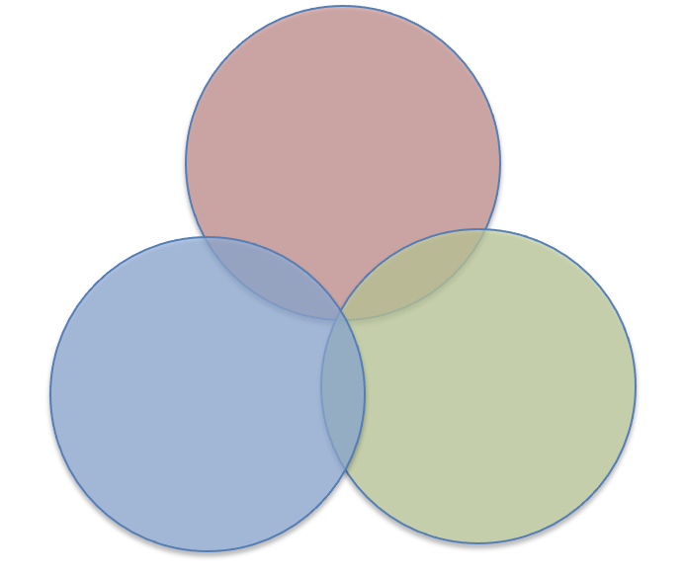
There Are Three Areas of Education
Each Thrive module focuses on three areas of education:
Positive parenting practices
Physical health promotion
Parent and child stress management

Slide 7
Thrive Meets Military Parents’ Needs
Military Parents Face
Thrive Provides
Experiences that can be associated with elevated mental and behavioral health issues in children:
Frequent moves
Family separations
Living 30 minutes or more from a military installation, which may limit access to resources and support of others who understand the culture of military life
Strategies and information that support child mental health:
Higher family communication
Family satisfaction
Spousal/parent social functioning
Flexible, online access to parenting education

Slide 8

Thrive Can Supplement Your
Existing Parent-Support Services
Thrive can work with or replace other parent-education programs and services that might be contracted. Benefits include:
  No cost to parents
  Convenient, high-quality modules
  Comprehensive coverage, ages 0-18
  Content shareable with family members, caregivers and friends

Slide 9
Supplemental Modules Benefit Families and Assist With Challenges
Supplemental modules are added regularly and address a number of parenting challenges, including:
  Adolescent mental health
  Anger and conflict management
  Co-parenting
  Families with exceptional needs
  Grandfamilies for grandparents raising children ages 10-14
  Unwanted or harmful behaviors
  Parental absence
  Sibling relationships
  Stepfamilies
  And more!

Slide 10
Thrive Offers Supplemental Resources to Support Parenting
Find valuable downloadable resources, including:
  Age-specific and supplemental program overviews
  Newsletters
  Resources and services
  Physical activity and playtime guides
  Healthy eating, menu planning and recipes
  Mindful strategies for parents and children
  Blogs
  And more!

Slide 11


Spread the Word About Thrive
Provide Thrive flyers and information cards to parents on installations.
Expand your parenting resources by accessing the Thrive library
of downloads.
Promote Thrive on your social media using the MC&FP social media toolkit.
Learn more about Thrive from Penn State.

Slide 12
Thrive Takeaways
The Defense Department is committed to supporting military-connected children and parents.
The no-cost, online programs are delivered in an engaging multimedia and self-directed format. They are evidence-informed and designed to tap into parents’ own strengths.
Thrive’s design has the military family in mind. We hope you encourage your military parents to check out Thrive.

Slide 13
Resources
For more information, visit the Thrive website at https://thrive.psu.edu/.
For research and publications see https://thrive.psu.edu/about/research-and-publications.

