Slide 1
Military Funeral Honors
United States Army

Slide 2
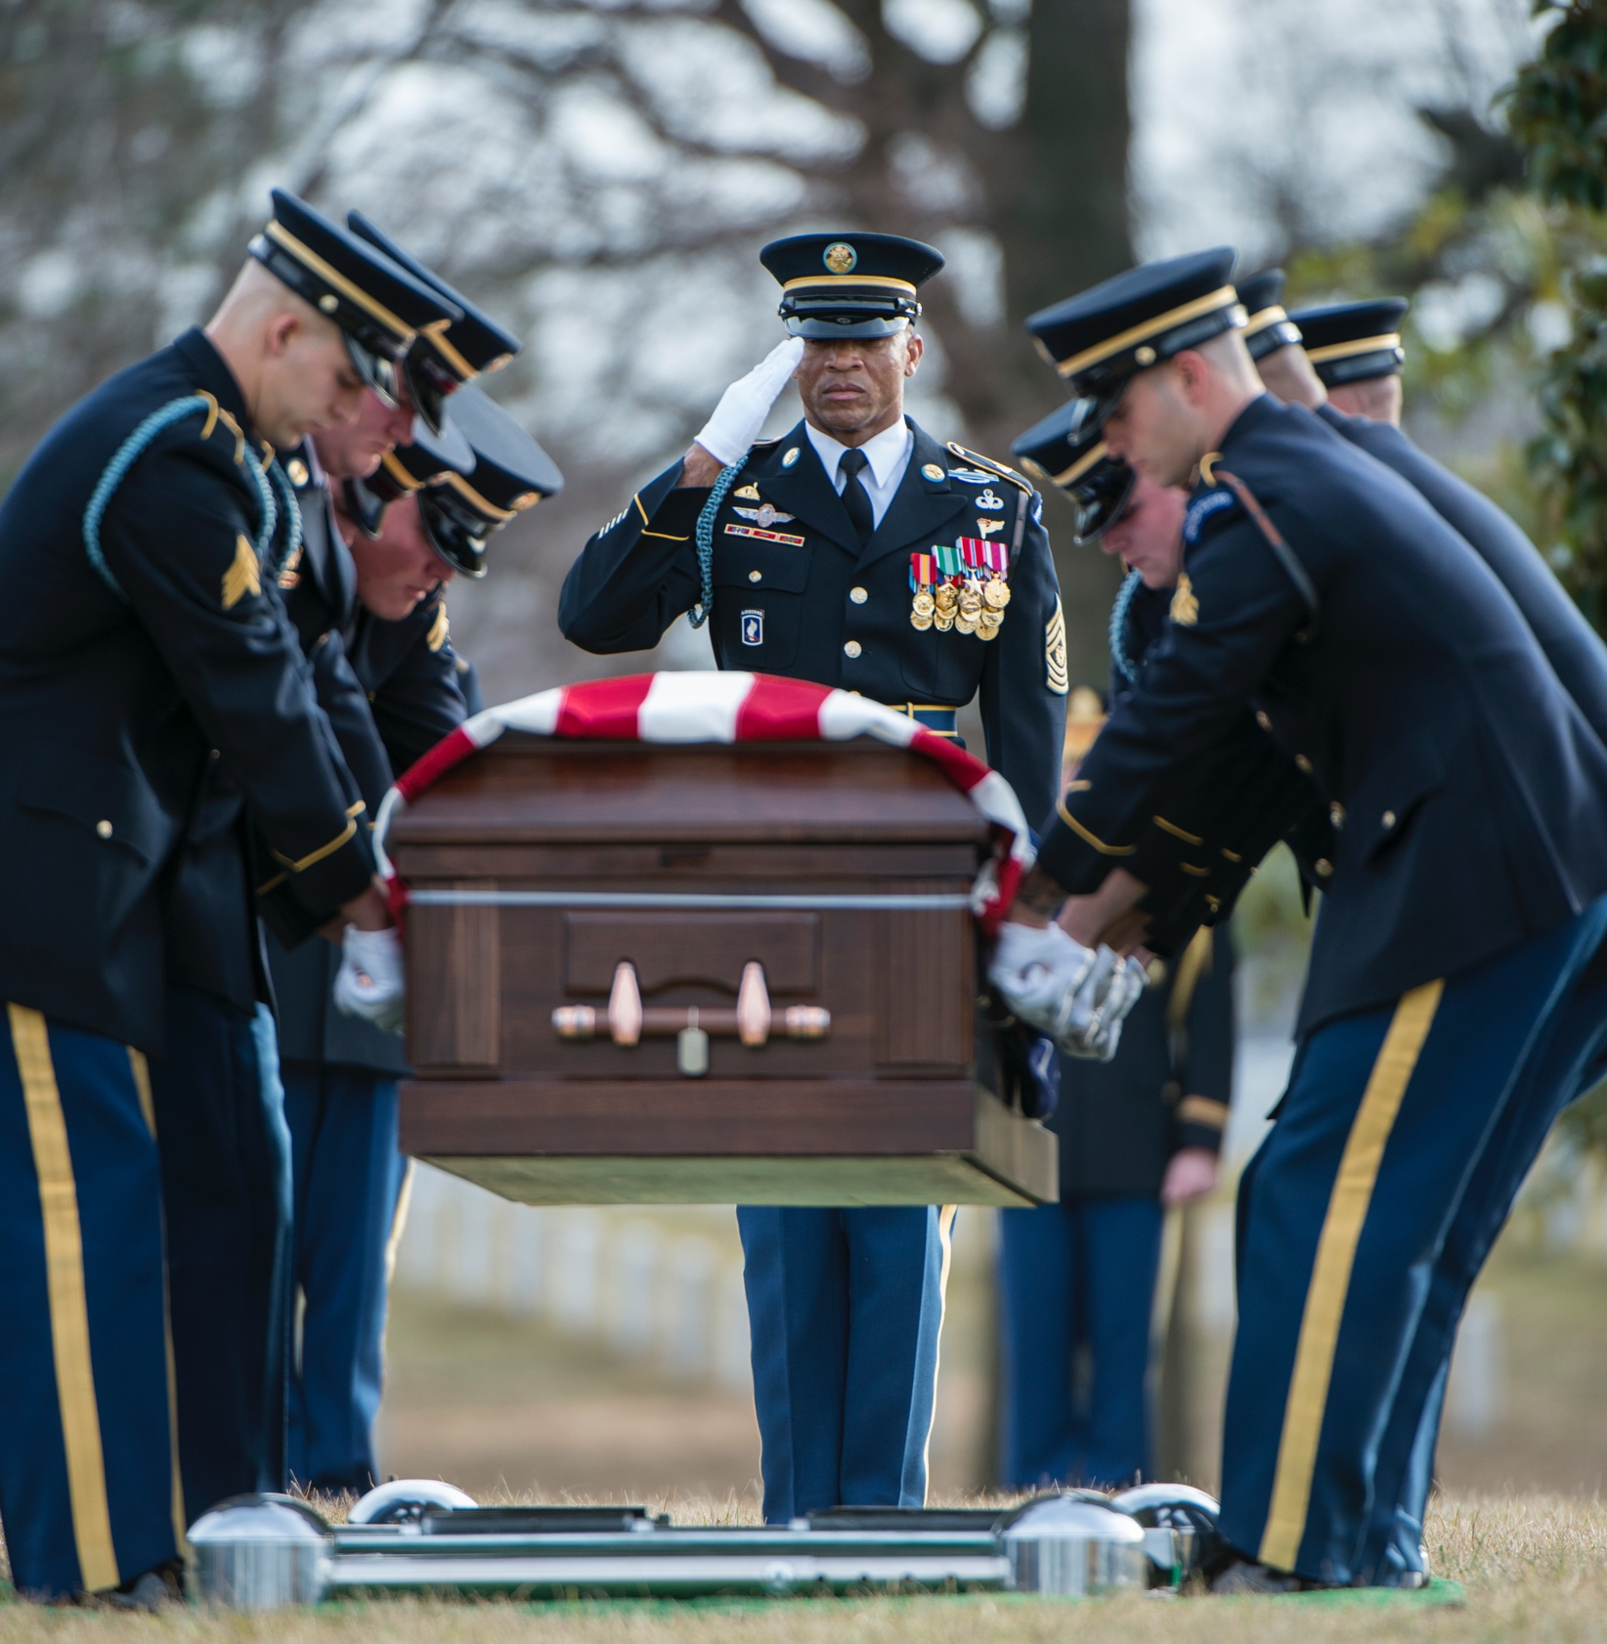
Eligibility Criteria
Active-duty service members
Selected reserve members
Honorably discharged retirees, veterans and selected reserve members
Medal of Honor recipients
Prisoner of War Medal recipients

Slide 3
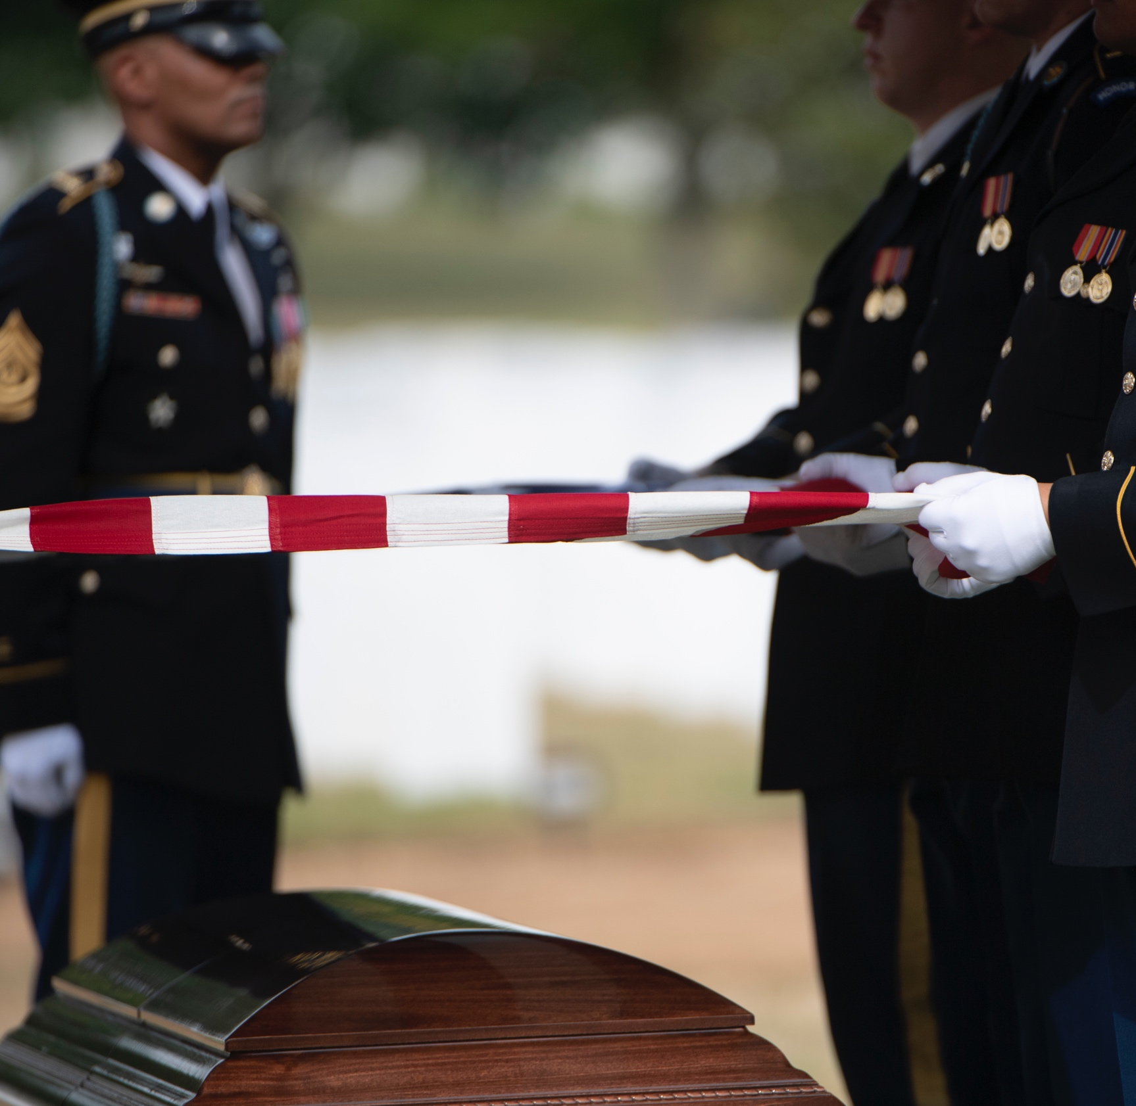
Military Funeral Honors Ceremony
The Army will provide a funeral honors ceremony including, at a minimum:
Folding of and presentation of the U.S. flag to the veteran’s family
Playing of Taps (unless a bugler is on hand, the funeral honors detail will play a recorded version of Taps).

Slide 4
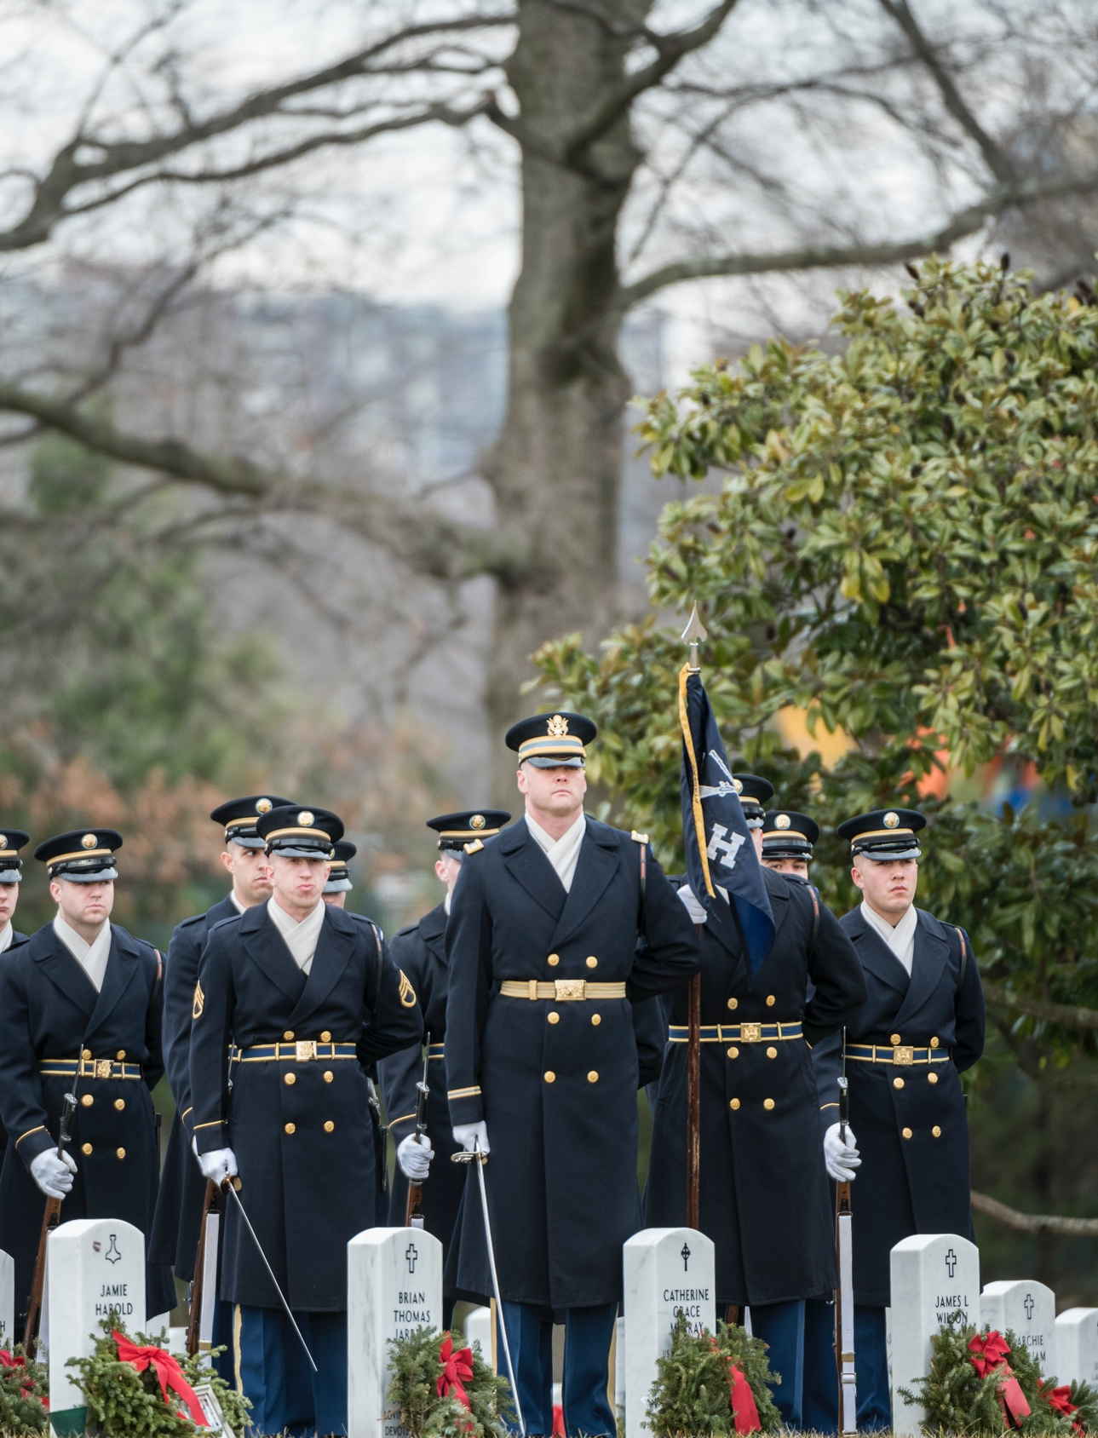
Honors Ceremony (continued)
Nine-member team (including firing party):
  Active-duty soldiers
  Medal of Honor and
  Prisoner of War Medal recipients
  Retirees*
Two-member team (at least one from veteran’s parent service):
  Veterans
  Retirees
*When resources are available.

Slide 5
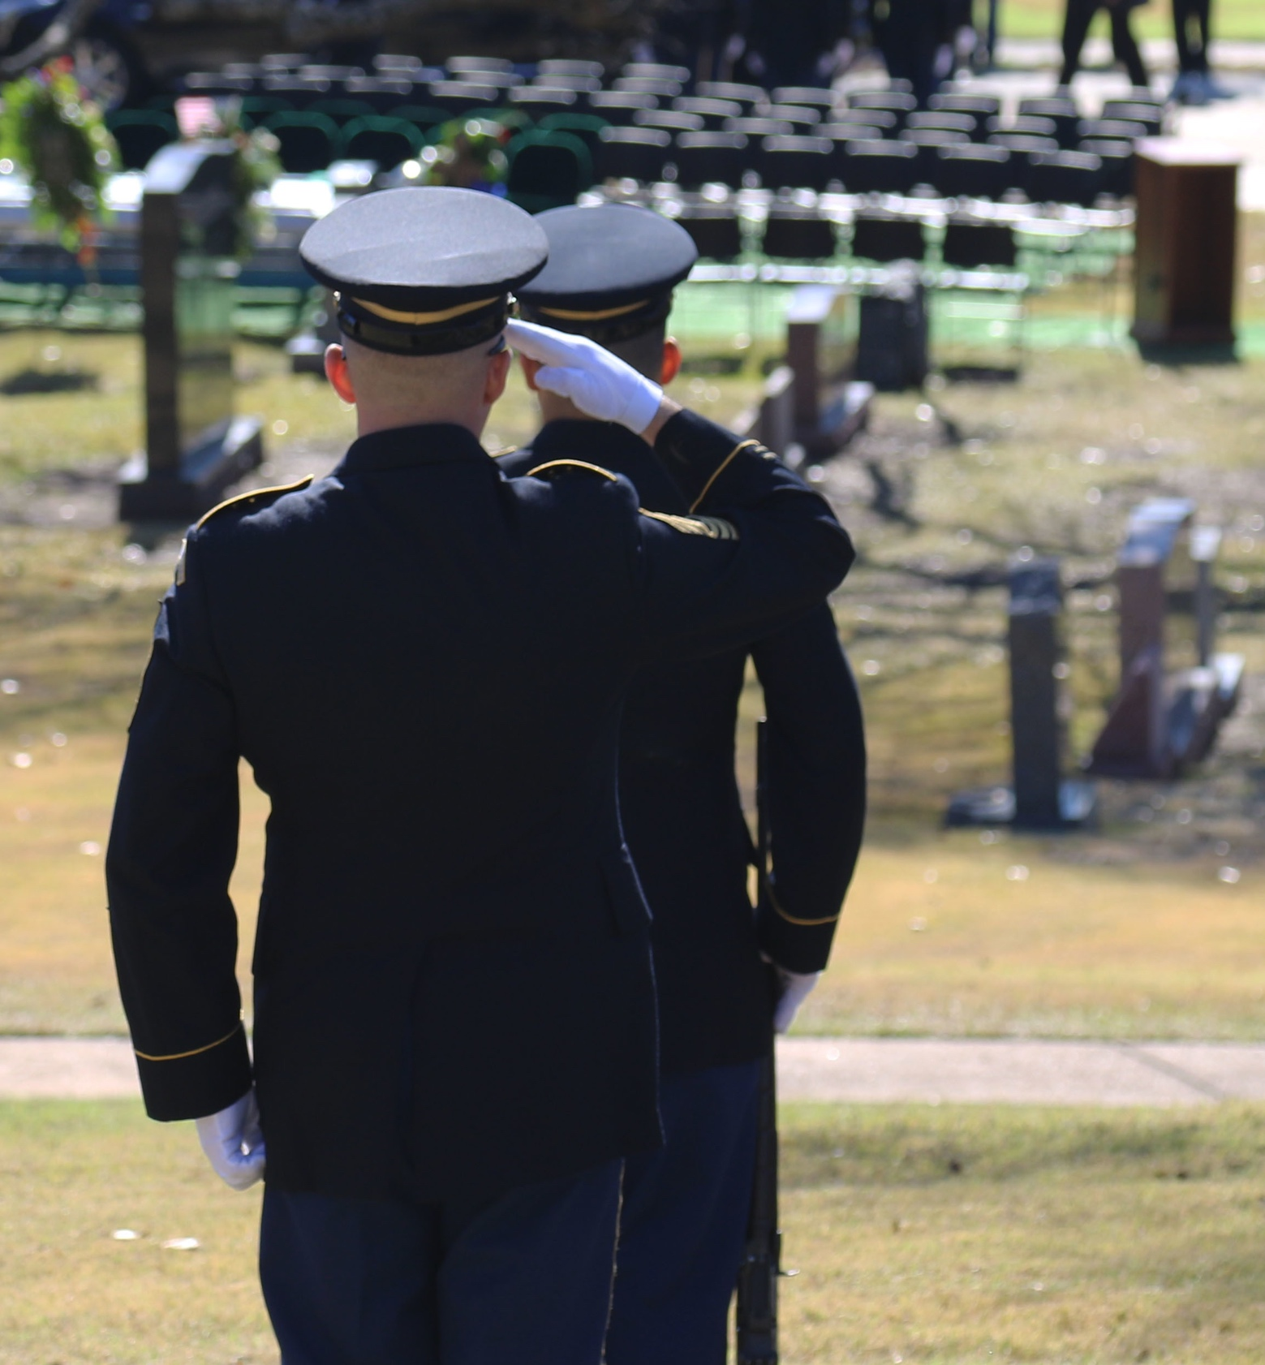
Requesting Funeral Honors
Funeral planners: Contact the military funeral honors regional coordinator through Military OneSource at: https://www.militaryonesource.mil/leaders-service-providers/casualty-assistance/military-funeral-honors

Slide 6
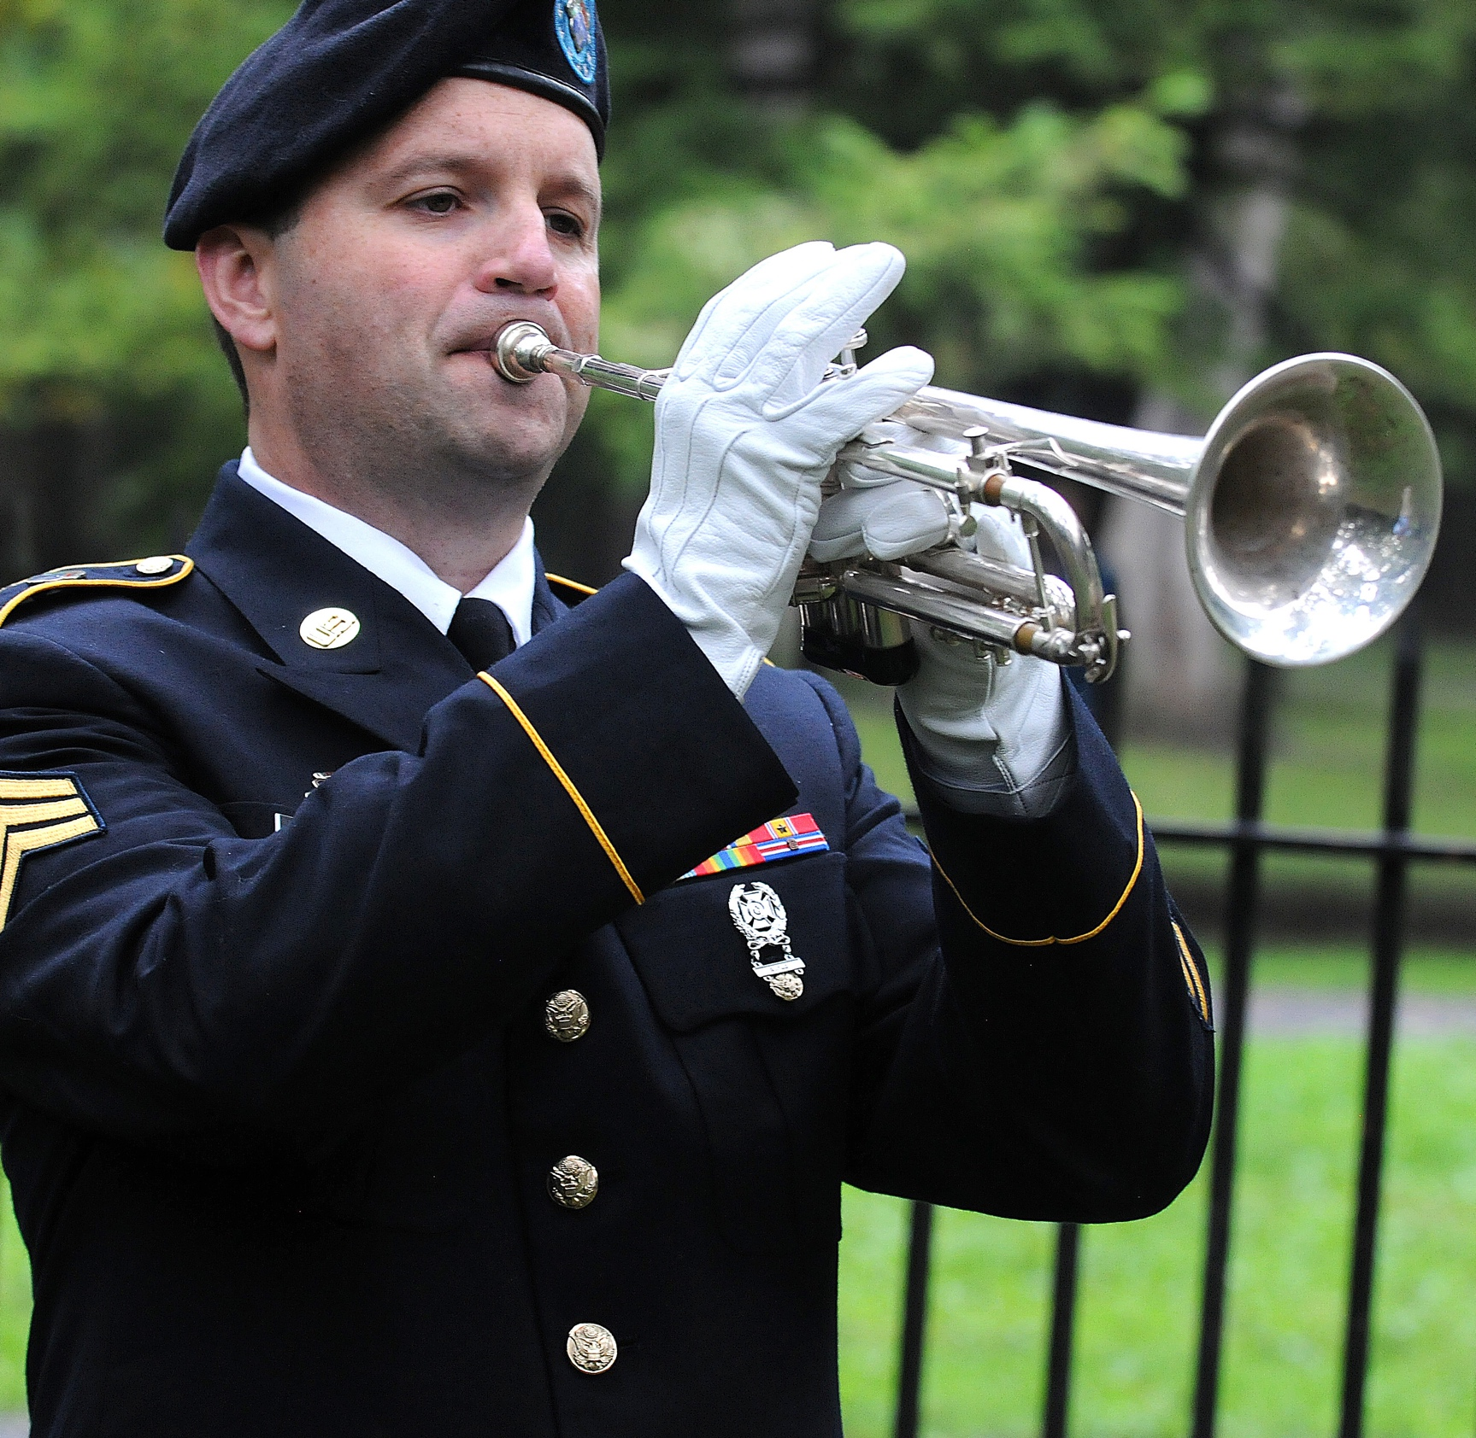
Statistics — Honors Rendered
In calendar year 2019, the Army rendered 135,305 honors.
In calendar year 2020, the Army rendered 111,630 honors.

Slide 7

Disclaimer
For additional information and resources related to the Military Funeral Honors Program, including Army Military Funeral Honors Program frequently asked questions,
visit Military OneSource
or call 800-342-9647.

