Slide 1
Military Funeral Honors
United States Marine Corps

Slide 2
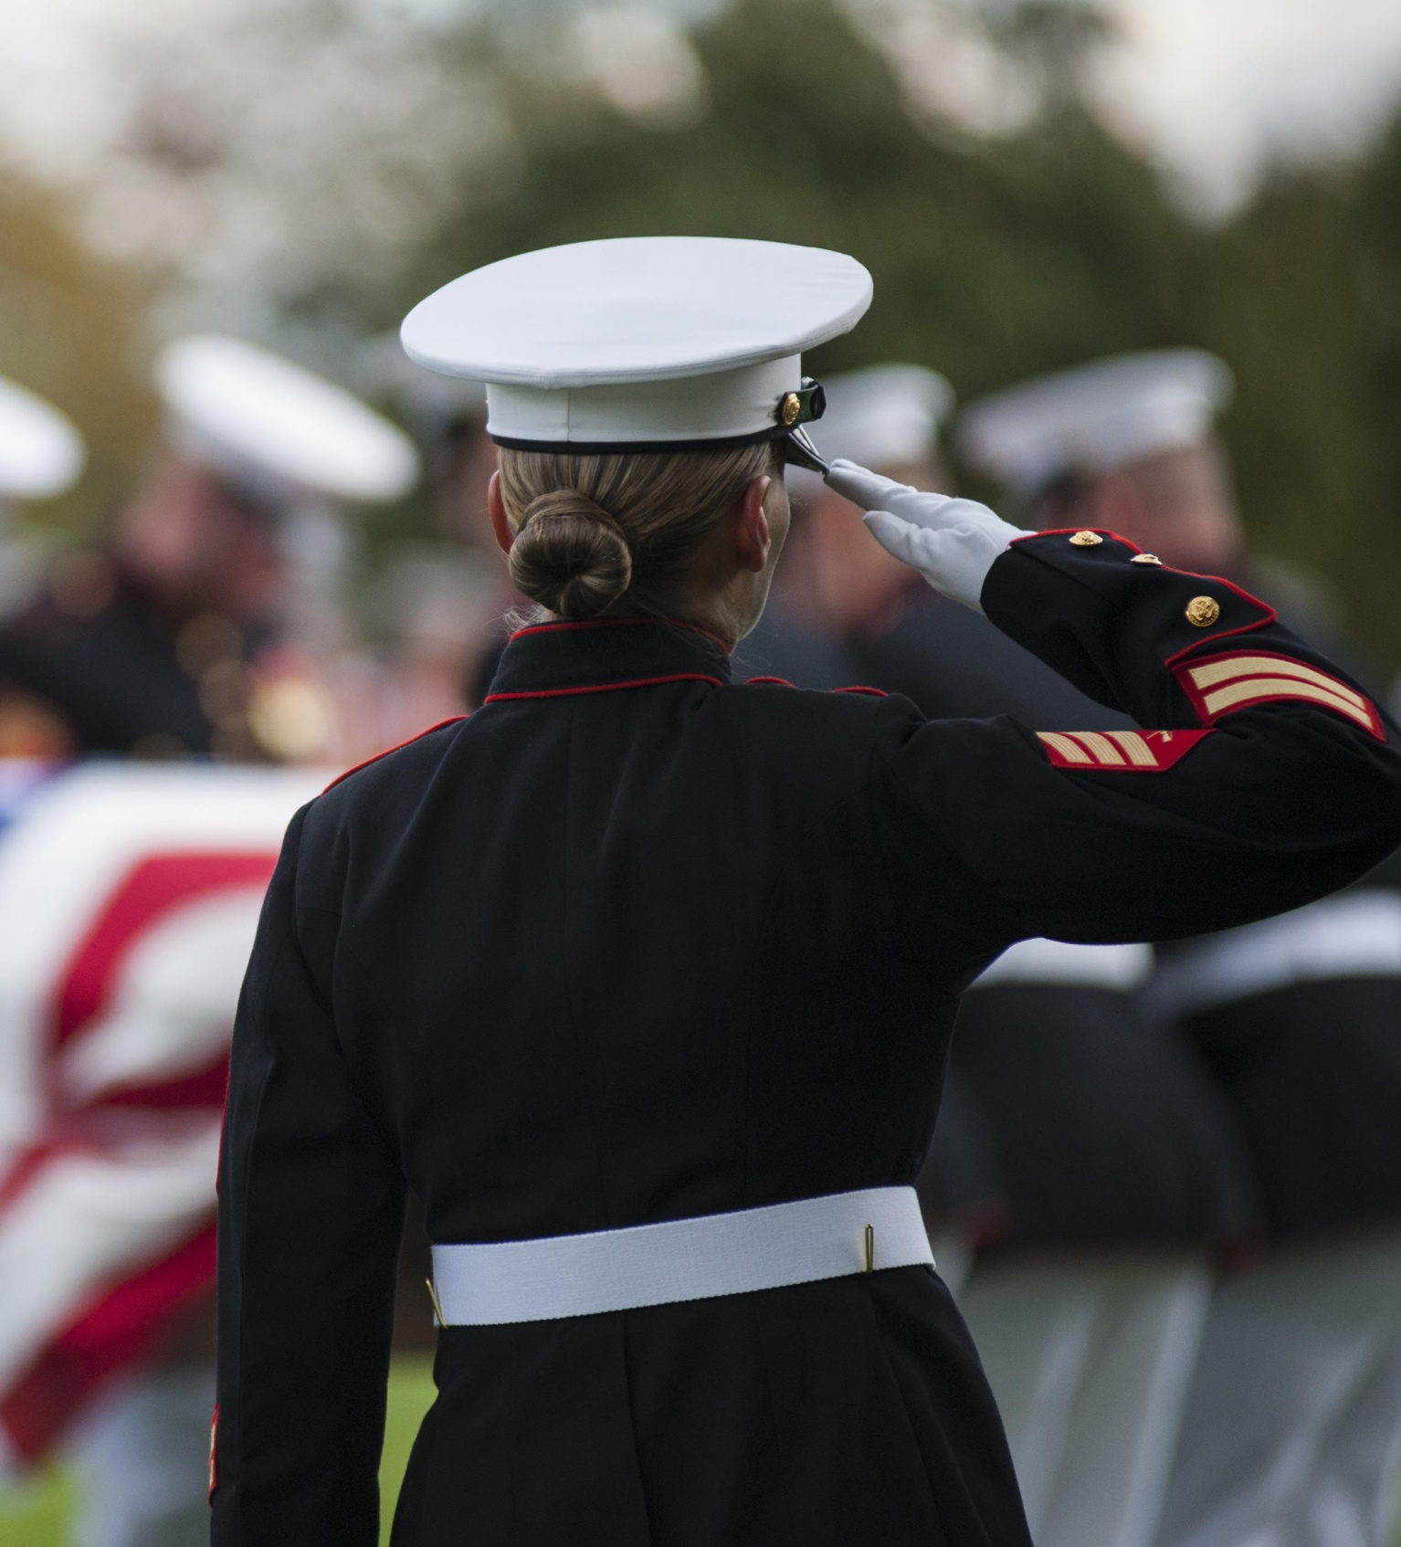
Mission
  “Taking Care of Our Own”
  This motto of the Marine Corps speaks to our enduring commitment to paying a final tribute to a Marine’s faithful and honorable service to our country by providing military funeral honors.

Slide 3
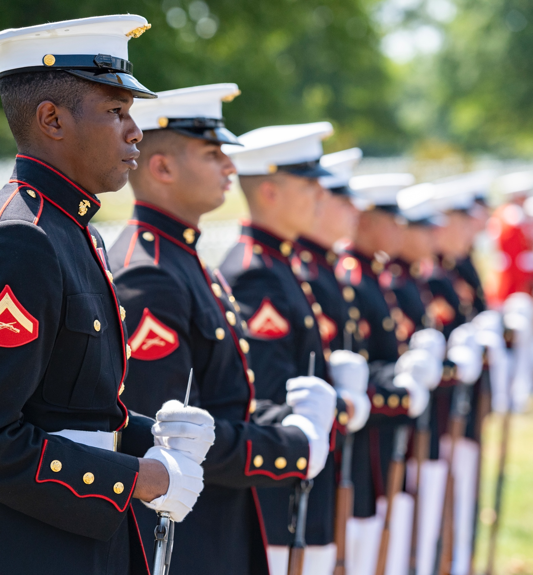
Eligibility Criteria
  The following personnel are eligible
  for honors:
  Active-duty service members
  Reserve service members
  Honorably discharged retirees
  Honorably separated veterans

Slide 4
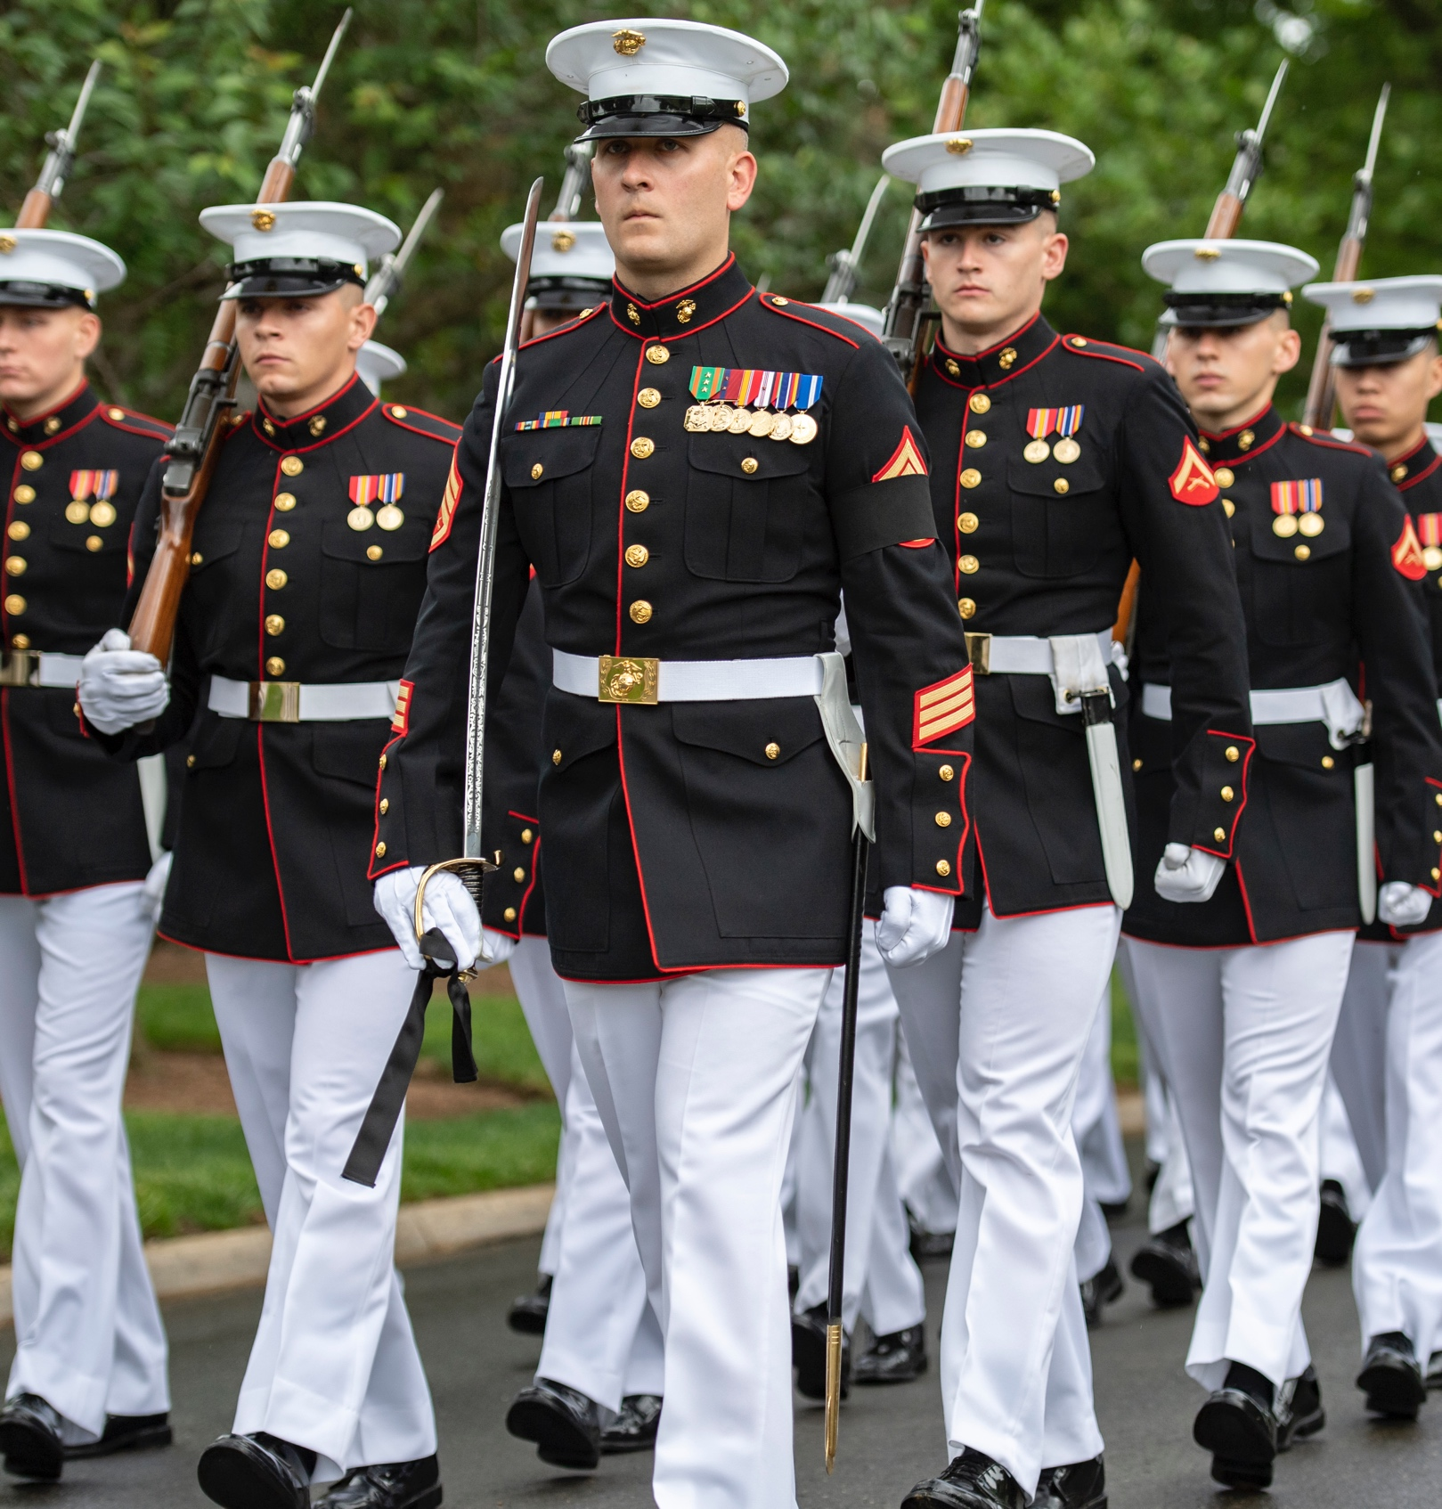
Denial of Military Funeral Honors
Funeral honors support will be denied for Marines or veterans who:
Die in a deserter status
Receive a bad conduct, dishonorable or any other-than-honorable discharge
Were convicted of a federal or state capital crime
Die before being tried for such a crime
Flee to avoid prosecution
Die under circumstances that would bring discredit to the Marine Corps

Slide 5
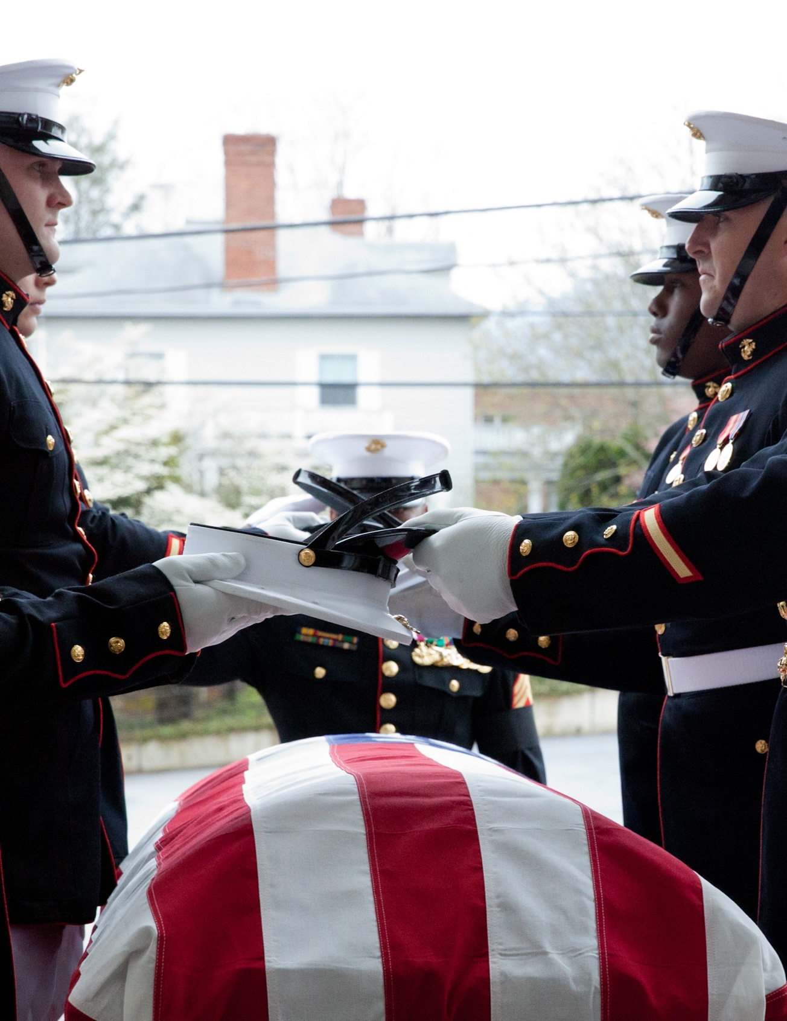
Procedures for Requesting Honors
  The funeral director or funeral planner is required to submit a request for military funeral honors with a DD Form 214 or the Honorable Discharge Certificate.
    Download the request form from this website: https://www.hqmc.marines.mil/agencies/Casualty-MFPC/Funeral-Honors-Request-form/
Submit the documentation to Marine Corps headquarters in one of the following ways:
  Website: https://www.hqmc.marines.mil
  Email: Funeral.Honors@usmc.mil
  Fax: 703-432-9248

Slide 6
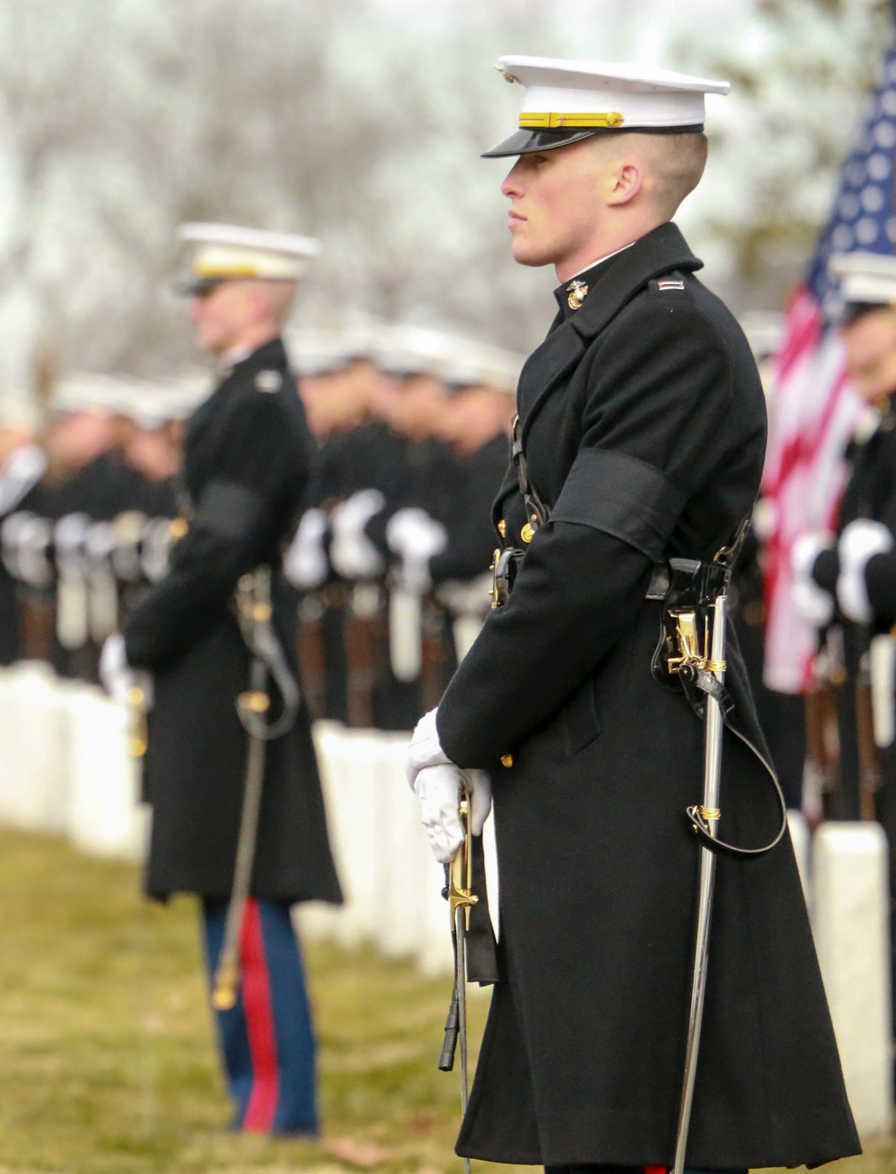
Procedures for Requesting Honors Continued
  Following receipt of the funeral director’s request form:
A Marine Corps representative will contact the funeral director or funeral planner within 24-hours to verify the information and request discharge documentation to verify the decedent’s honorable service.
Upon verification of honorable service, the Marine Corps unit closest to the place of interment/inurnment will be tasked to perform honors.

Slide 7
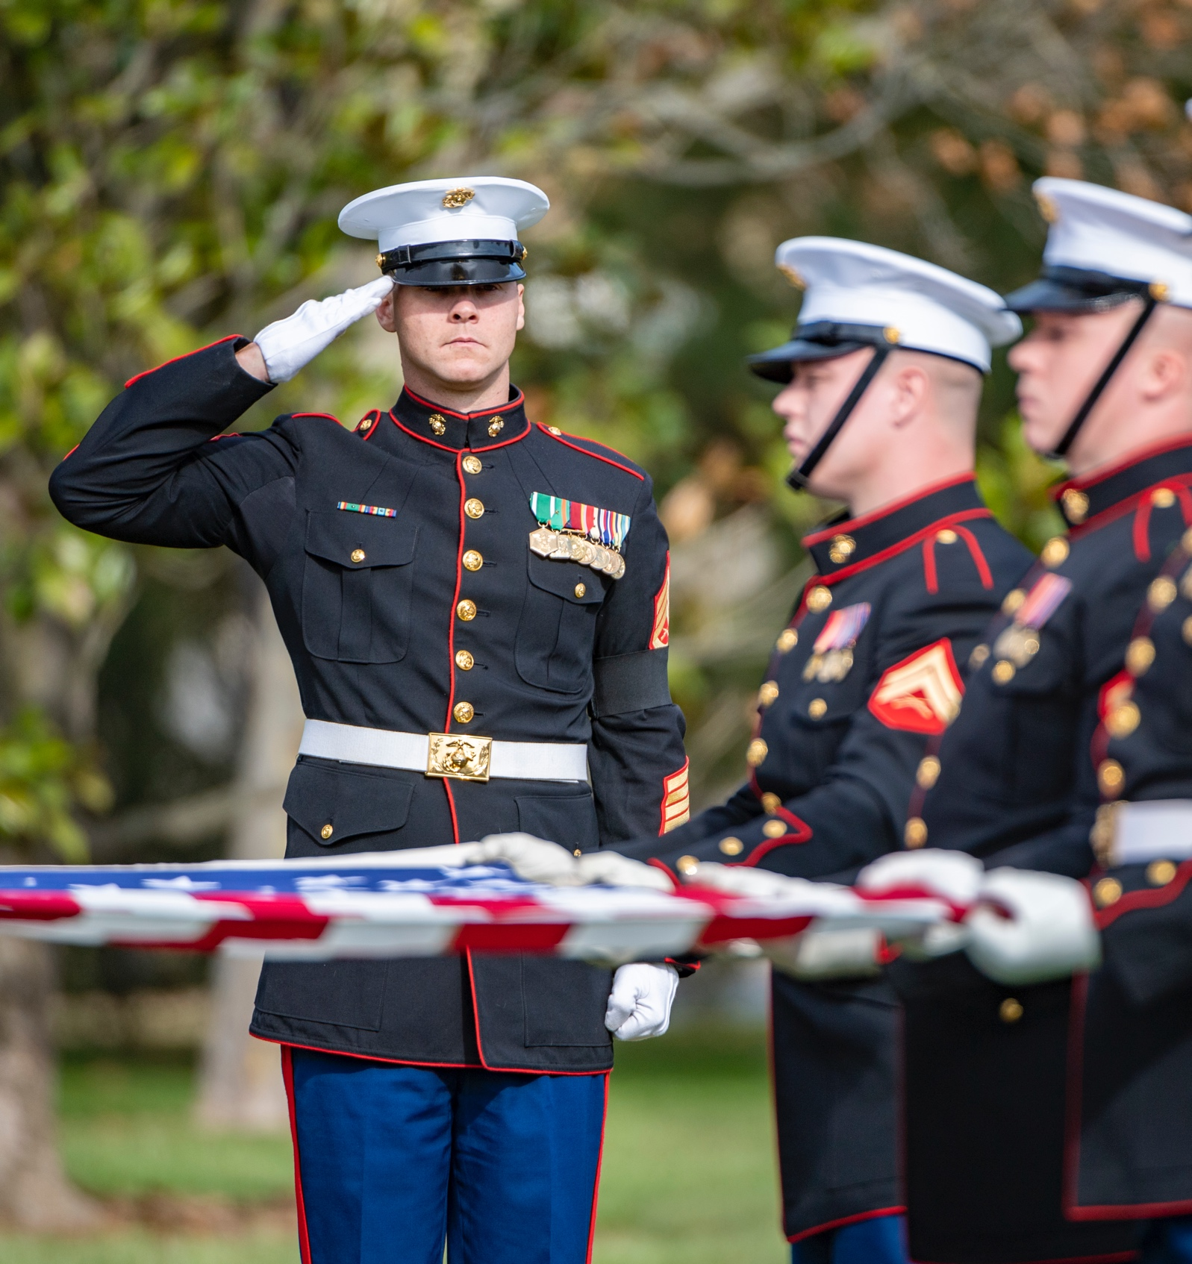
Funeral Honors Support — Minimum Requirements
  Upon approval for military funeral honors:
A detail is provided.
The ceremony will include the folding of the flag and its presentation to the next of kin (or an approved representative), and the playing of Taps via a ceremonial or live bugler.
Two members of the detail must be members of the armed forces, and at least one must be a Marine.

Slide 8
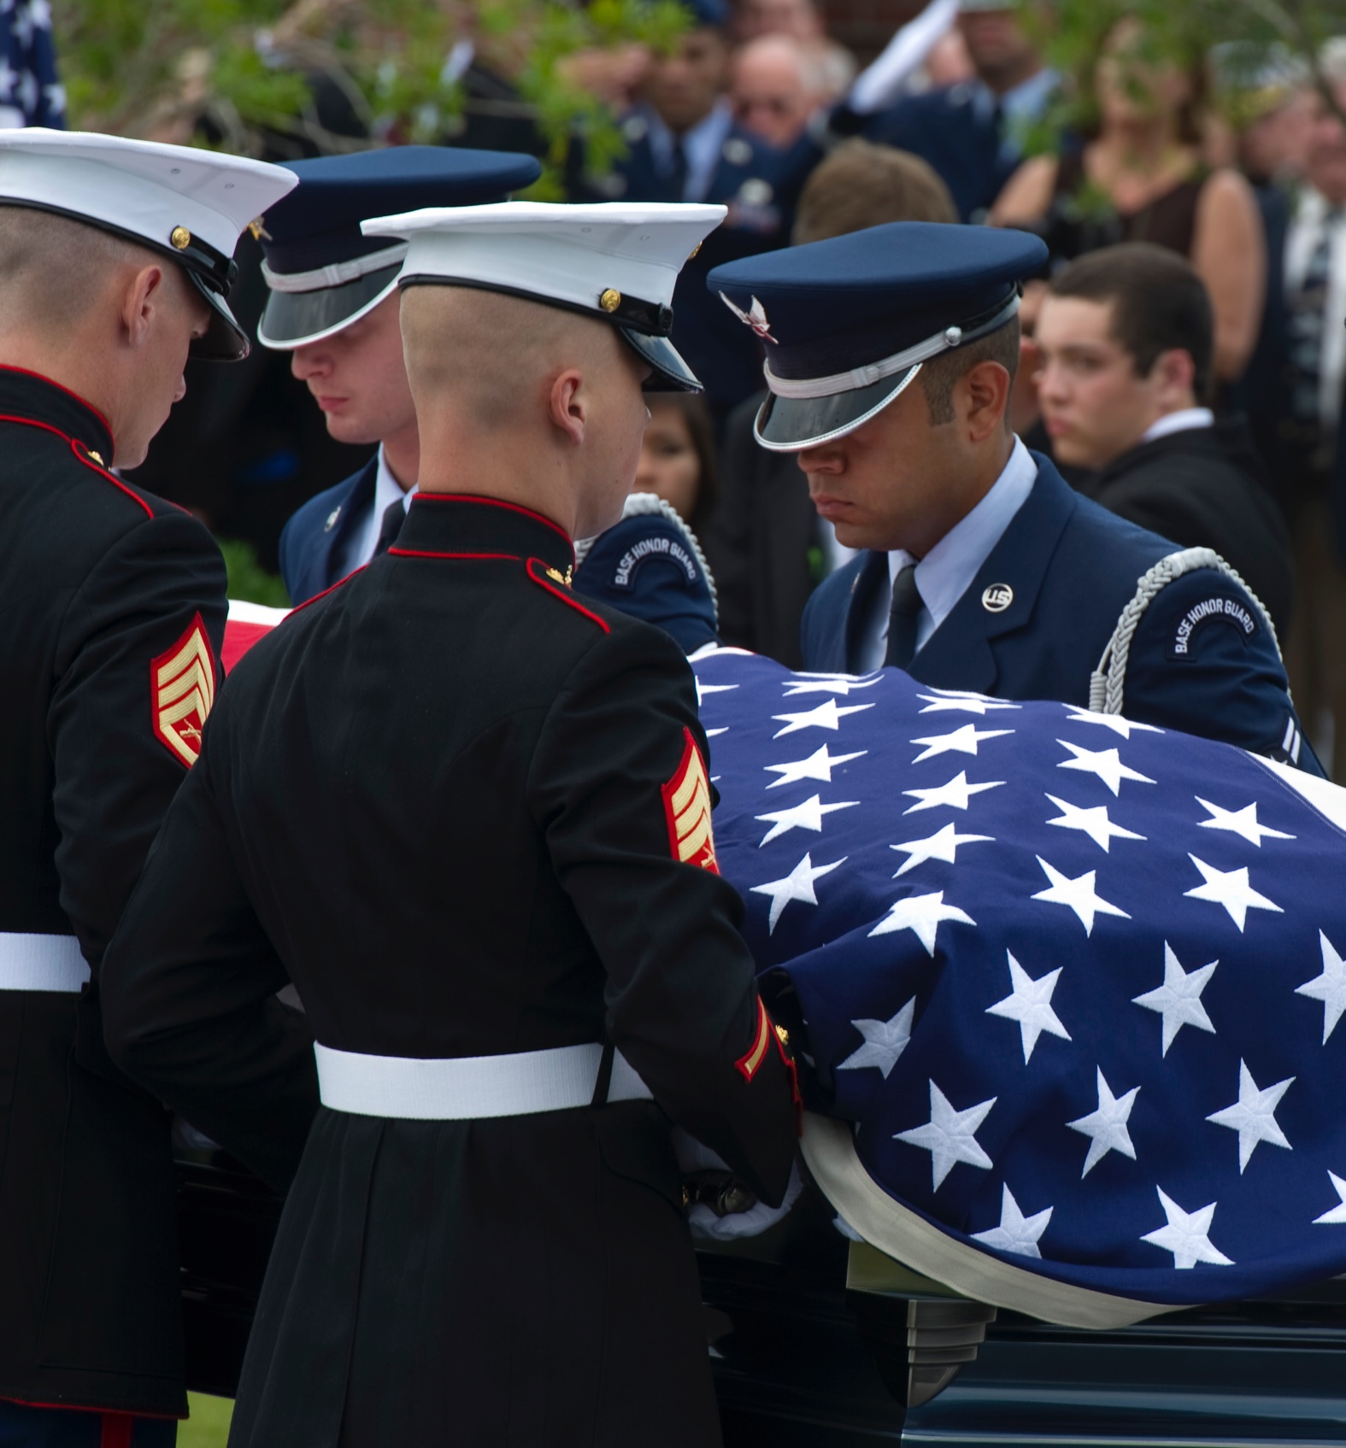
Supporting Members of Another Service
Upon request, the Marine Corps will render honors for veterans from another branch of service provided the decedent:
    Served under a Marine command (parent branch of service will be notified first)
    Served in the Marine Corps prior to another branch (with supporting documents)
    Was honorably discharged from both branches

Slide 9

Contact:
For additional information and resources related to the Military Funeral Honors Program, including Military Funeral Honors Program, frequently asked questions,
visit MilitaryOneSource.mil or call 800-342-9647.

