Slide 1
Military Funeral Honors
United States Navy Burial At Sea Program

Slide 2
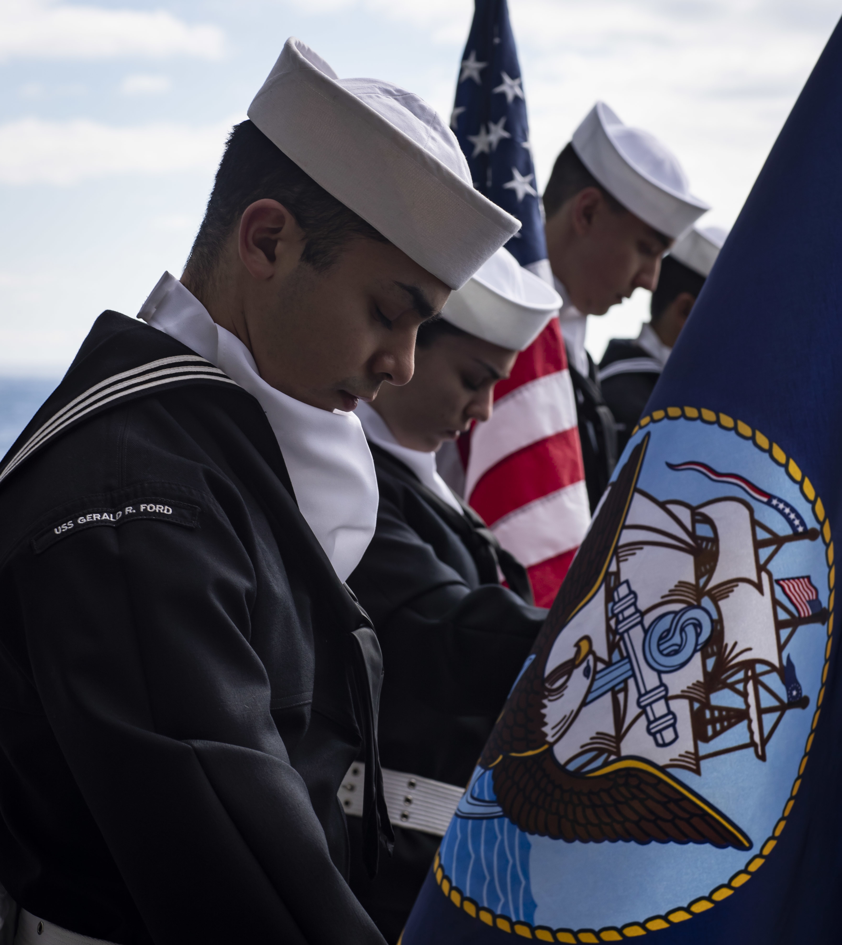
Burial at Sea
Burial at sea is a means of final disposition of remains, which is performed:
On U.S. Naval vessels
While the ship is deployed
Without family members present
Once completed, the commanding officer will notify the family of the ceremony’s:
Date
Time
Latitude and longitude

Slide 3
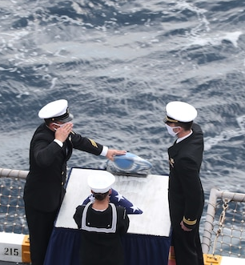
Eligibility Criteria
Active-duty service members
Honorably discharged retirees and veterans
U.S. civilian marine personnel of the Military Sealift Command
Dependent family members of active-duty personnel, retirees and veterans

Slide 4
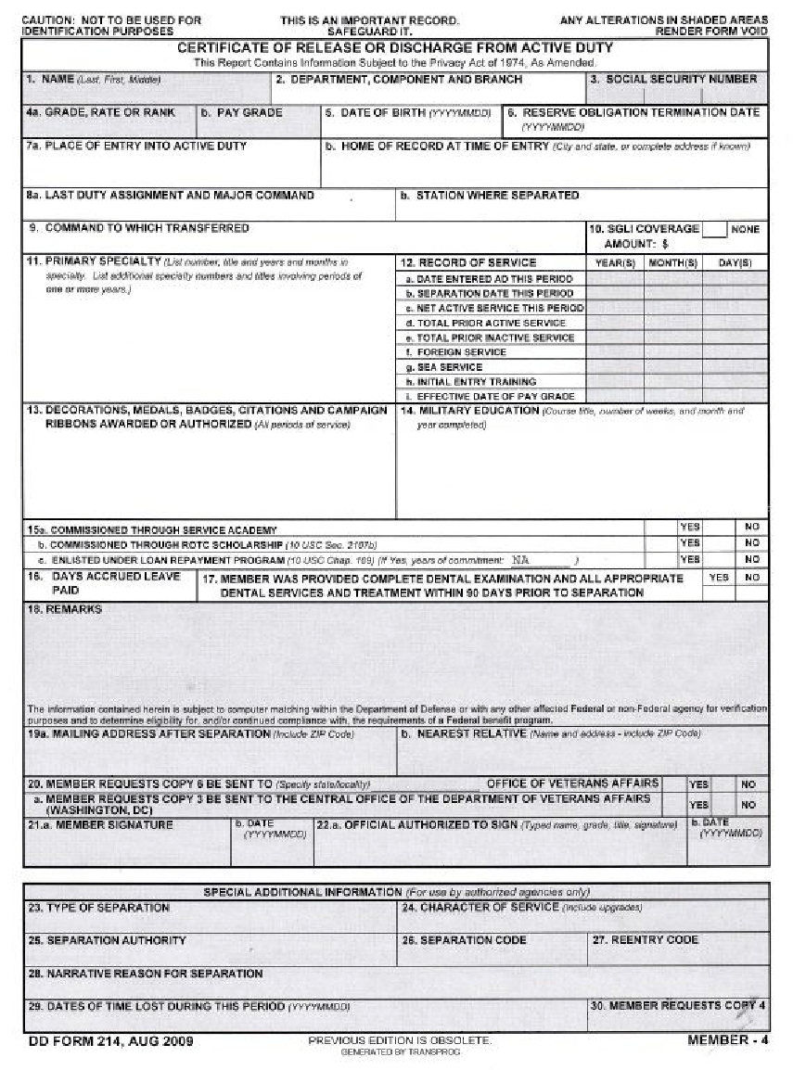
How to Get Started
After the death of the individual, the person authorized to direct disposition or the primary next of kin should print out and complete the Burial At Sea Request Form and include the following documents:
Photocopy of the death certificate
Burial transit permit or the cremation certificate
A non-notarized copy of DD Form 214, the discharge certificate or retirement orders

Slide 5
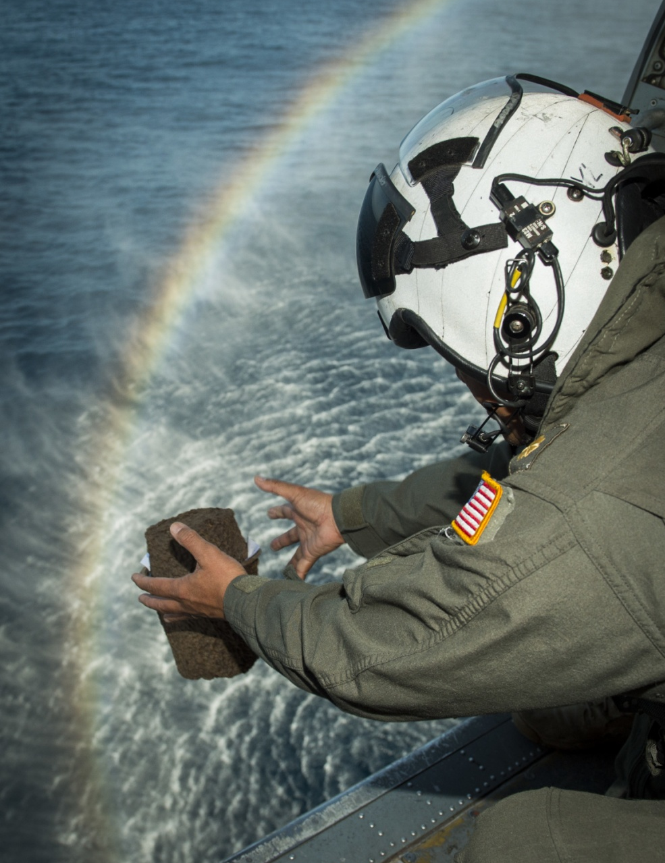
Timeline for Burial at Sea (Urn)
Once all services for the deceased are completed, the urn, flag and required documents are sent to one of five burial-at-sea ports:
Norfolk, Virginia (urns or caskets)
Jacksonville, Florida (urns only)
San Diego (urns or caskets)
Bremerton, Washington (urns only)
Honolulu (urns only)
Once the port receives the urn and documentation, it can take:
Three months to be assigned to a U.S. vessel
Two weeks prior to the ship’s deployment to notify the family
One year for the ship to deploy (when burial at sea will occur)
Until the ship returns from deployment for the family to receive a video of the service, a map showing where the burial took place and a letter from the commanding officer

Slide 6
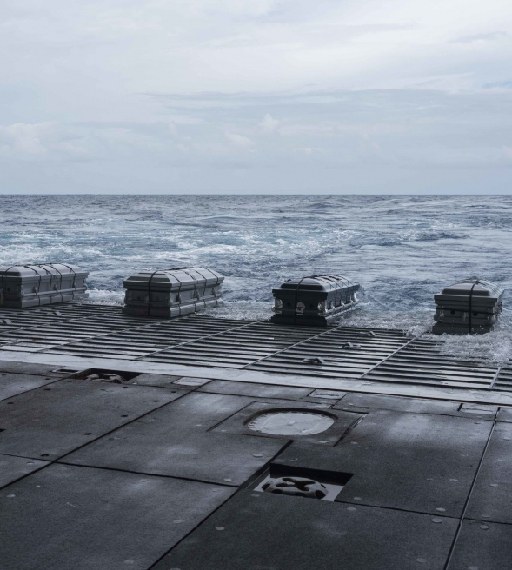
Timeline for Burial at Sea (Caskets)
The timeline for casketed remains is the same as cremated remains.
The Navy cannot recommend any funeral homes in the port cities (Norfolk, Virginia and San Diego).
The funeral home should be located near the port for when the Navy calls the funeral home for delivery.

Slide 7
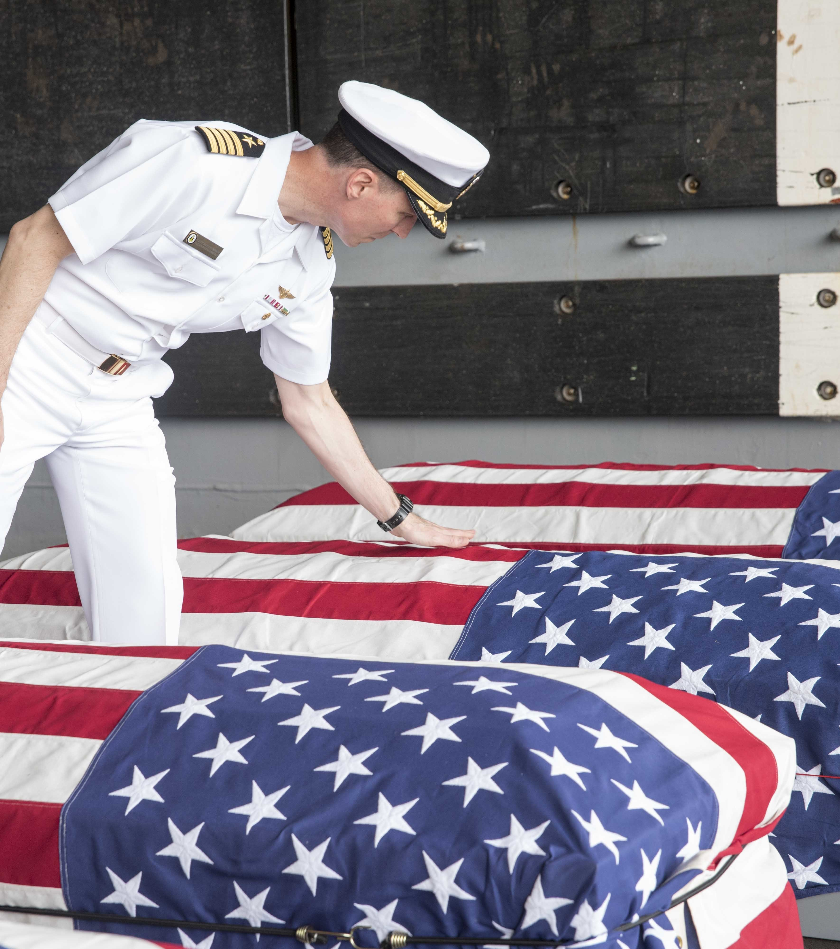
Burial Flag
A burial flag is required.
If the person authorized to direct disposition wants the flag flown over the ship during the committal service, they must send a flag with the remains/cremated remains.
Following the service, the flag is returned to the PADD. If no flag is sent, the ship’s flag will be flown during the committal service and will NOT be sent to the PADD.

Slide 8
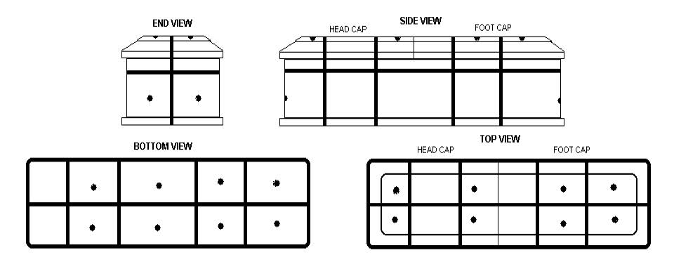
Casket Preparation for Burial at Sea
Add weight to the foot end of the casket until the total weight reaches 300 pounds.

Slide 9

Types of Urns for Burial at Sea
To help preserve the oceans, the U.S. Navy only allows for the following urns:
    Biodegradable (sea salt or cardboard)
    Metal
    Marble (stone)
No plastic urns will be used for burial at sea.
Remains that arrive at the port in a plastic urn will not
be assigned to a ship until a new urn can be furnished.

Slide 10

Contact:
For additional information and resources related to the Military Funeral Honors Program, including Navy Burial At Sea Program frequently asked questions, visit MilitaryOneSource.mil
or call 800-342-9647.

