Slide 1

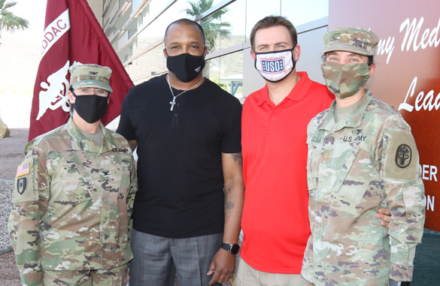
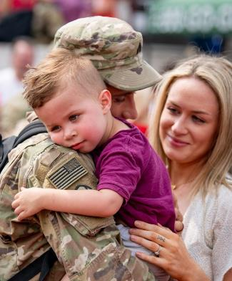








Resources Exist, Asking Can Help–Spouse
REACH OUT, GET HELP, AND THRIVE
Session 1:
Overcoming Barriers, Finding Resources, and Thriving as a Military Spouse
Facilitator Name
Location
Date
Active Duty; Version 3 (March 2024)
(OPA-2021-035, PERSEREC-PA-20-01)

Slide 2
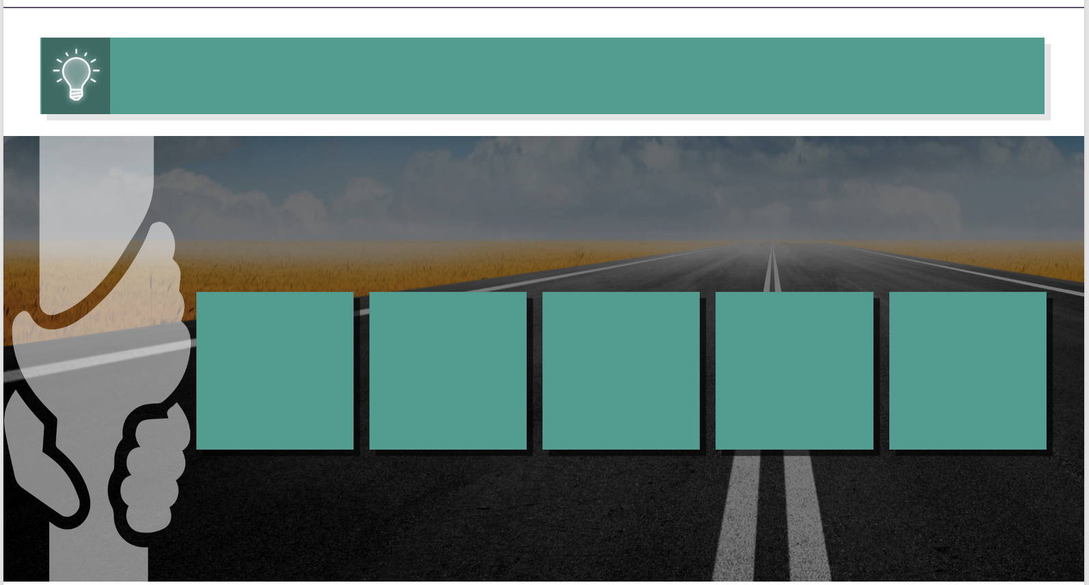

Session 1 Roadmap
Your journey to self-care and wellness starts here!
Purpose of REACH-Spouse
Content of REACH-Spouse
Unique Challenges
Barriers to Help Seeking
Practice Call to Military OneSource
Self-Care
Wrap-Up &
Resource List
Privacy of what we discuss
REACH–Spouse was developed by
Unique Challenges
Barriers to Help Seeking
Practice Call to Military OneSource
Self-Care
Wrap-Up &
Resource List
Privacy of what we discuss

Slide 3


Military Spouse Challenges
As a group, military spouses report having significantly more mental health concerns than spouses who are not in the military. Why is that?
As a group, military spouses report having significantly more mental health concerns than spouses who are not in the military. Why is that?
Challenges
All Spouses Face:
Little time for self-care
Frequently parenting
alone
Relationship problems
Unemployment or underemployment
Financial concerns
Self-reliant mentality
Additional Challenges
Military Spouses Face:
Wide range of military-related responsibilities and expectations
Frequent relocations
  Education and job security
Being away from family and friends
Service member frequently gone
  Long days, trainings, extended time in the field
Deployment and reintegration
Service member’s health and well-being
Access to care challenges
We can overcome these challenges by reaching out for help when we need it.
Challenges
All Spouses Face:
Little time for self-care
Frequently parenting
alone
Relationship problems
Unemployment or underemployment
Financial concerns
Self-reliant mentality
Additional Challenges
Military Spouses Face:
Wide range of military-related responsibilities and expectations
Frequent relocations
  Education and job security
Being away from family and friends
Service member frequently gone
  Long days, trainings, extended time in the field
Deployment and reintegration
Service member’s health and well-being
Access to care challenges
We can overcome these challenges by reaching out for help when we need it.

Slide 4




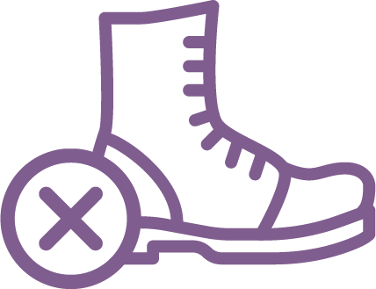
Barriers to Help Seeking
Why are military spouses often reluctant to seek help for mental health concerns?
Why are military spouses often reluctant to seek help for mental health concerns?
Barrier to Care: A barrier or obstacle, real or perceived, that prevents
a person from accessing needed help.
Based on published literature and discussions with military spouses, the most
frequently identified barriers to seeking help with a personal problem were:
Unaware of Available Resources
Stigma
Fear of Negative Impact on Service Member’s Career
Practical
Concerns
Barrier to Care: A barrier or obstacle, real or perceived, that prevents
a person from accessing needed help.
Based on published literature and discussions with military spouses, the most
frequently identified barriers to seeking help with a personal problem were:
Unaware of Available Resources
Stigma
Fear of Negative Impact on Service Member’s Career
Practical
Concerns

Slide 5






Mental Health Resources for Military Spouses
Unaware of
Available Resources
CONFIDENTIALITY
EXCEPTIONS
FORMAT
Local Religious Leaders or Installation Chaplains
Total
Unless consent is freely given and is specific regarding the information to be disclosed
In-person
Telephone*
Military/Veterans Crisis Line
Total
If the caller provides contact information,
a case manager will make contact by the
next business day
Telephone*
Email*
Live chat*
Military OneSource
Non-Medical Counseling
Partial
Duty to warn
In-person
Telephone*
Secure video*
Secure online chat*
Military & Family Life Counselors (MFLC)
Partial
Duty to warn
In-person
Telephone*⁺
Secure video*⁺
Family Readiness System
Partial
Duty to warn
In-person
Telephone*
Behavioral Health Services
Partial
Duty to warn
In-person
Secure video*⁺
Emergency Room
Partial
Duty to warn
In-person
* Can be done in the privacy of one’s home. ⁺ Available in areas where face-to-face support is restricted due to COVID-19.

Slide 6
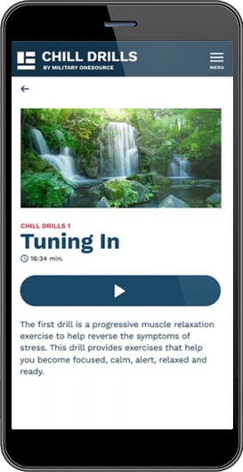

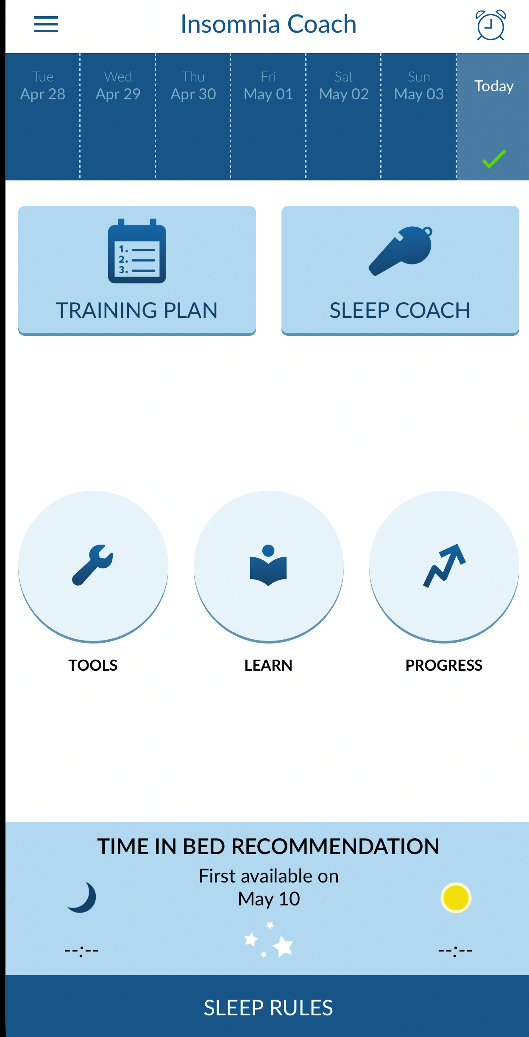
Mobile Resilience Tools
Unaware of
Available Resources
*All can be downloaded for FREE from iOS App Store or Google Play Store.

Slide 7


Fear of Being Perceived as Broken
Stigma
On a scale from 1-10, if you faced a mental
health problem, how likely would you be to
seek help?
On a scale from 1-10, if you faced a mental
health problem, how likely would you be to
seek help?
Coping with mental health stigma:
Learn about it—what resource is best for you?
Trust yourself—don’t let self-doubt and shame stop you from getting help.
Find your people—who helps you? Who makes you feel better?
Join a support group you feel comfortable with.
Speak about your experiences.
Always remember:
It is not your fault and you are not alone.
You are amazing just the way you are. You are more than just your problems.
Everyone deserves to get help. Advocate for yourself!
Seeking help early is always better.
Do not give up until you get the help you need.
If you are still reluctant to reach out for help because of stigma, try the resources that offer total confidentiality.
1
2
3
4
5
6
7
8
9
10
Coping with mental health stigma:
Learn about it—what resource is best for you?
Trust yourself—don’t let self-doubt and shame stop you from getting help.
Find your people—who helps you? Who makes you feel better?
Join a support group you feel comfortable with.
Speak about your experiences.
Always remember:
It is not your fault and you are not alone.
You are amazing just the way you are. You are more than just your problems.
Everyone deserves to get help. Advocate for yourself!
Seeking help early is always better.
Do not give up until you get the help you need.
If you are still reluctant to reach out for help because of stigma, try the resources that offer total confidentiality.

Slide 8
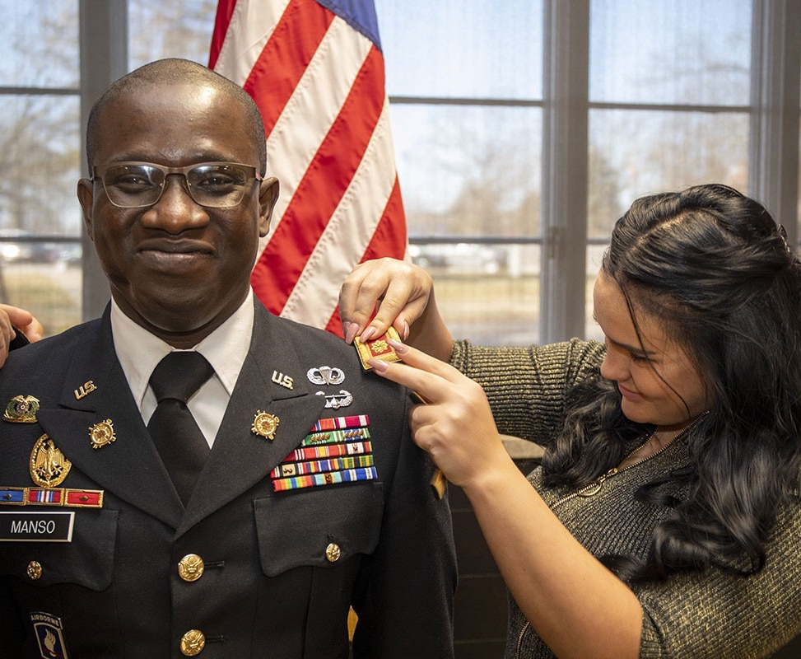
Fear of Negative Career Impact
Fear of Negative Impact on Service Member’s Career
Many spouses fear that if they seek mental health treatment, it will hurt their service member’s career.
Removing Fear
Improving your mental health can lead to positive changes in the service member’s mental health and career.
A healthy environment in the home helps to foster a healthy and productive environment at work.
Improving Outcomes
Getting help early outweighs the possible risks.
The earlier you seek help for a mental health issue, the lower the possible impact, if any, on family and career.
Still Concerned?
Choose more confidential resources.
Many spouses fear that if they seek mental health treatment, it will hurt their service member’s career.
Removing Fear
Improving your mental health can lead to positive changes in the service member’s mental health and career.
A healthy environment in the home helps to foster a healthy and productive environment at work.
Improving Outcomes
Getting help early outweighs the possible risks.
The earlier you seek help for a mental health issue, the lower the possible impact, if any, on family and career.
Still Concerned?
Choose more confidential resources.

Slide 9


Practical Concerns
Practical Concerns
ISSUE | IDEAS TO HELP
Child Care | Look to build a social support network at each location (friends, religious options, drop-in day care, on-base day care options)
Transportation | Look for installation shuttles, bus passes, car pools, Lyft/Uber, rideshare
Schedule Too Busy/ Working | Book telehealth appointments, find alternative meeting times (24/7 and evening/weekend resources); coordinate with spouse; prioritize yourself
Personal Career Concerns | Find help early; ask about confidentiality
Difficulty Scheduling Appointments | Find a primary care manager/or a liaison for help; have someone call for you; start early
Navigating Insurance | Find a liaison; plan ahead
Cost | Look for reduced fee/free services (Employee Assistance Programs, local nonprofits, Give-an-Hour, Military OneSource, MFLCs)
Finding a Provider | Look for insurance provider list; ask others for referrals; look for online reviews; ask provider if they have worked with military families; ask about confidentiality
What other strategies have you used to overcome these issues?
What other strategies have you used to overcome these issues?

Slide 10
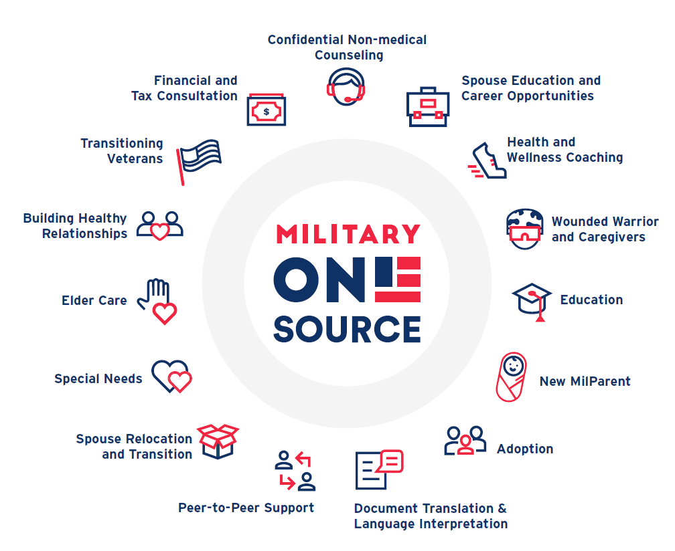
Military OneSource: 24/7 Support for the Military Community
Which of these resources do you see yourself using in the next few months?
Which of these resources do you see yourself using in the next few months?

Slide 11


Practice Call
Practice Making a Military OneSource Call
What did you notice about the call?
How would you feel about making a similar call if you were in that situation?
Commit to Seeking Help in the Future
Save these numbers in your phone:
  1-800-342-9647
  988, Press 1
When in need, use these resources and share them with your family members and military friends!
Practice Making a Military OneSource Call
Commit to Seeking Help in the Future
What did you notice about the call?
How would you feel about making a similar call if you were in that situation?
Save these numbers in your phone:
1-800-342-9647
988, Press 1
When in need, use these resources and share them with your family members and military friends!

Slide 12


The Importance of Self-Care
What is self-care and why is it important for your mental health and well-being?
What is self-care and why is it important for your mental health and well-being?
Definition: Any activity that we do deliberately to take care of our mental, emotional, and physical health.
Let’s consider:
What would you estimate is the average amount of time you spend each day on self-care?
Try to commit to scheduling self-care on a daily, weekly, or monthly basis.
“Authenticity is a collection of choices that we have to make every day.”
–Brené Brown
On a scale from 1-10, how likely would you be
to start practicing a daily self-care ritual?
Definition: Any activity that we do deliberately to take care of our mental, emotional, and physical health.
Let’s consider:
What would you estimate is the average amount of time you spend each day on self-care?
Try to commit to scheduling self-care on a daily, weekly, or monthly basis.
“Authenticity is a collection of choices that we have to make every day.”
–Brené Brown
On a scale from 1-10, how likely would you be
to start practicing a daily self-care ritual?
1
2
3
4
5
6
7
8
9
10

Slide 13


Self-Care and Mental Wellness Strategies
What do you do for self-care?
Self-Care Practices:
Relaxation: Meditation, physically unwinding, laughter
Mindfulness
Making time for hobbies: Reading, crafts, sewing, hiking
5-Minute breaks: What can you do during that time?
Connecting with friends
  Asking for help
Healthy lifestyle: Nutrition, sleep, exercise, regular checkups
Knowing your limits
  Saying “no”
Try this:
For one minute, let’s close our eyes and simply follow our breath. As you breathe in, think “in.” As you breathe out, think “out.”
“If you’re breathing, there’s more right with you than wrong.”
- Jon Kabat-Zinn
What do you do for self-care?
Self-Care Practices:
Relaxation: Meditation, physically unwinding, laughter
Mindfulness
Making time for hobbies: Reading, crafts, sewing, hiking
5-Minute breaks: What can you do during that time?
Connecting with friends
  Asking for help
Healthy lifestyle: Nutrition, sleep, exercise, regular checkups
Knowing your limits
  Saying “no”
Try this:
For one minute, let’s close our eyes and simply follow our breath. As you breathe in, think “in.” As you breathe out, think “out.”
“If you’re breathing, there’s more right with you than wrong.”
- Jon Kabat-Zinn

Slide 14


Takeaways
Military life is demanding, but I have the strength and resources to rise above.
Reaching out
early will help
me and my
family thrive.
Military life is demanding, but I have the strength and resources to rise above.
Reaching out early will help me and my family thrive.
I know what to expect when I call a resource line.
Self-care is important for my own and my family’s mental and physical health.
What did you find most helpful about today’s session?
I know what
to expect when
I call a resource line.
Self-care is
important for
my own and my
family’s mental
and physical health.
What did you find most helpful about today’s session?

