Slide 1

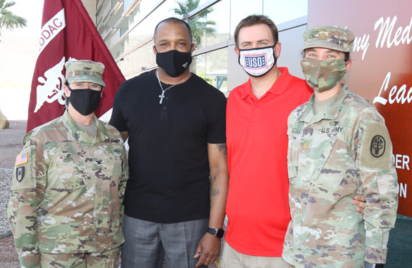
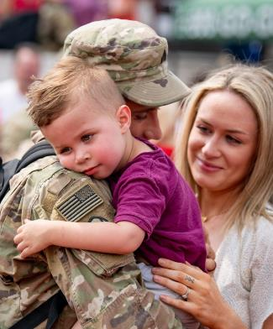








Resources Exist, Asking Can Help–Spouse
REACH OUT, GET HELP, AND THRIVE
Session 2:
Supporting Your Service Member’s Mental Health and Well-Being
Facilitator Name
Location
Date
Active Duty; Version 3 (March 2024)
(OPA-2021-035, PERSEREC-PA-20-01)

Slide 2




Session 2 Roadmap
Supporting your service member in their journey to self-care and wellness!
Purpose of REACH-Spouse
Content of REACH-Spouse
Service Member Challenges
Barriers to Help Seeking
Practice Call to Military OneSource
Suicide Prevention Skills
Wrap-Up & Resource List
Privacy of what we discuss
Supporting your service member in their journey to self-care and wellness!
Purpose of REACH-Spouse
Content of REACH-Spouse
Service Member Challenges
Barriers to Help Seeking
Practice Call to Military OneSource
Suicide Prevention Skills
Wrap-Up &
Resource List
Privacy of what we discuss
REACH–Spouse was developed by

Slide 3

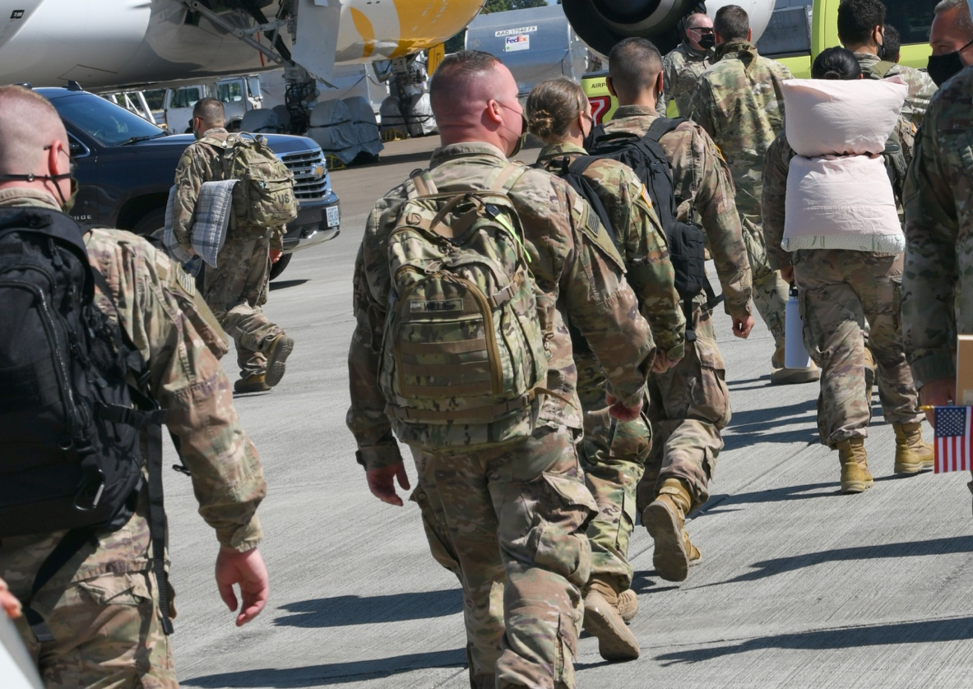
Service Member Challenges
Why do service members report having more mental health concerns than their civilian counterparts?
Service members have to deal with:
A wide range of military-related responsibilities and expectations
  Unpredictability
Frequent relocations
  Emotional stress
Separation from immediate family
  Long days, trainings, extended time in the field
Deployment and reintegration
  Combat-related trauma
Access to care issues
You can help your service member overcome these challenges by encouraging
them to reach out for help when they need it.
Why do service members report having more mental health concerns than their civilian counterparts?
Service members have to deal with:
A wide range of military-related responsibilities and expectations
  Unpredictability
Frequent relocations
  Emotional stress
Separation from immediate family
  Long days, trainings, extended time in the field
Deployment and reintegration
  Combat-related trauma
Access to care issues
You can help your service member overcome these challenges by encouraging
them to reach out for help when they need it.

Slide 4

Service Member Barriers to Help Seeking
Why are service members reluctant to seek help for mental health concerns?
Why are service members reluctant to seek help for mental health concerns?
Barrier to Care: A barrier or obstacle, real or perceived, that prevents
a person from accessing needed help.
Based on the 2018 DoD Status of Forces Survey and published literature, the most
frequently identified barriers to seeking help with a personal problem were:
77% Preference for Self-Reliance
67% Perception of Being “Broken”
65% Fear of Negative Career Impact
50% Not Knowing Which Resource To Use
Barrier to Care: A barrier or obstacle, real or perceived, that prevents
a person from accessing needed help.
Based on the 2018 DoD Status of Forces Survey and published literature, the most
frequently identified barriers to seeking help with a personal problem were:
77%
67%
65%
50%
Preference
for Self-Reliance
Perception
of Being “Broken”
Fear of Negative
Career Impact
Not Knowing Which Resource To Use

Slide 5
Handling Things on Their Own
Preference for
Self-Reliance
77%
SELF-CARE CONTINUUM
Pure Self-Care
Responsible Individual
Reading Self-Help Literature
Maintaining Physical Fitness
Talking to Your Spouse/Friend
Using Mental Health Apps
Shared Care
Shared Responsibility
Speaking With a Chaplain
Consulting a Health & Wellness Coach
Talking to a Counselor
Medical Care
Professional Responsibility
Seeing a Therapist
Managing Medication With a Psychiatrist
Going to the Emergency Room
Visual aid inspired by: http://www.selfcareforum.org/about-us/what-do-we-mean-by-self-care-and-why-is-good-for-people
Help your service member choose the optimal resource for each situation.
SELF-CARE CONTINUUM
Pure Self-Care
Responsible Individual
Shared Care
Shared Responsibility
Medical Care
Professional Responsibility
Reading Self-Help
Literature
Talking to Your Spouse/Friend
Managing Medication With
a Psychiatrist
Speaking With
a Chaplain
Talking to a
Counselor
Maintaining Physical Fitness
Using Mental
Health Apps
Consulting a Health
& Wellness Coach
Seeing a Therapist
Going to the
Emergency Room
Visual aid inspired by: http://www.selfcareforum.org/about-us/what-do-we-mean-by-self-care-and-why-is-good-for-people
Help your service member choose the optimal resource for each situation.

Slide 6
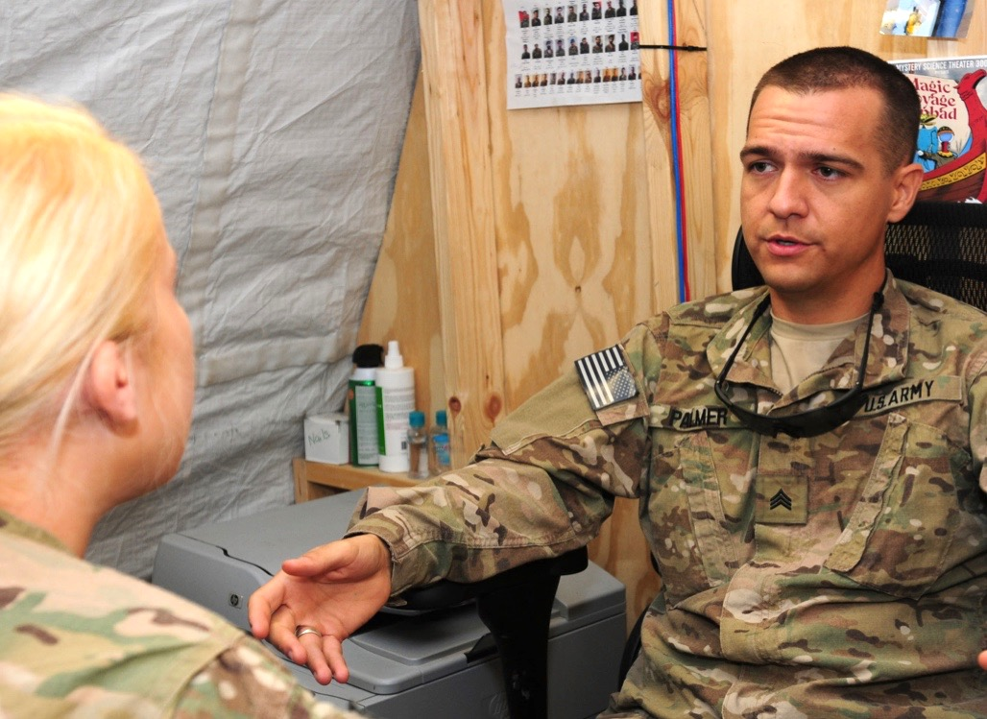
Fear of Being Perceived as Broken
Perception of
Being “Broken”
67%
Many service members equate mental illness with mental weakness.
Mental health is not a luxury
It affects your service member’s quality of life and their ability to accomplish the mission at hand.
  If your service member breaks their leg, they wouldn’t be expected to run 10 miles. They would seek appropriate treatment.
  Help your service member treat their mental health the same as they would treat their physical health.
On a scale from 1-10, how likely would you
be to encourage your service member to
get help early on?
Many service members equate mental illness with mental weakness.
Mental health is not a luxury
It affects your service member’s quality of life and their ability to accomplish the mission at hand.
  If your service member breaks their leg, they wouldn’t be expected to run 10 miles. They would seek appropriate treatment.
  Help your service member treat their mental health the same as they would treat their physical health.
On a scale from 1-10, how likely would you
be to encourage your service member to
get help early on?
1
2
3
4
5
6
7
8
9
10

Slide 7
Mental Health Treatment and Career Outcomes
Fear of Negative
Career Impact
65%
What percentage of security clearances are denied
or revoked due to reported mental health issues only?
Answer: <1%
Self-referrals: Going in on your own improves results
  Research shows that service members who seek mental health help on their own initiative are less likely to have the provider contact their command.
  Service members who seek mental health help on their own initiative tend to have more positive career outcomes.
You Know Your Spouse Best!
Early symptoms of stress that you should pay attention to include:
Having Trouble Sleeping
Feeling Tired All the Time
Feeling Grumpy
Having Frequent Arguments
Encourage your service member to seek help early to reduce the possible impact on their career!
What percentage of security clearances are denied
or revoked due to reported mental health issues only?
Answer: <1%
Self-referrals: Going in on your own improves results
  Research shows that service members who seek mental health help on their own initiative are less likely to have the provider contact their command.
  Service members who seek mental health help on their own initiative tend to have more positive career outcomes.
You Know Your Spouse Best!
Early symptoms of stress that you should pay attention to include:
  Having Trouble Sleeping
  Feeling Tired
  All the Time
  Feeling Grumpy
  Having Frequent Arguments
Encourage your service member to seek help early to reduce the possible impact on their career!

Slide 8





Mental Health Resources for Military Members
Not Knowing Which Resource to Use
50%
CONFIDENTIALITY
EXCEPTIONS
FORMAT
Installation Chaplains or Local Religious Leaders
Total
Unless consent is freely given and is specific regarding the information to
be disclosed
In-person
Telephone*
Military/Veterans Crisis Line
Total
If the caller provides contact information,
a case manager will make contact by the
next business day
Telephone*
Email*
Live chat*
Military OneSource
Non-Medical Counseling
Partial
Duty to warn
Illegal activity
In-person
Telephone*
Secure video*
Secure online chat*
Military & Family Life Counselors (MFLC)
Partial
Duty to warn
Illegal activity
In-person
Telephone*⁺
Secure video*⁺
Mental Health Clinic/Military Treatment Facility
Partial
Duty to warn
Risk to mission
Updates to leadership if a
Command-Directed Evaluation
In-person
Telephone*
Secure video*⁺
Emergency Room
Partial
Duty to warn
Risk to mission
Updates to leadership if a
Command-Directed Evaluation
In-person
* Can be done in the privacy of one’s home. ⁺ Available in areas where face-to-face support is restricted due to COVID-19.

Slide 9
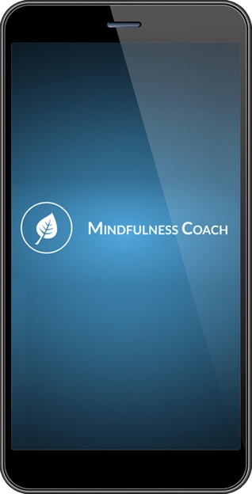
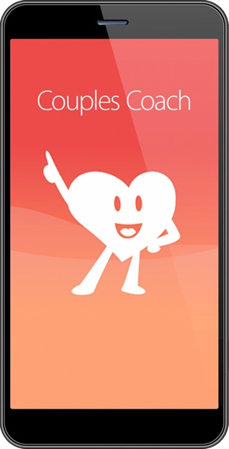
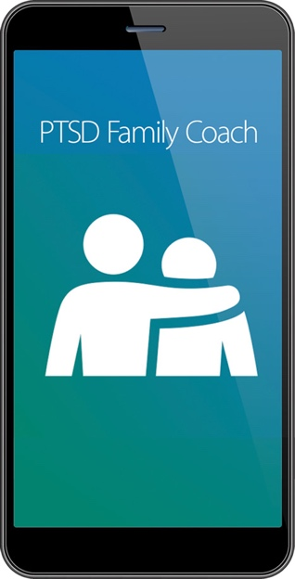
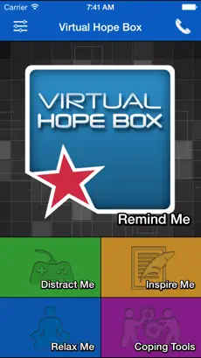
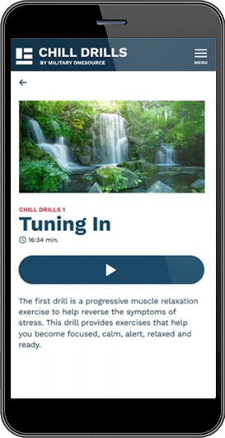
Mobile Resilience Tools
Not Knowing Which Resource to Use
50%
  *All can be downloaded for FREE from iOS App Store or Google Play Store.

Slide 10
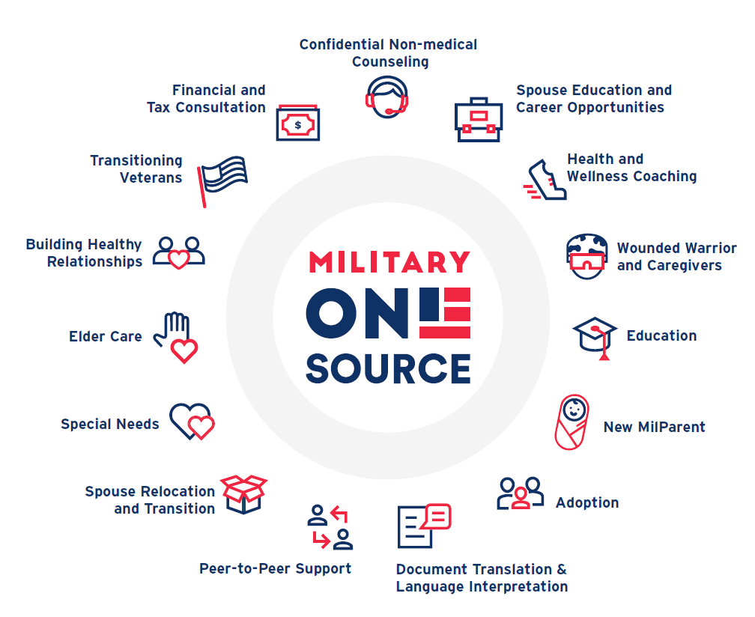
Military OneSource: 24/7 Support for the Military Community
Which of these resources would your service member be most likely to use?
Which of these resources would your service member be most likely to use?

Slide 11


Practice Call
Practice Making a Military OneSource Call
What did you notice about the call?
How would you feel about making a similar call if you were in that situation?
Commit to Seeking Help in the Future
Save these numbers in your phone:
  1-800-342-9647
  988, Press 1
When in need, use these resources and share them with your family members and military friends!
Practice Making a Military OneSource Call
Commit to Seeking Help in the Future
What did you notice about the call?
How would you feel about making a similar call if you were in that situation?
Save these numbers in your phone:
1-800-342-9647
988, Press 1
When in need, use these resources and share them with your family members and military friends!

Slide 12

Suicide Prevention Skills
Sometimes, despite our best efforts, we are still unable to prevent a mental health crisis from occurring.
If you or your service member aren’t able to get to get a handle on a mental health issue, you may need to look for signs and symptoms of suicide risk using the Question, Persuade, and Refer (QPR) technique.

Slide 13
Signs and Symptoms of Suicide Risk
Signs of suicide risk may include verbal or written statements, changes
in behavior, or inappropriate displays of emotion.
Signs of suicide risk may include verbal or written statements, changes
in behavior, or inappropriate displays of emotion.
Expresses a desire to die or wants to kill oneself
Makes a plan or looks for a way to kill oneself
Shows an increased interest in firearms or purchases one
Uses alcohol or drugs more often
Withdraws from family and friends
Changes eating and/or sleeping habits
Takes great risks that could lead to death, such as driving too fast
Gives away important possessions, puts affairs in order, suddenly makes a will
Expresses feelings of emptiness, anxiety, hopelessness, agitation, or having no reason to live
Feels unbearable pain (emotional or physical)
Displays extreme mood swings
Expresses great guilt or shame
Expresses feelings of being trapped or feeling that there are no solutions
Expresses the feeling of being a burden to others
Shows rage or talks about seeking revenge
Talks or thinks about death often
Says goodbye to friends and family
Suddenly seems relieved or happy after feeling down
Expresses a desire to die or wants to kill oneself
Makes a plan or looks for a way to kill oneself
Shows an increased interest in firearms or purchases one
Uses alcohol or drugs more often
Withdraws from family and friends
Changes eating and/or sleeping habits
Takes great risks that could lead to death, such as driving too fast
Gives away important possessions, puts affairs in order, suddenly makes a will
Expresses feelings of emptiness, anxiety, hopelessness, agitation, or having no reason to live
Feels unbearable pain (emotional or physical)
Displays extreme mood swings
Expresses great guilt or shame
Expresses feelings of being trapped or feeling that there are no solutions
Expresses the feeling of being a burden to others
Shows rage or talks about seeking revenge
Talks or thinks about death often
Says goodbye to friends and family
Suddenly seems relieved or happy after feeling down

Slide 14
Question, Persuade, Refer (QPR)
QUESTION
If you believe someone is struggling and may be at risk, ask them directly "Are you having any thoughts about suicide or hurting yourself?”
PERSUADE
Say, “I care about you and I want to help. Will you go with me or let me help you get help?”
REFER
Refer the person to an appropriate resource for assistance. If at all possible, personally escort them to see a health care professional.
You may need to repeat these steps.
Don’t give up! Keep questioning, persuading, and referring.
Use the Columbia-Suicide Severity Rating Scale (C-SSRS) included in the Resources Handout to help guide your questioning. It explains how to screen for suicide risk.
On a scale from 1-10, if your service member
was in distress, how comfortable would you
be to use QPR with him or her?
If you believe someone is struggling and may be at risk, ask them directly "Are you having any thoughts about suicide or hurting yourself?”
QUESTION
Say, “I care about you and I want to help. Will you go with me or let me help you get help?”
PERSUADE
Refer the person to an appropriate resource for assistance. If at all possible, personally escort them to see a health care professional.
REFER
You may need to repeat these steps.
Don’t give up! Keep questioning, persuading, and referring.
Use the Columbia-Suicide Severity Rating Scale (C-SSRS) included in the Resources Handout to help guide your questioning. It explains how to screen for suicide risk.
On a scale from 1-10, if your service member
was in distress, how comfortable would you
be to use QPR with him or her?
1
2
3
4
5
6
7
8
9
10

Slide 15



Takeaways
Military life is demanding, but my service member has the knowledge and resources to rise above.
Reaching out
for help early will increase my service member’s rate of success.
Military life is demanding, but my service member has the knowledge and resources to rise above.
Reaching out for help early will increase my service member’s rate of success.
I know how to help my service member call a resource line.
I know how to use the QPR approach to screen for suicide risk.
What did you find most helpful about today’s session?
I know how to help my service member call a resource line.
I know how to use the QPR approach to screen for suicide risk.
What did you find most helpful about today’s session?

