Slide 1
PCS and Relocation Tools and Resources
Updated March 14, 2024

Slide 2
Pinning Down PCS Success
Click here to watch a video and explore a wide range of support at your fingertips from the Relocation Assistance Program and Military OneSource to master your PCS.

Slide 3
PCS Support
The Relocation Assistance Program and Military OneSource are your direct connection to relocation support — providing access to at-the-ready benefits and resources that help make moving smoother and less stressful.
From understanding entitlements and shipment options, to learning about a new community, exploring housing and schools, and moving with pets — Military OneSource has tools and resources to connect you with a full spectrum of PCS and relocation support.
Need local support? Contact your installation relocation assistance experts at your local Military and Family Support Center for help.
Stressed about your PCS?
A call to Military OneSource at 800-342-9647 or 24/7 live chat will put you in touch with a person who understands moving in the military and can connect you with the resources you need to make your PCS a success!

Slide 4
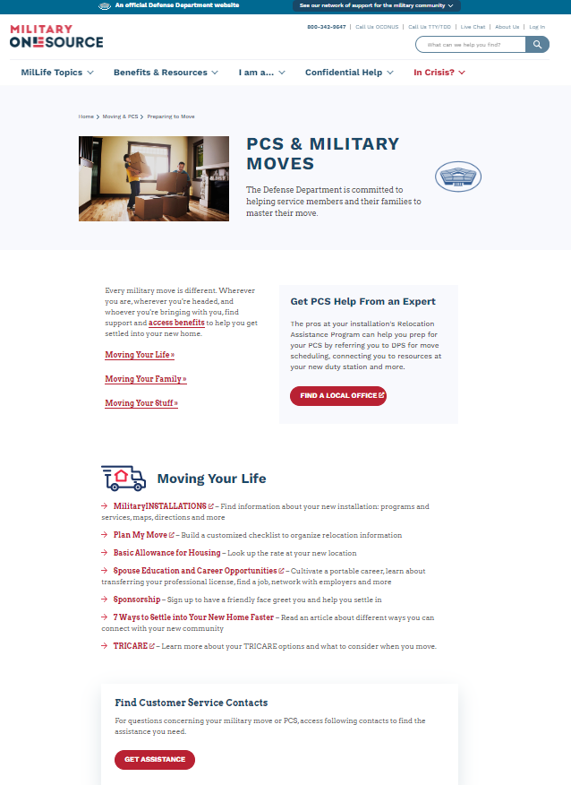
Online Resources for Military Moves
Explore the PCS & Military Moves landing page on MilitaryOneSource.mil for comprehensive relocation information and resources. Find powerful planning tools to help with:
Moving your life — Resources like Plan My Move can get you organized with customized moving checklists.
Moving your family — Search MilitaryINSTALLATIONS for information about base essentials, housing, child care and family support programs, and to find information about your new neighborhood with the Neighborhood Navigator.
Moving your household goods — Visit Moving Your Personal Property to access information about scheduling your personal property shipments, customer service contacts, filing a claim and more.

Slide 5
Additional PCS Resources
Moving OCONUS? Check out these resources and tips for planning an overseas move.
Manage your career move as a military spouse during a PCS with support from the Spouse Education and Career Opportunities program, or SECO.
Settling in After Moving — Go here to find out about child care options, programs for youth and teens, filing moving claims and more once you’re settled at your next duty station.
Sesame Street for Military Families — Find a suite of tools, information and resources to help military families cope with common challenges in building community.
Preparing to Move — Read relevant articles about the practical and emotional aspects of a PCS, including topics like “Making the Move Easier for Military Children” and “How to Inventory Your Belongings.”
Moving with Pets — Read about updates to reimbursements when moving with pets.
Blog Brigade — Engage with stories from military spouses and their boots on the ground experience turning a wide array of PCS experiences into opportunities.
Spouse Relocation and Transition — Find personalized support with Military OneSource specialty consultants who can assist you with personalized support for your PCS.

Slide 6
Listen In — Military OneSource Podcasts
Navigate through topics important to military life with short podcasts from Military OneSource. Listen to these and subscribe for more podcasts on the way:
Tips and Tools for PCS Success — Hear from a military spouse who can shed light on making frequent moves with success, including what helped and what was learned each time their family moved.
Sponsorship and Getting Settled at Your New Duty Station — Learn how Military OneSource, your installation Military and Family Support Center, and military sponsors can help you get settled at your new duty station.
Moving Under the Household Goods Contract — Learn more about the Global Household Goods Contract, which is changing the way personal property shipments will be managed, the Defense Department’s plan to improve the relocation experience for service members and their families, and key changes customers should know about before their next PCS.
Play or download these podcasts on MilitaryOneSource.mil, Apple,
Spotify, DVIDS, Google, Pandora, TuneIn and Amazon.

Slide 7
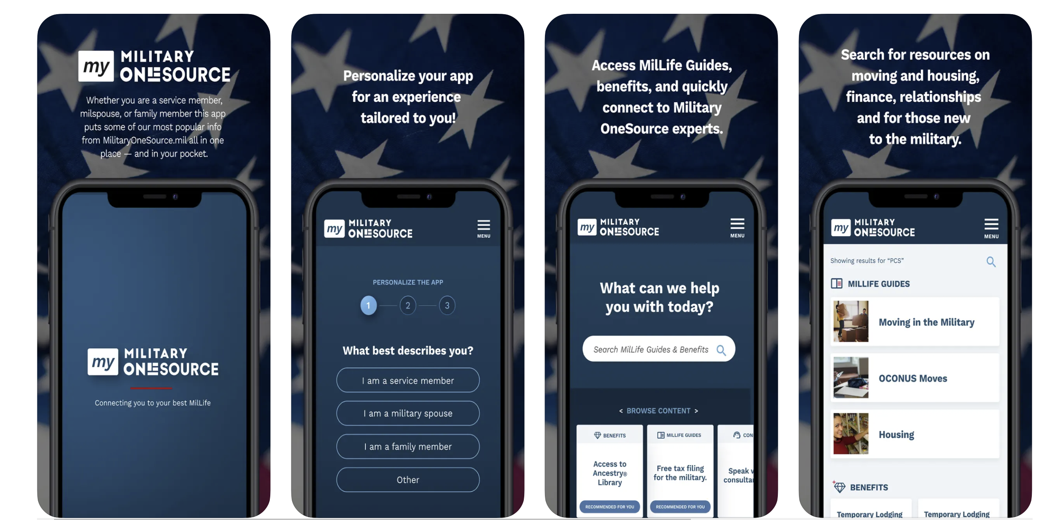
24/7 Support with Military OneSource
Download the My Military OneSource app and connect fast to support and personalized answers for you and your MilLife.
Gain 24/7 access to powerful tools and help from the Defense Department — in your hands, anytime, anywhere.

